Slide 1
Financial Backing of Collegiate Athletes: Should They Get Paid?
Renato Cozzarelli and George Vafeas

Slide 2
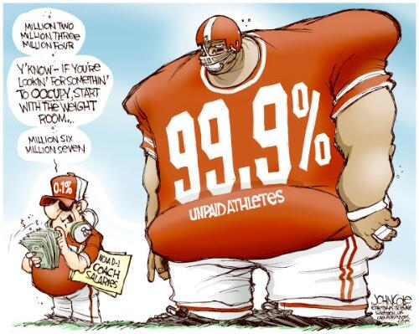
Background
College athletic is currently a multimillion dollar industry. In 2017, NCAA generated $1.1 billion in revenue.
Pitt received $54 million dollars in revenue in 2017 from the ACC.
In 2011, Pitt spent $40k total per football player
Players receive $3,200 in stipends
Image courtesy of woodypaige.com

Slide 3
Problem & Perspective
Problem:
Should universities pay student athletes beyond the current stipend format?
Perspective
This project will use a particular university, Pitt.
The project is from the perspective of the Pitt chancellor.

Slide 4
Alternative Solutions
Maintain Scholarships for All Athletes
Pay Athletes in Revenue Generating Sports
Pay Athletes in All Athletic Organizations
This option maintains the understanding that student athletes are firstly students, then athletes.
This option would require compensation of a select group of athletes who participate in revenue generating sports; usually defined as Football, and Men’s and Women’s Basketball. They become salaried employees.
This option would require the compensation of all athletes under the umbrella of the Athletics department, included the varsity sports teams, the Cheerleaders, and the University of Pittsburgh Varsity Marching Band. They all become salaried employees.
This is equivalent to the “do nothing” option
All other athletes in the “Olympic” (non-revenue generating) sports would maintain their status as student athletes and will continue to receive their scholarships.

Slide 5
Strategic Criteria
Academics
Product on the field
Professional Development
Pitt Community
Pittsburgh Community Impact
Name | Normalized
1.Academics | 0.4890
2.Product on Field | 0.2213
3.Professional Development | 0.0916
4.Pitt Community | 0.1281
5.Pittsburgh Community Impact | 0.0700

Slide 6
Benefits Network
Finances covers all benefits that generate more revenue for the university.
Operational cluster are related to changes to the net profit for the university
Logistical cluster are related to how the athletes are classified and the money pool
Organization covers all benefits for both the athletic department and the university as a whole.
Team cluster considers how the teams dynamics and recruiting will change
School cluster considers the product and facility impacts
Social covers all benefits for the athletes and other people associated with these alternatives.
Athletes cluster describes how athletes see Pitt after the decision is made
It is also important to consider the fanbase and community views and impact on the product

Slide 7
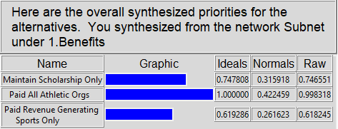
Benefits - Synthesis
Paying all athlete organizations is the best decision
Increases net profits even with increase in insurance
Money pool can be drawn from eager boosters seeking to improve the program
Immediate impact on recruiting
Positive perception from new athletes and higher satisfaction from current athletes

Slide 8
Opportunities Network
Finances covers all the long term opportunities to generate more revenue.
Sports cluster considers long term opportunities that can come from this decision including improved media contracts, increase in revenues, and structure of athlete contracts
School cluster looks at how the academic revenue could change and what long term facility improvements could be made at the school
Social covers all the goodwill and positive social views the school will see from their decision.
Logistics cluster looks at the impact of the decision from a social standpoint and how more long term recruiting cycles will positively affect the program
Product cluster considers what the product impact will be in the long-term. Does this decision lead to nation championships? How will the fans and community feel about this decision down the road?

Slide 9
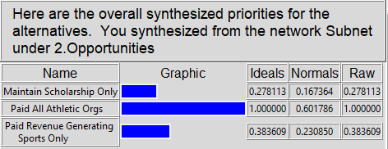
Opportunities - Synthesis
Paying all athlete organizations is the best decision
In the long run both academic and athletic revenues will increase
First to start paying athletes allows Pitt to lock in favorable contracts
Recruiting will be completely changed in a favorable way
Athletes won’t feel unfairly treated. Fans will be swayed once they see improvements to the program.

Slide 10
Costs Network
Finances covers costs the incurred for by athletes and running the program.
There are five major cost drivers: direct cost, insurance, contract, gameday, and fines
NCAA fines will be a large cost if Pitt decides to start paying athletes.
Organization looks at all the costs not directly tied to the athletes or the program
Athletes cluster considers the legal costs needed to combat the NCAA and any other issues, the cost to set up proper classification of athletes if there is a change, and finally the cost to meet the satisfaction of the athlete.
System cluster considers costs to develop a new system and roll it out as well as how the system will control so that all athletes, boosters, and the school adhere to that system.

Slide 11
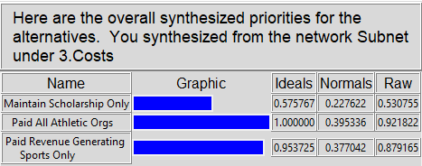
Costs - Synthesis
Paying all athlete organizations is the most costly decision
More students to pay and more of an organizational costs
Large costs associated with legal and classification battle
Complex network will need to be set up and roll out will be pricy
Unknown how much athletes are expecting to get paid and how much negotiation will be needed to reach an acceptable value

Slide 12
Risks Network
Finances covers economic risks which can affect the school’s bottom line.
HR cluster measures the risk of legal and classification mishaps which could cripple the program
Cashflow considers that money pool is not consistent and neither are the direct costs or insurance costs.
Organization considers the risks with current and future athletes
Current players cluster consider the damage a change to the system could have on team dynamics and athlete satisfaction.
Prospective players cluster considers the issues with bringing in new athletes under this system. It is unknown how they will react and what the fall out may be.
Social considers the governance and the experience of the fans and athletes
Similar to costs, there are long term risks in the governance of the system.
Experience cluster considers the negative fallout from fans and players to a possible change in the system.

Slide 13
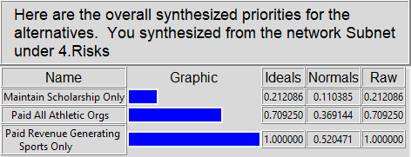
Risks - Synthesis
Paying revenue generating sports only is riskiest
The school sets the precedent that not all athletes are paid equally
Invites the conversation of paying more for stars
Fans and athletes will perceive this to be unfair
Negative impact on recruiting of sports with non-paid athletes

Slide 14
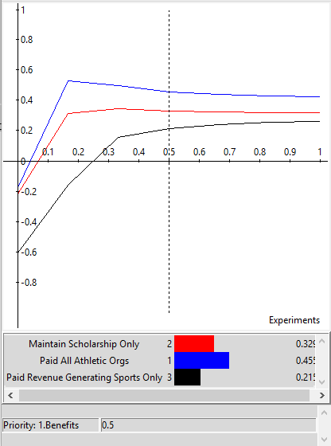
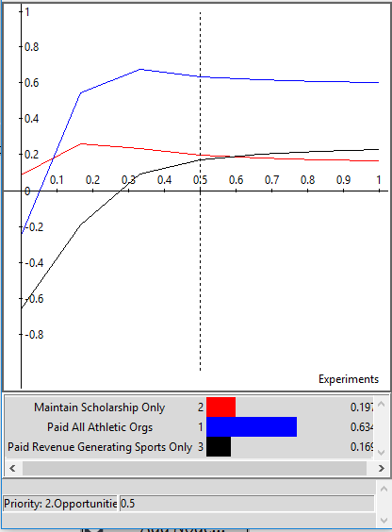
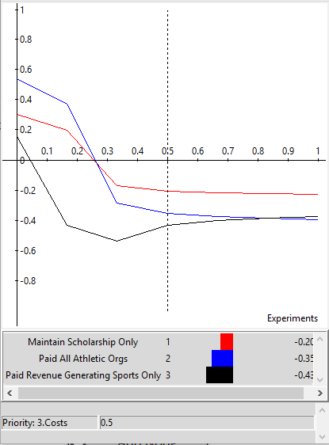
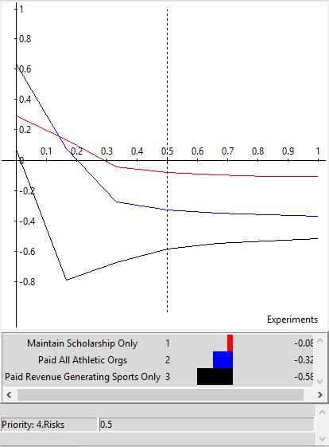
Sensitivity
Benefits
Opportunities
Costs
Risks

Slide 15
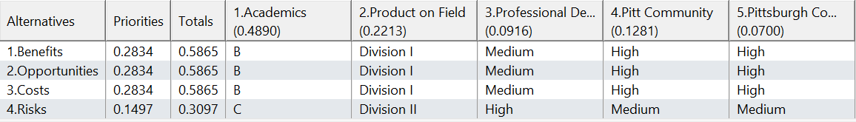
Ranking Alternatives
Academics: increased notoriety, better students apply, more space to take on new students
Product on the Field: if paying players, then should get the best athletes for all sports (Division I level) improving product on field
Professional Development: paying on select players heightens those player’s development
Pitt Community & Pittsburgh Community: paying all athletes allows them to better focus their skills to help both communities.

Slide 16
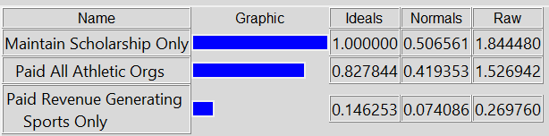
Short Term Model View
Done by using the multiplicative formula
Maintaining scholarships is the best decision in the short run
Lots of cost and risk in changing the system which requires more in depth discussion
NCAA permission is the better way to roll out this program rather than paying fines

Slide 17
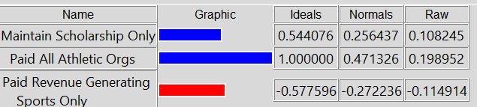
Long Term Model View
Done by using the additive (negative) formula
Changing to paying all athletes is better in the long run.
By understanding and limiting some of the risks in short term then making the switch
Paying athletes will put a better product on the field and improve academics at the university

Slide 18
Conclusion
Pitt should consider in the long run changing to paying athletes based on the criteria of this model
This is a debate which has not finished in society now. Major issues with paying athletes include
Where the money will come from
How it is controlled
Who should get paid and how much
Changes in the above answers will greatly influence the results of the model.
Convincing the NCAA is the largest hurdle in place to change the structure.

