Slide 1
Imposed Tariff on Steel Imports
- An ANP approach -
Yong Cheng
Klaus Tenderich

Slide 2
Background
President Bush imposes temporary tariff on steel imports from Asia and Europe (up to 30 %)
Temporary relief for the damaged steel industry to restructure itself
Time frame set for three years
U.S. Trading partners criticized tariffs as protectionist measure and threatened to retaliate

Slide 3
Alternatives
Impose temporary tariff on imported steels (status quo)
Not impose tariff on imported steels
Solve the steel-overproduction issue under WTO

Slide 4
Ratings
Subjective Value in Evaluating Merits
National Interest: 0.23
Domestic Economy: 0.25
National Security: 0.75
Domestic Politics: 0.65
International Relationship: 0.12
Trade Relations: 0.75
Diplomatic Relations: 0.25

Slide 5
Priority for ratings
Very High (0.47), High (0.27), Medium (0.14), Low (0.08), Very Low (0.04)
 |  | Benefits | Opportunities | Costs | Risks
National Interest | Domestic Economy | Medium | Low | High | Medium
 | National Security | Medium | Low | Very Low | Very Low
Domestic Politics |  | High | High | Low | Low
International Relationship | Trade Relations | Low | Low | Very High | Very High
 | Diplomatic Relations | Low | Low | Very High | High
Priorities |  | 0.326 | 0.303 | 0.196 | 0.175

Slide 6
The model – BCOR Network
GOAL
Benefits
Opportunities
Costs
Risks
Economic
Globalization
Economic
Global Credibility
Political
Technology Development
Political
Leadership in WTO
Social
Social
WTO Dispute Resolution
Domestic Industrial Infrastructure
Domestic Political Popularity
International Support

Slide 7
Benefits Criteria
Control Criteria | Sub-criteria | Description
Economic | Economic Structure | Economic infrastructure of USA
 | Steel Industry Recovery | Recovery of steel industry in the USA
 | Supply & Demand | Impact on supply and demand of steel in the USA
Political | Domestic Political Credibility | Credibility of the ruling party in the USA
 | Domestic Political Stability | Stability of political structure in USA
 | Military Defense | Impact on raw materials for military armory
Social | Employment Rate | Impact on overall employment rate in the USA
 | Environment | Steel industry’s impact on environment - pollution

Slide 8
Opportunities Criteria
Control Criteria | Description
Domestic Political Popularity | Reinforcing the popularity of the ruling party among the citizens
Globalization | Increased mobility of goods, services, labor and technology throughout the world
Technology Development | Technology development within the steel industry with the goal to increase productivity
WTO Dispute Resolution | The solution of trading dispute between countries in WTO

Slide 9
Costs Criteria
Control Criteria | Sub-criteria | Description
Economic | Inflation | A persistent increase in the level of consumer prices
 | Steel Price | The price of steel in the USA
 | Price of Industry-related Goods | The price of steel-related goods in the USA. (e.g. auto parts)
 | Retaliation on US Exported Products | Tariff imposed on US export goods by other countries
Political | International Credibility | Credibility of USA in the world
 | International Support on Free-Trade | Support on free-trade around the world
Social | Crime Rate | Crime rate due to high unemployment in USA
 | Social Security | Ensuring acceptable standard of living

Slide 10
Risks Criteria
Control Criteria | Description
Global Credibility | Credibility of USA in the world
International Support on Political Issues | Support on political issues around the world
Leadership in WTO | Leading position within WTO
Domestic Industrial Infrastructure | Industrial infrastructure of USA to meet future challenge

Slide 11
Criteria & priorities

Slide 12
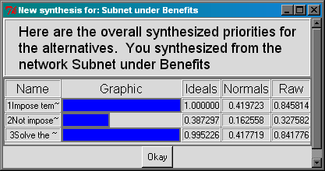
Decision Network
Benefit

Slide 13
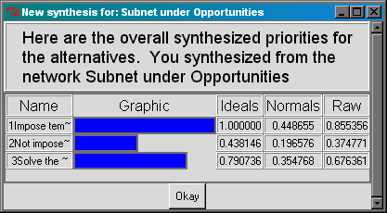
Decision Network
Cost

Slide 14
Decision Network
Opportunities

Slide 15
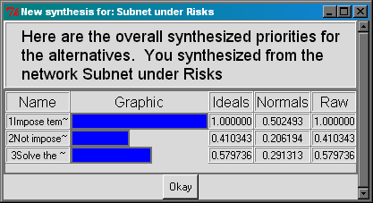
Decision Network
Risks

Slide 16
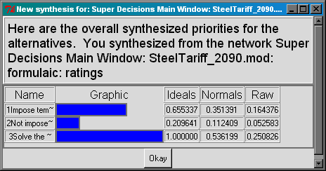
Synthesized Result

Slide 17
Sensitive Analysis
Changes in the priority of Benefits will not change the final outcome
As the priority of Opportunities increased, “Impose temporary tariff on imported steel” becomes the best option
As the priority of Costs increased, “Not impose tariff on imported steel” becomes the best option
As the priority of Risks increased, “Not impose tariff on imported steel” becomes the best option

Slide 18
Conclusion
Model support “resolve steel over-production under WTO”
Demanding free trades while practicing protectionism
Retaliation has a major impact on U.S. Export
Domestic steel production for national defense not critical
Saving jobs in steel industry will “destroy” proportionally more jobs in steel-consuming industry
Government starts to make adjustments to the steel tariff already

