Slide 1
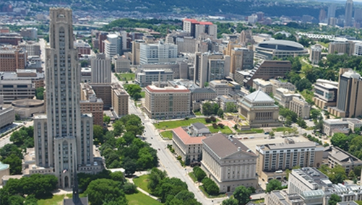
Pitt Must Pick: BOCR Modeling to Determine How Pitt Should Deliver Undergraduate Classes For Fall 2020
Kenneth Parker Ulrich
Decision Making In Complex Environments

Slide 2
Introduction: The Major Players
Covid-19
  A Respiratory Illness That Is Highly Contagious And Potentially Deadly
  Spreads Easily With Close Contact
    Can Spread Illness Before Showing Symptoms
  Currently Classified As A Pandemic
The University Of Pittsburgh
  An Urban Campus With High Population Density And Active Surrounding Community
  Attracts Students From Around The World
  Delivers Undergraduate Classes In Person
    Requires Living On Campus Or Commuting

Slide 3
Introduction: The Problem
Pitt Attracts 19,200 Undergraduate Students From Around The World
  Packed Densely Into Oakland And The Surrounding Neighborhoods
COVID Spreads Most Efficiently In Population Dense Areas And Close Contact
  COVID Is A Safety Concern For Pitt Undergraduates And The Surrounding Areas
Pitt Has A Responsibility To Provide An Education For Their Students
  Classes Need To Be Offered In Some Capacity

Slide 4
The Goal
For The University Of Pittsburgh To Decide How To Offer Classes For The Fall 2020-2021 Term

Slide 5
The Decision Maker
The University Of Pittsburgh’s Strategic Criteria
  As Stated In “The Plan For Pitt: Making A Difference Together – Academic Years 2016-2020”
    Consistently Deliver Excellence In Education
    Impact Through Pioneering Research
    Build Community Strength
    Extend Global Reach
    Provide Top Value
    Secure An Adequate Resource Base
BOCR Strategic Criteria
    Consistently Deliver Excellence In Education
    Be Profitable
    Provide Top Value
    Build Community Strength
    Extend Global Reach

Slide 6
Alternative Solutions
Offer Classes In-person
  This Is The Traditional Method That Pitt Offers To Undergraduate Students. It Involves Students Meeting In Classrooms On Pitt’s Campus In Oakland.
Offer Classes Online
  This Would Commit Pitt To Offering All Undergraduate Classes In An Online Format, Most Likely Using Zoom Sessions To Deliver Lectures, And CANVAS To Submit Assignments And Take Tests.
Offer Hybrid Style Classes
  This Would Be A Mixed Offering Of In-person And Online Classes. Most Likely Involving Splitting The Semester Into Two Parts, With One Part Being In Person And The Other Part Being Online.
Cancel Classes
  This Would Commit Pitt To Canceling All Classes For The Semester.

Slide 7
BOCR Model
Goal: To Determine How to Offer Undergraduate Classes
Pitt's Strategic Criteria
1. Deliver Excellence in Education
2. Be Profitable
BOCR Model
Benefits
Risks
3. Provide Top Value
4. Build Community Strength
5. Extend Global Reach
Opportunities
Costs
Ratings Model

Slide 8
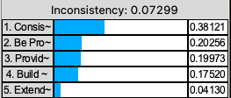
Strategic Criteria Weights

Slide 9
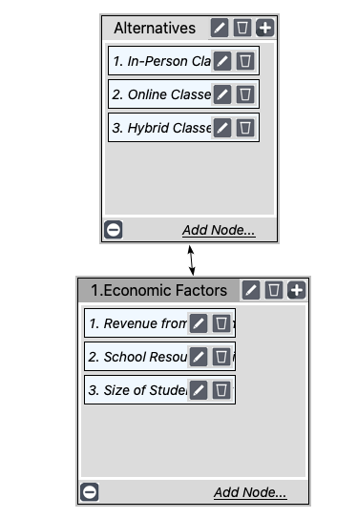
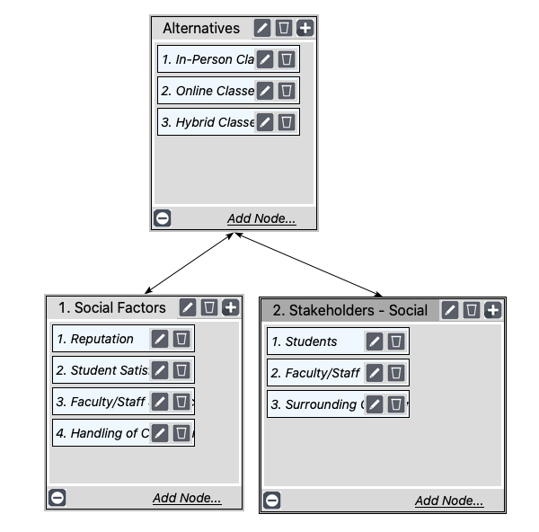
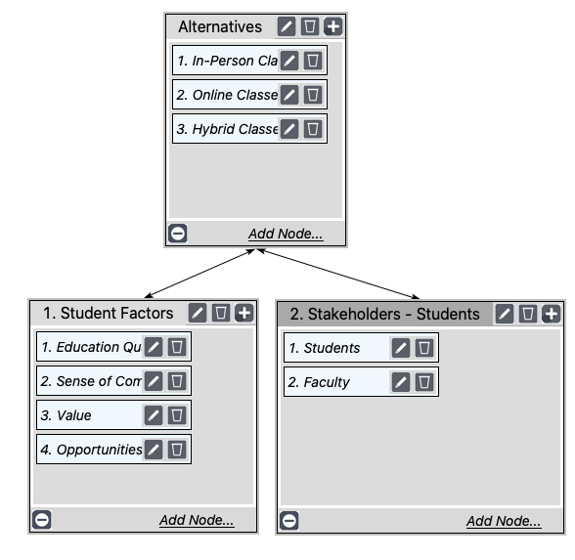
Benefits

Slide 10
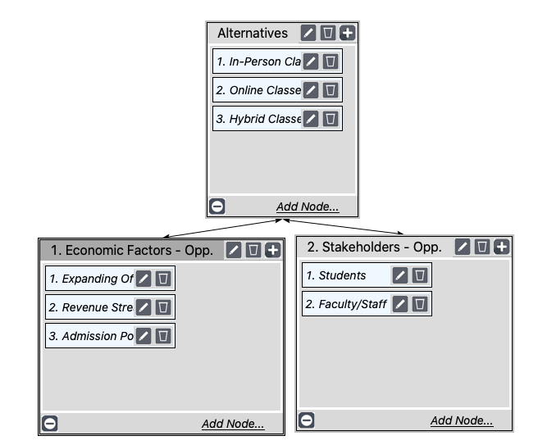
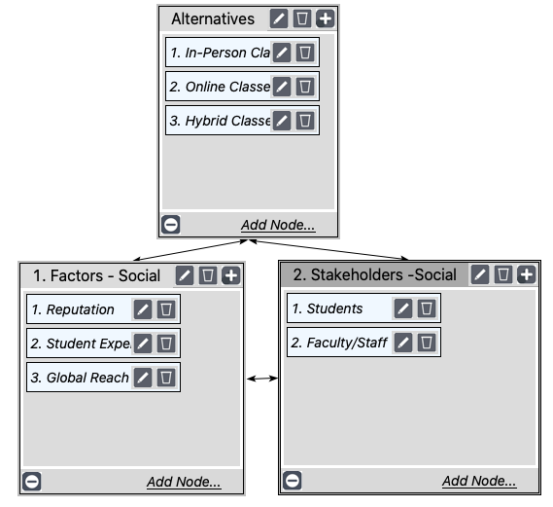
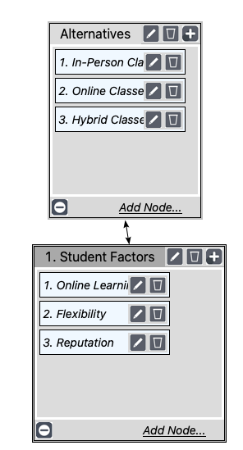
Opportunities

Slide 11
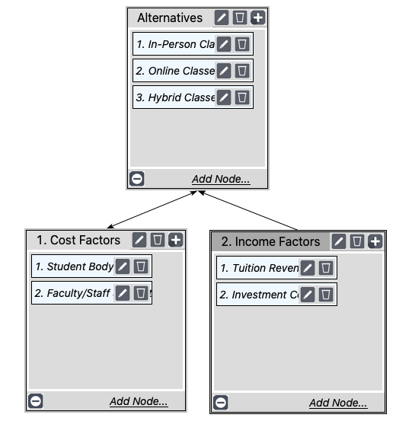
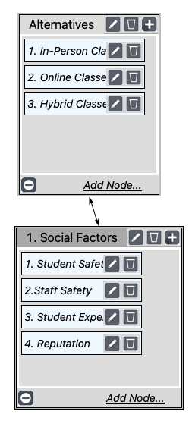
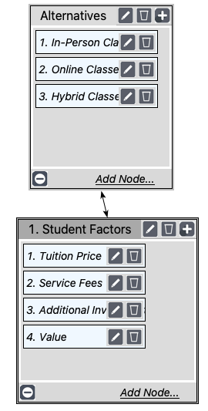
Costs

Slide 12
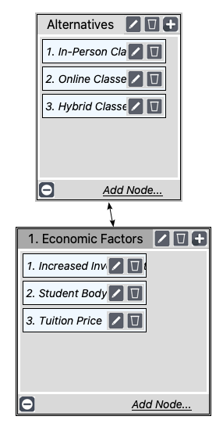
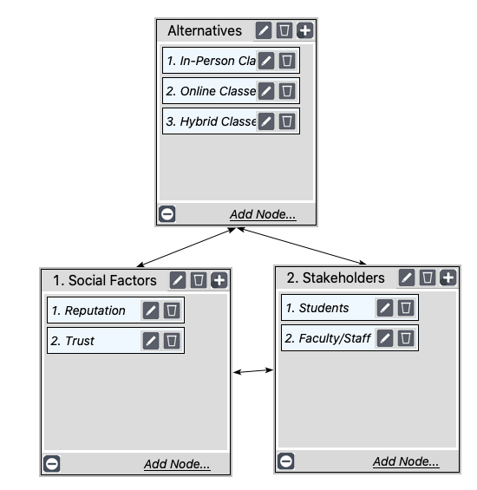
Risks

Slide 13
BOCR Priorities

Slide 14
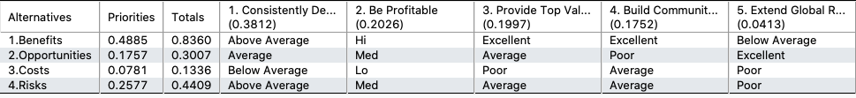
Ratings Model Entries

Slide 15
Results

Slide 16
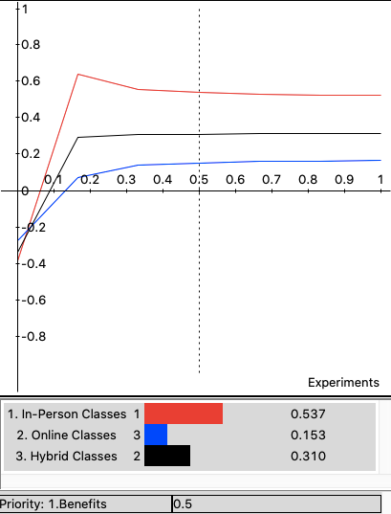
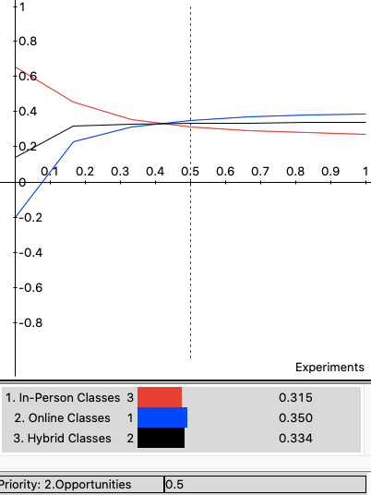
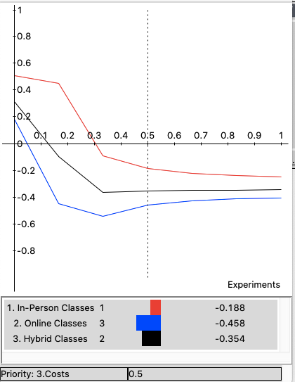
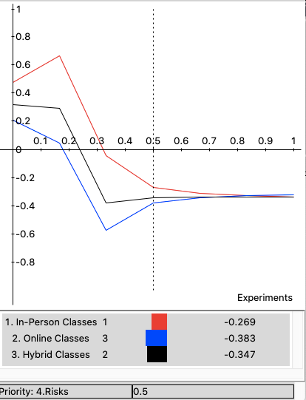
Sensitivity Analysis

Slide 17
Actual Results
Pitt Chose To Deliver Classes In A Hybrid Style
  In-person Classes In The First Part Of The Semester Followed By Online Classes And Finals After The Thanksgiving Break
Aligns With Results – Sort Of
  BOCR Results Said In-person
  Actual Results Are Hybrid
    Large Amount Of Time In Person
      Only 2 Weeks Online
        Mostly Just Finals
          Don’t Want Us To Return After Dispersing Home

