Slide 1
Data Harmonization for MRI
BOCR model

Slide 2
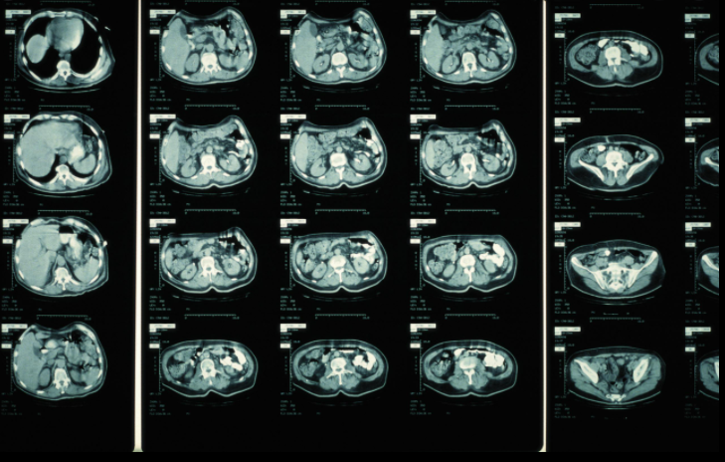
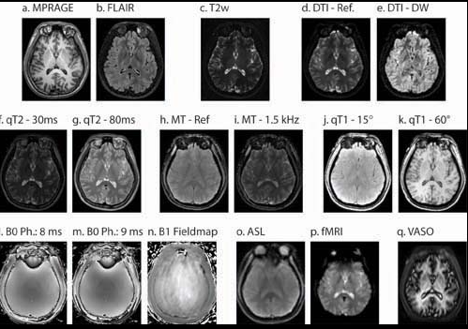
Background
Accuracy of medical imaging depends on precision more than accuracy currently
CT calibration for 30 years
  Introduction of test tube phantoms
MRI calibration non-existent
CT imaging
Extent of Deharmonization
Three primary scanner model suppliers
  GE, Siemens, Phillips
  Each with 3+ primary brands
Precision drops up to 30+ percent between brands
  Within scanner model drops of up to 10 percent
MRI modalities

Slide 3
Goal
Design a solution for quick precise and reliable calibration for scanners nationwide.
Decision Maker
Biomedical imaging lab at the University of Pittsburgh. ~7 members in core lab, received initial funding for project. Headed by PI who has final say.

Slide 4
Strategic Criteria
Integrity – work is transparent, precise, repeatable and follows criteria outlined in grant contract
Excellence – the lab strives to achieve solutions to problems that use state of the art technologies robust enough to be implemented in medical applications
Innovation – Each project attempts to tackle issues with solutions on the bleeding edge of technology.
Collaboration – Diversity of thought and peer review are crucial elements to robust and honest work

Slide 5
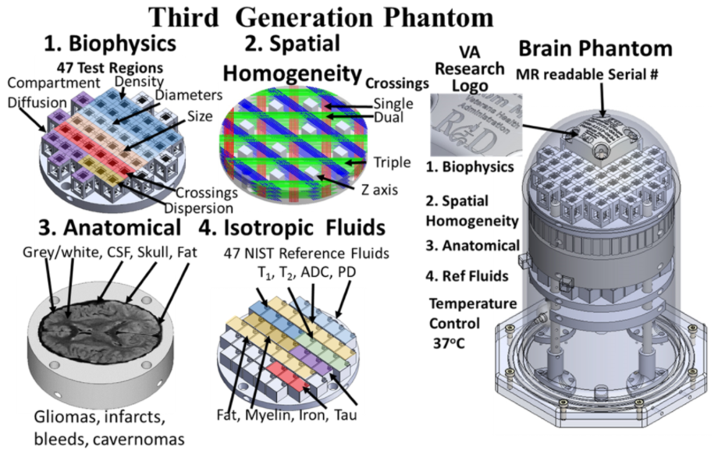

Solutions
Phantom Design
Simulated Calibration
-normative calibration based on distribution fingerprints, CSF, GM, WM, homogeneity fields

Slide 6
Alternatives
Create phantom and backend externally in collaboration with other groups
-funds are spread
-specialization between different labs
-co-authorship
-first prototypes shared
-backend decentralized
-robust solution with state of the art tech
Create phantom and backend internally within lab
-funds kept mostly internally
-external manufacturing aid
-prototype kept internally
-centralized backend
-robust solution with state of the art tech
Create simulated method of calibration and backend internally within the lab
-funds kept internally
-front end and back end kept internally
-robust solution

Slide 8
Benefits
Opportunities
Financial
-short-term funding
-centralization
-fund allocation
Operational
-installation efficiencies
-external support
-task efficiency
-accuracy of results
Organizational
-vendor privacy
-sole proprietorship
-interconnectivity
Financial
-future grants
-scalability savings
-training savings
Operational
-installation efficiencies
-external support
-task efficiency
-accuracy of results
Reputation
-future collab
-trust in central data
-vendor/hospital trust
Costs
Risks
Financial
-method cost
-consultation cost
-parts/transport costs
Operational
-accuracy/precision
-transport
-replaceability
-debug/fixing rate
Organizational
-staff workload
-external support
-funding discrepancies
Financial
-manufacturing/ upkeep
-scalability costs
-competition
-total scanner harmonization
Operational
-upgradeability
-scalability
-total scanner harmonization
Organizational
-risk of open communication
-risk of vendor/hospital transparency
-risk of hospital/researcher pushback
Reputation
-future collab
-trust in central data
-vendor/hospital trust

Slide 9
Benefits
Financial
-short-term funding
-centralization
-fund allocation
Phantom Collab – favorable short term allocation due to scope of work, poor centralization of data, unfavorable fund allocation
Phantom Internal-medium short term funding, decent centralization, great fund allocation
Simulated Calib-poor short term funding, superb centralization, superb fund allocation
Risks
Operational
-upgradeability
-scalability
-total scanner harmonization
Reputation
-future collab
-trust in central data
-vendor/hospital trust

Slide 10
Ratings
Strategic Criteria | Norm Weight
Integrity | 31%
Excellence | 26%
Innovation | 23%
Collaboration | 20%
 | B | O | C | R
PhantomCollab | 28% | 29% | 35% | 30%
PhantomInternal | 36% | 33% | 33% | 34%
SimCalib | 36% | 38% | 32% | 36%
Results
Short Term
Long Term
Phantom Collab | 25%
Phantom Internal | 35%
Simulated Calib | 40%
Phantom Collab | 7%
Phantom Internal | 41%
Simulated Calib | 52%

Slide 11
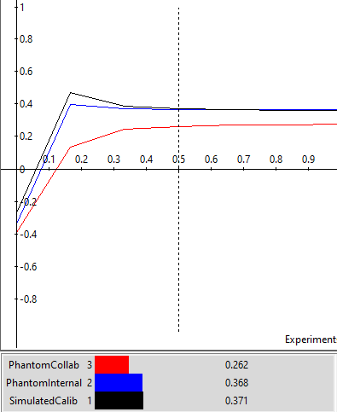
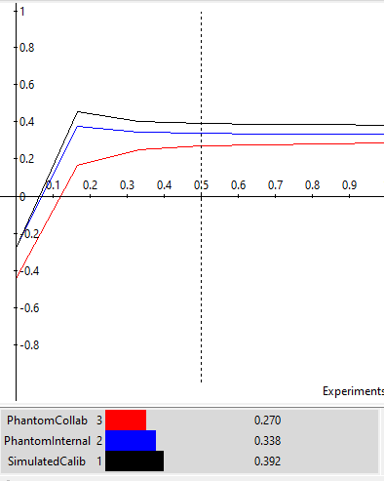
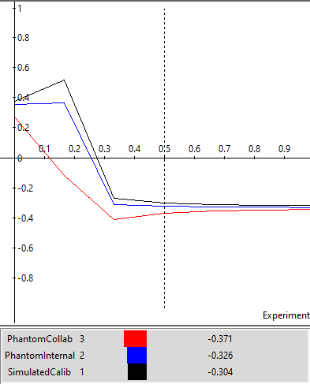
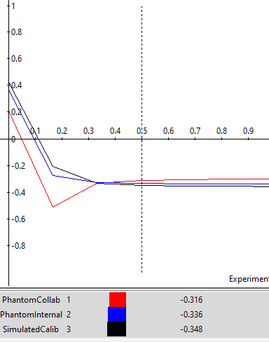
Sensitivity Analysis
Benefits
Opportunities
-typically internal phantom and simulated method are both quite close
-for risks, the reputation criteria accounts for the long term benefits of phantom collaboration method
-for costs, phantom collab catches up if weighted highly due to spread of costs
Costs
Risks

Slide 12
Discussion
Relatively robust model
Matches gut feelings
Next steps if following model
  Begin to implement software based simulation scheme with API that would accept both hardware and software input
  Plan architecture with future phantom ground truth in mind
In lab, similar decision issues
  Recently found two new possible employees to work on synthetic neuron generation and manufacturing of phantom for long term push

