Slide 1

FAILURE IN A PANDEMIC HOW SHOULD THE INCREASED PROPORTION OF FAILURES BE HANDLED AMID COVID-19?
Zachary G. Penrod

Slide 2
THE BACKGROUND
In January 2020, the COVID-19 pandemic started its spread throughout the United States
On 13 March 2020, Morrow Elementary School sent students and staff home indefinitely
Technological issues, incompatible learning styles, and misplaced motivation have led to an increased proportion of failures among students (2% ⇒ 7%)

Slide 3
THE PROBLEM
How should the Principal and Counselor handle the increased proportion of failures during the pandemic-induced online learning period?

Slide 4
THE STRATEGIC CRITERIA
School Ranking – 0.37
Student Success – 0.17
School Climate – 0.11
Student Enrollment – 0.35

Slide 5
THE SUBCRITERIA
FINANCIAL
Budget
Cash Flow
EDUCATIONAL
Grades
Knowledge

Slide 6
THE ALTERNATIVES
Retain & Monitor (Status Quo)
1
Allow to Pass
2
Educate at Home
3
Curve Grades
4
Summer School
5

Slide 7
THE NETWORKS
Goal
Benefits
Costs
Risks
Budget
Knowledge
Cash Flow
Budget
Knowledge
Grades
Opportunities

Slide 8
THE RESULTS

Slide 9
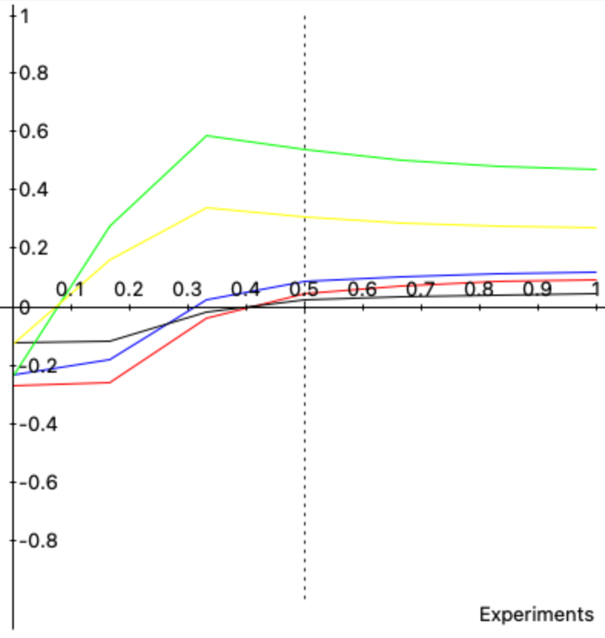
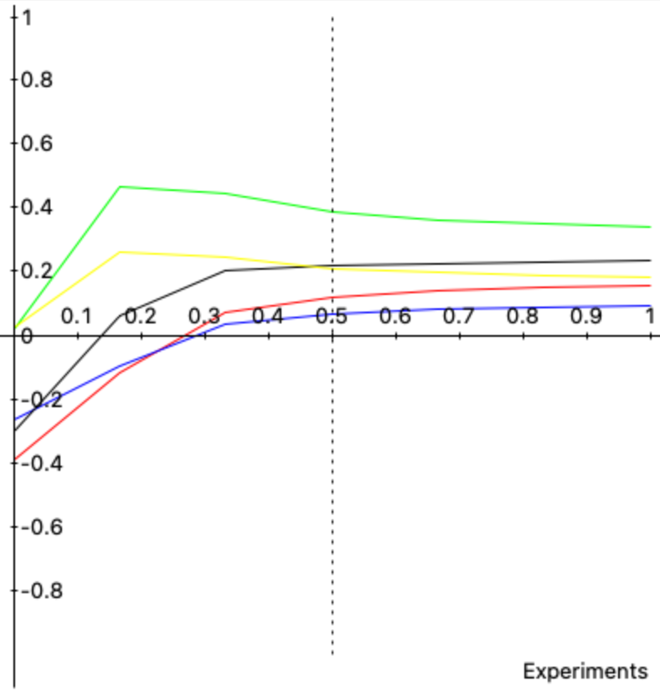
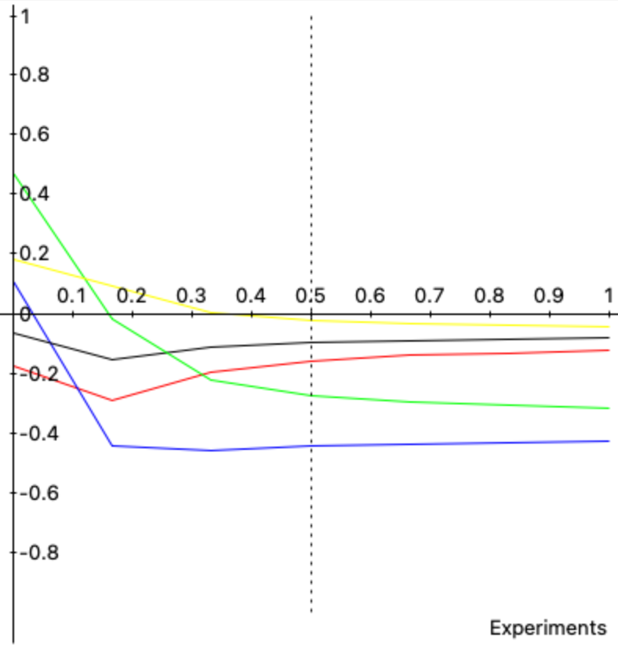
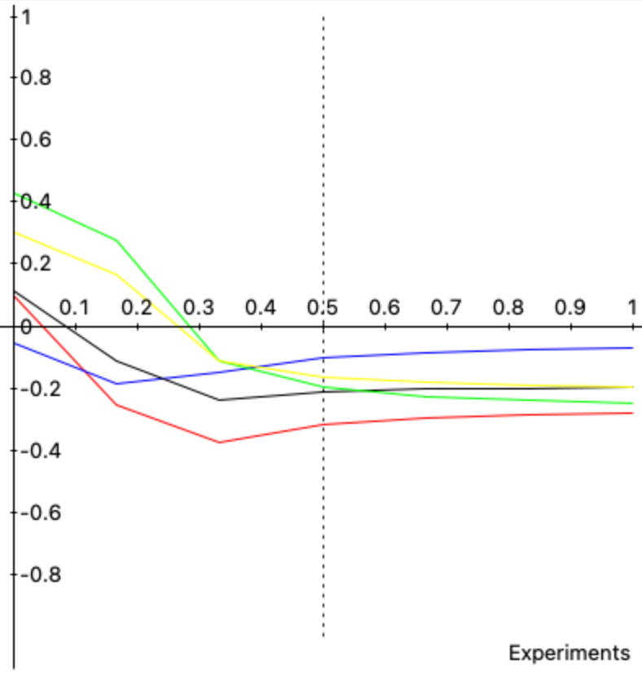
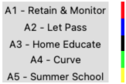
THE SENSITIVITY
BENEFITS
OPPORTUNITIES
COSTS
RISKS

