Slide 1
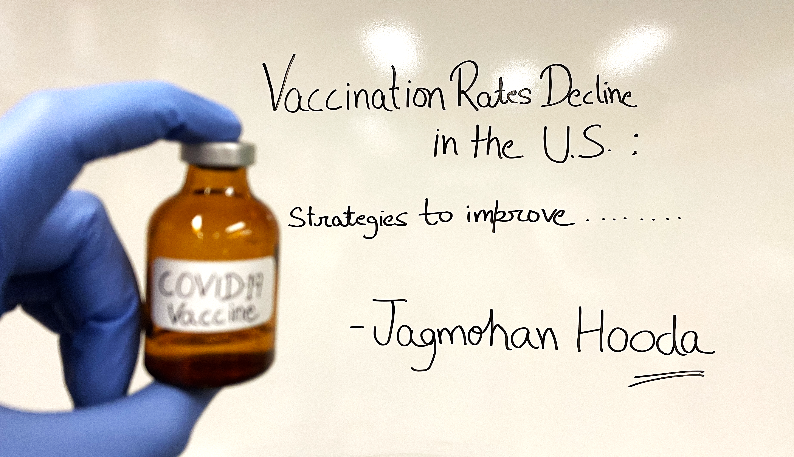

Slide 2
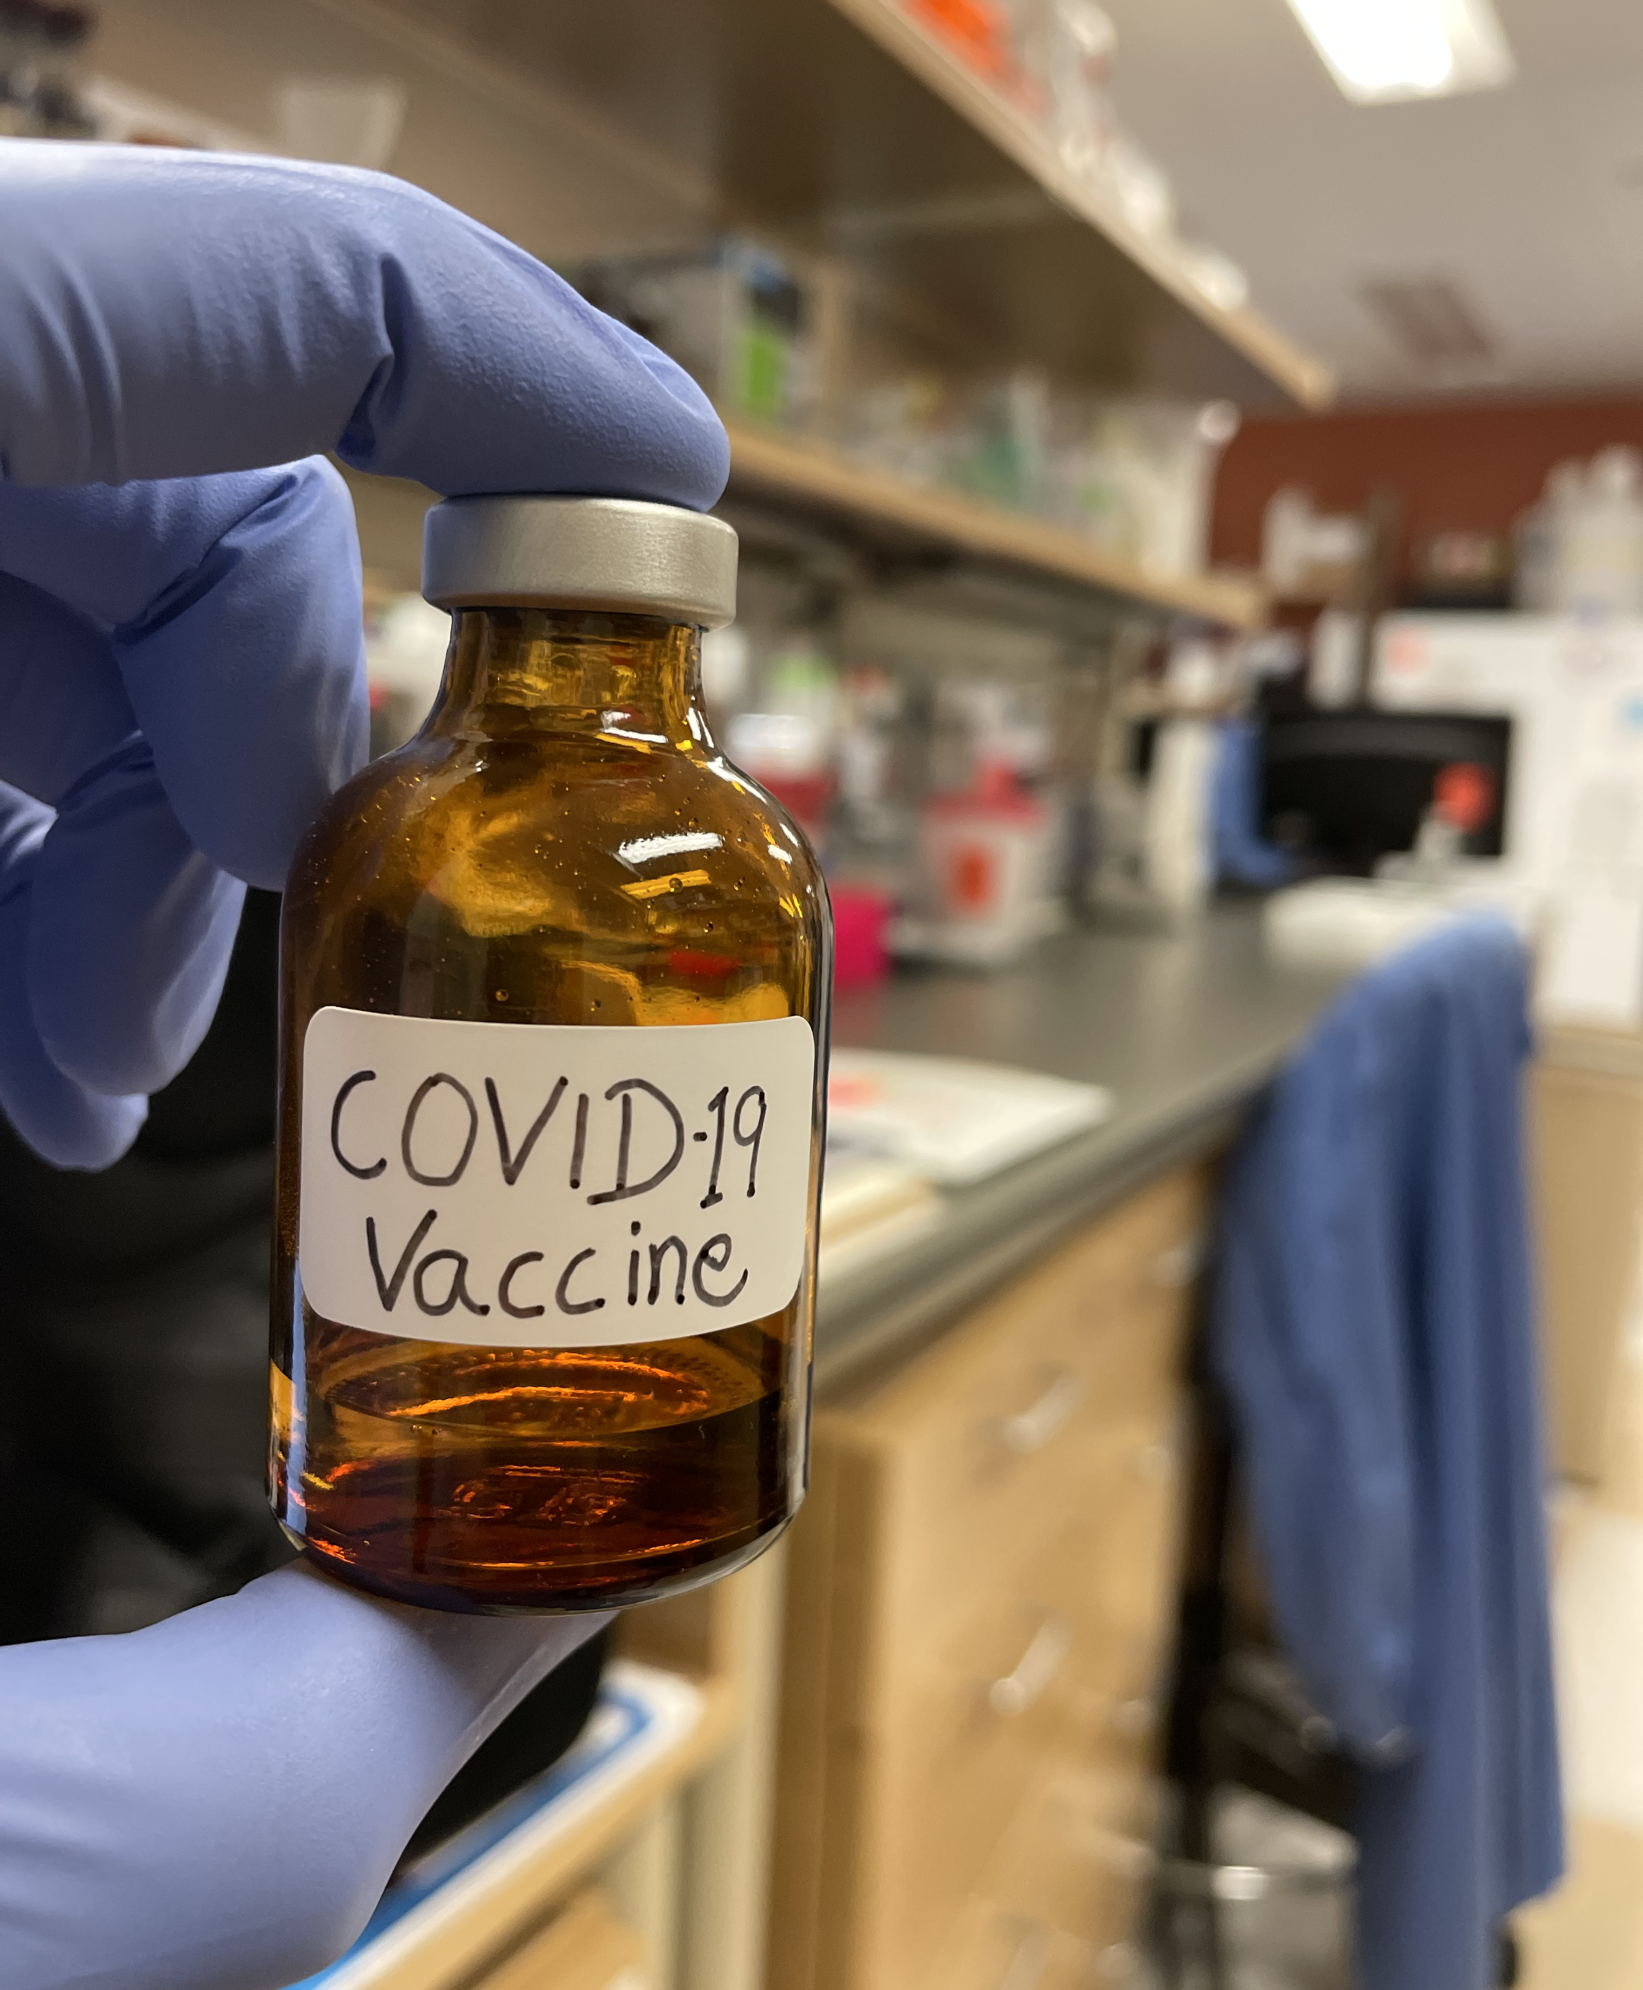
Outline
Background
The problem, Goal and the decision maker
Strategic criteria
Alternatives
BOCR Model
Sensitivity analysis

Slide 3
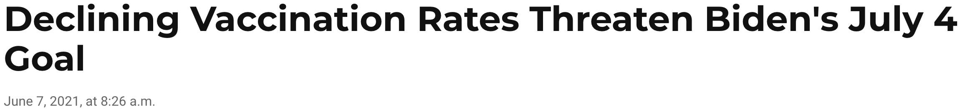

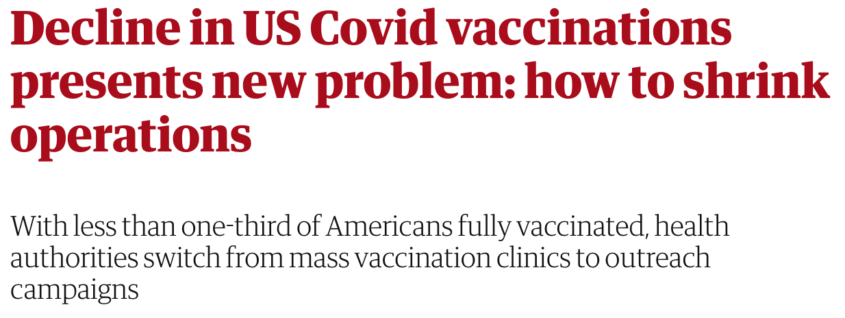

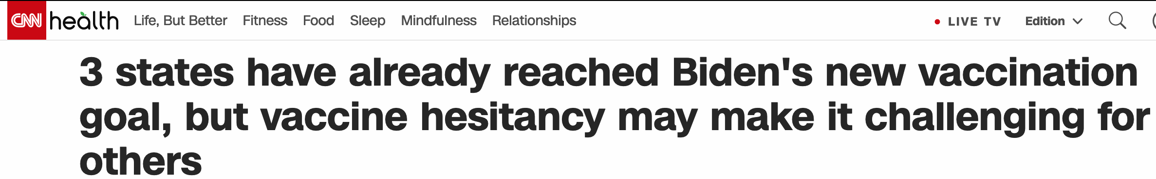
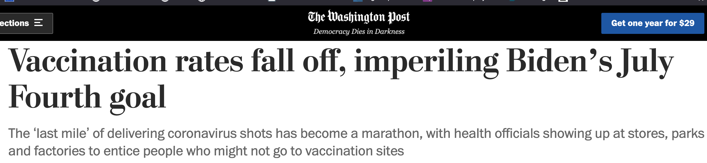
The Problem

Slide 4
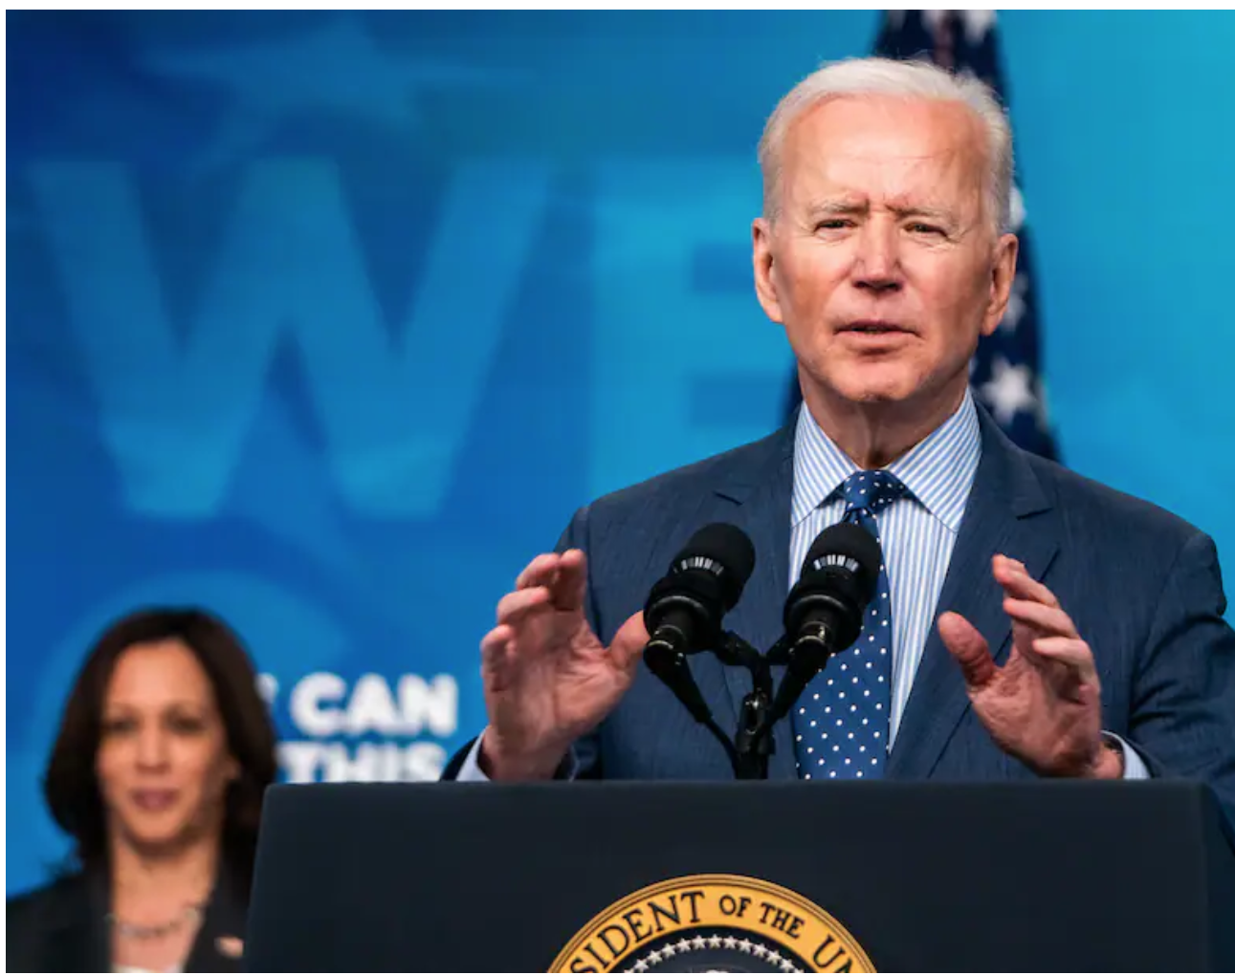
The Goal and the decision maker
To increase the vaccination rate in the United States: to lower COVID-19 infection rates
Washington Post

Slide 5
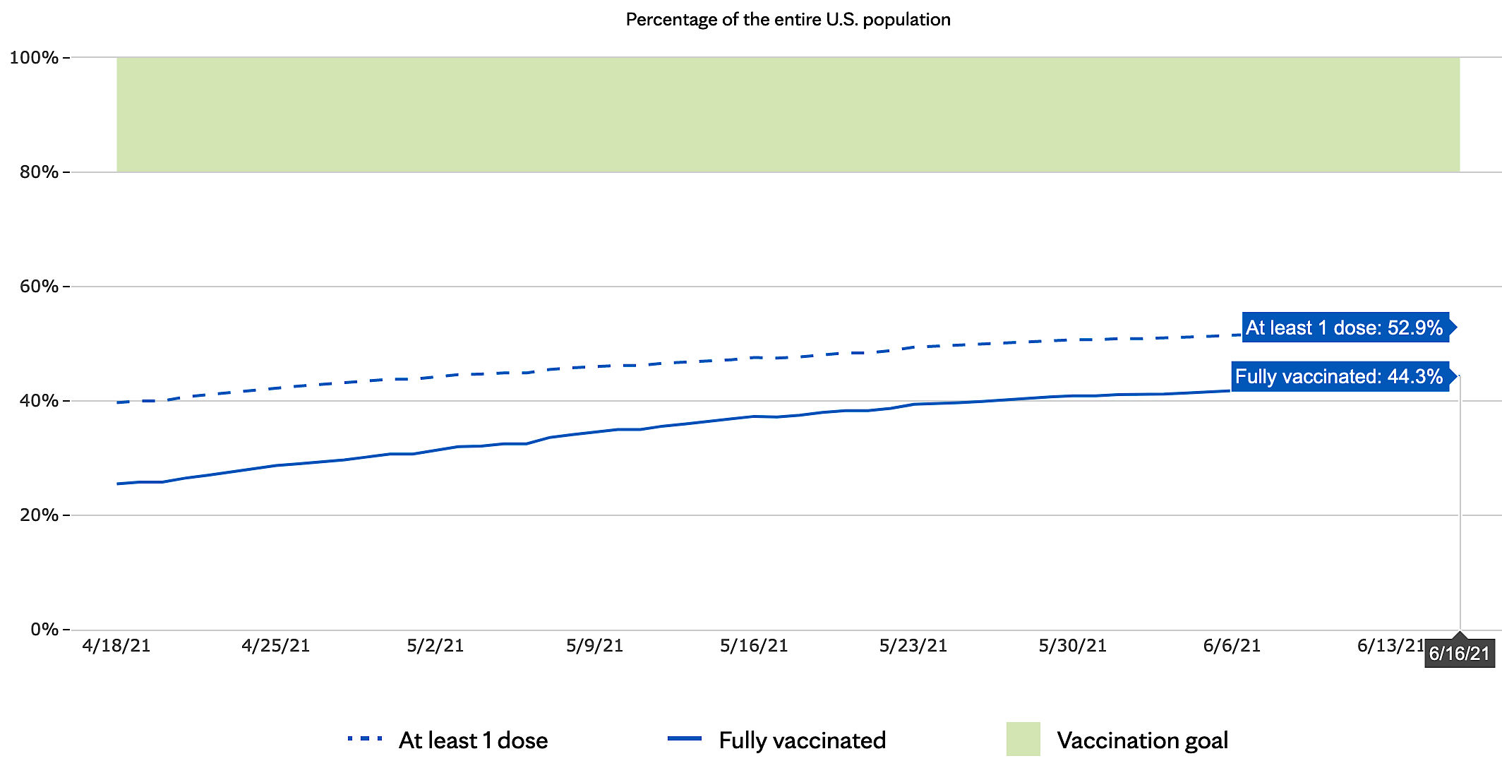
Where are we now?
Mayoclinic.org

Slide 6
Decision Making: BOCR Model

Slide 7
Strategic Goal
1. Healthcare & Economic Burden
2. Quality of Life
3. Global Leadership

Slide 8
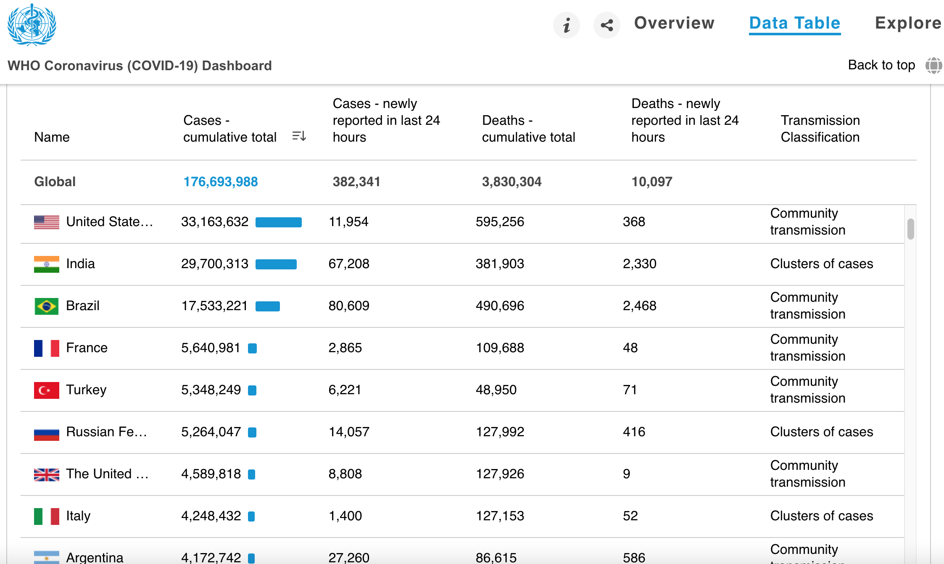
Strategic Goal

Slide 9
Alternatives
A1_Insentives
A2_Mandating
A3_Outreach

Slide 10
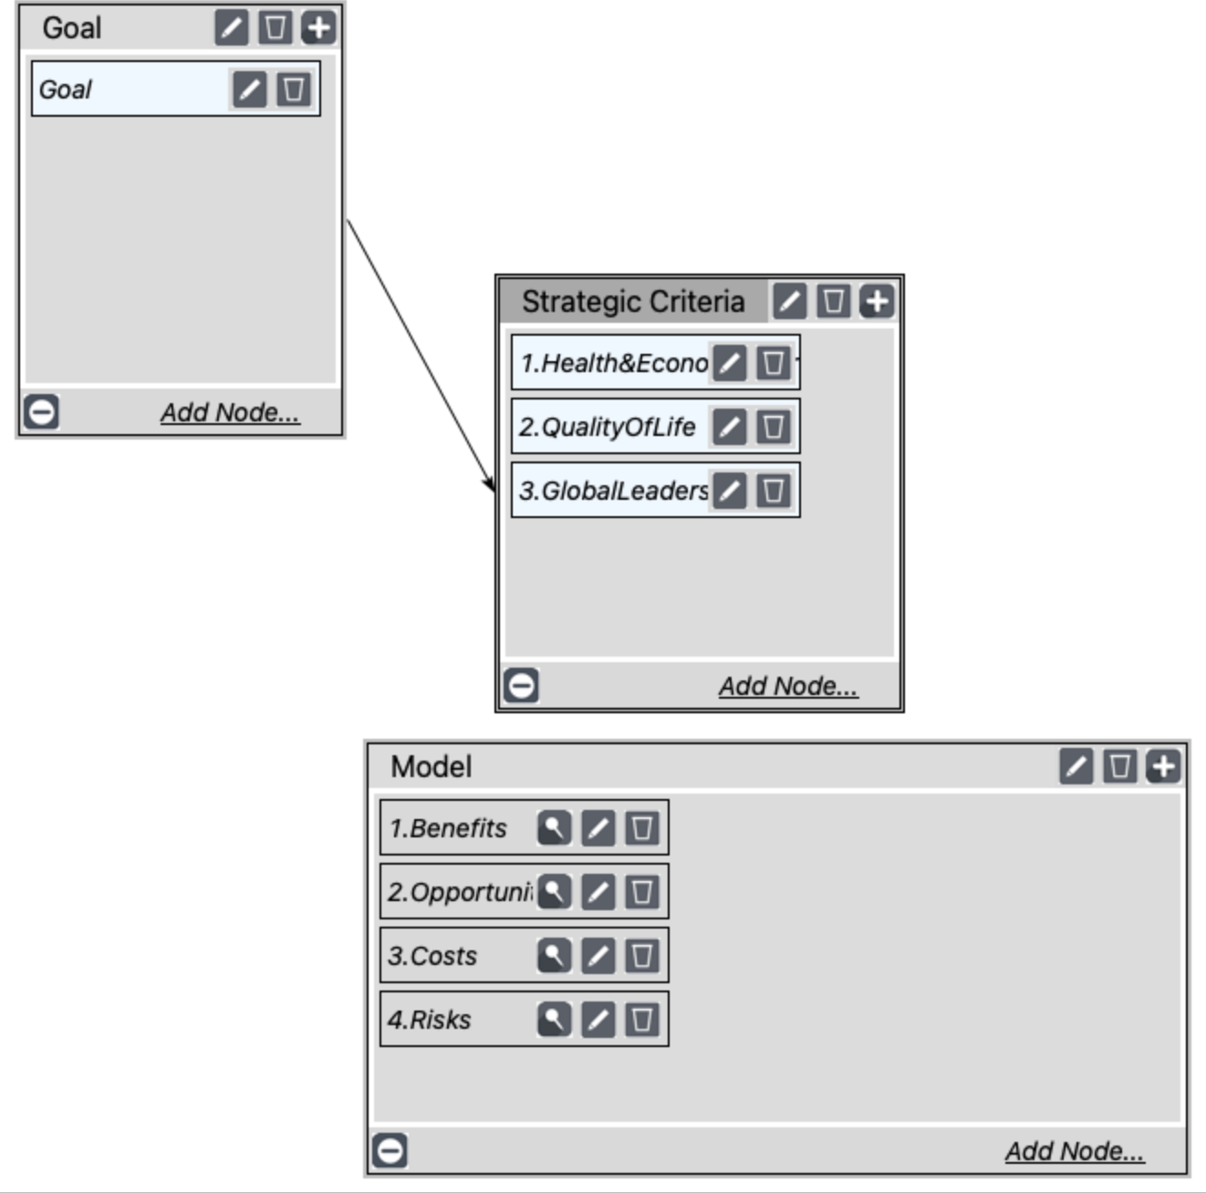
Main Network

Slide 11
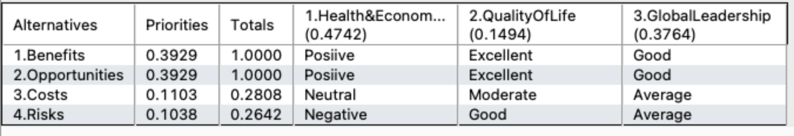
BOCR Ratings

Slide 12
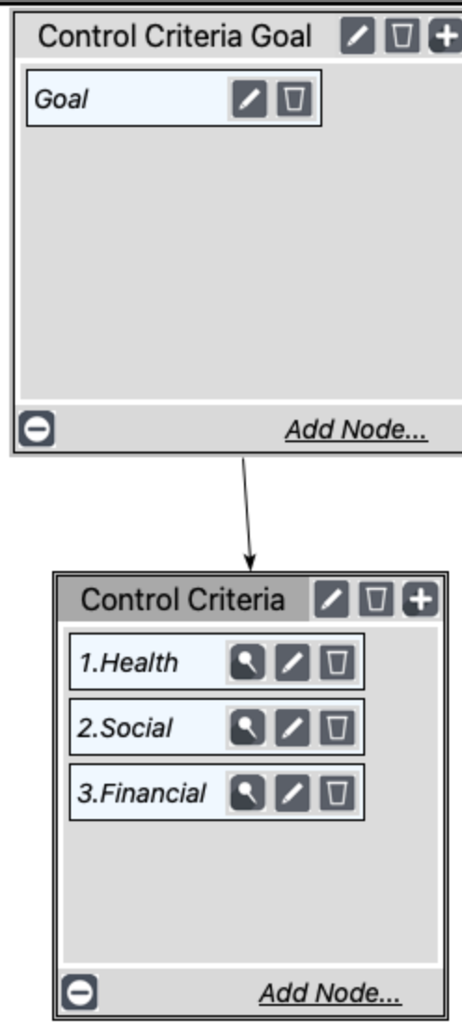
Benefits Subnetwork

Slide 13
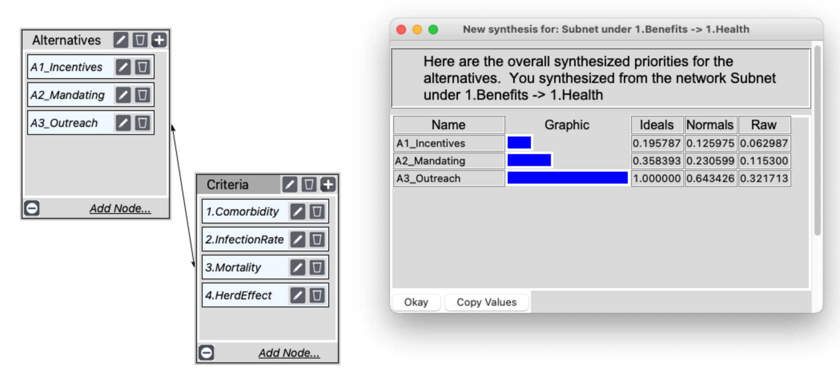
Benefits Subnetwork: Health

Slide 14
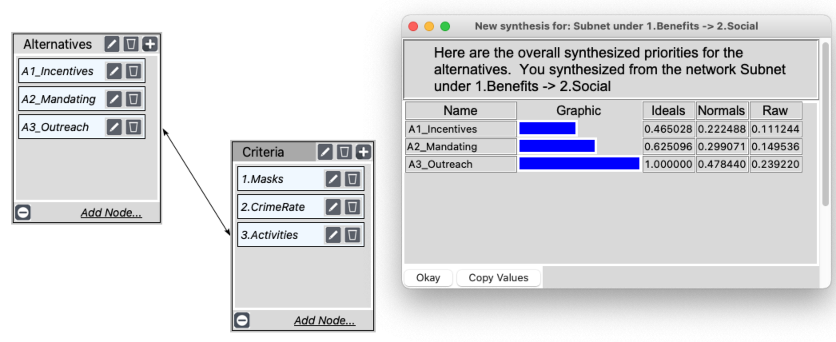
Benefits Subnetwork: Social

Slide 15
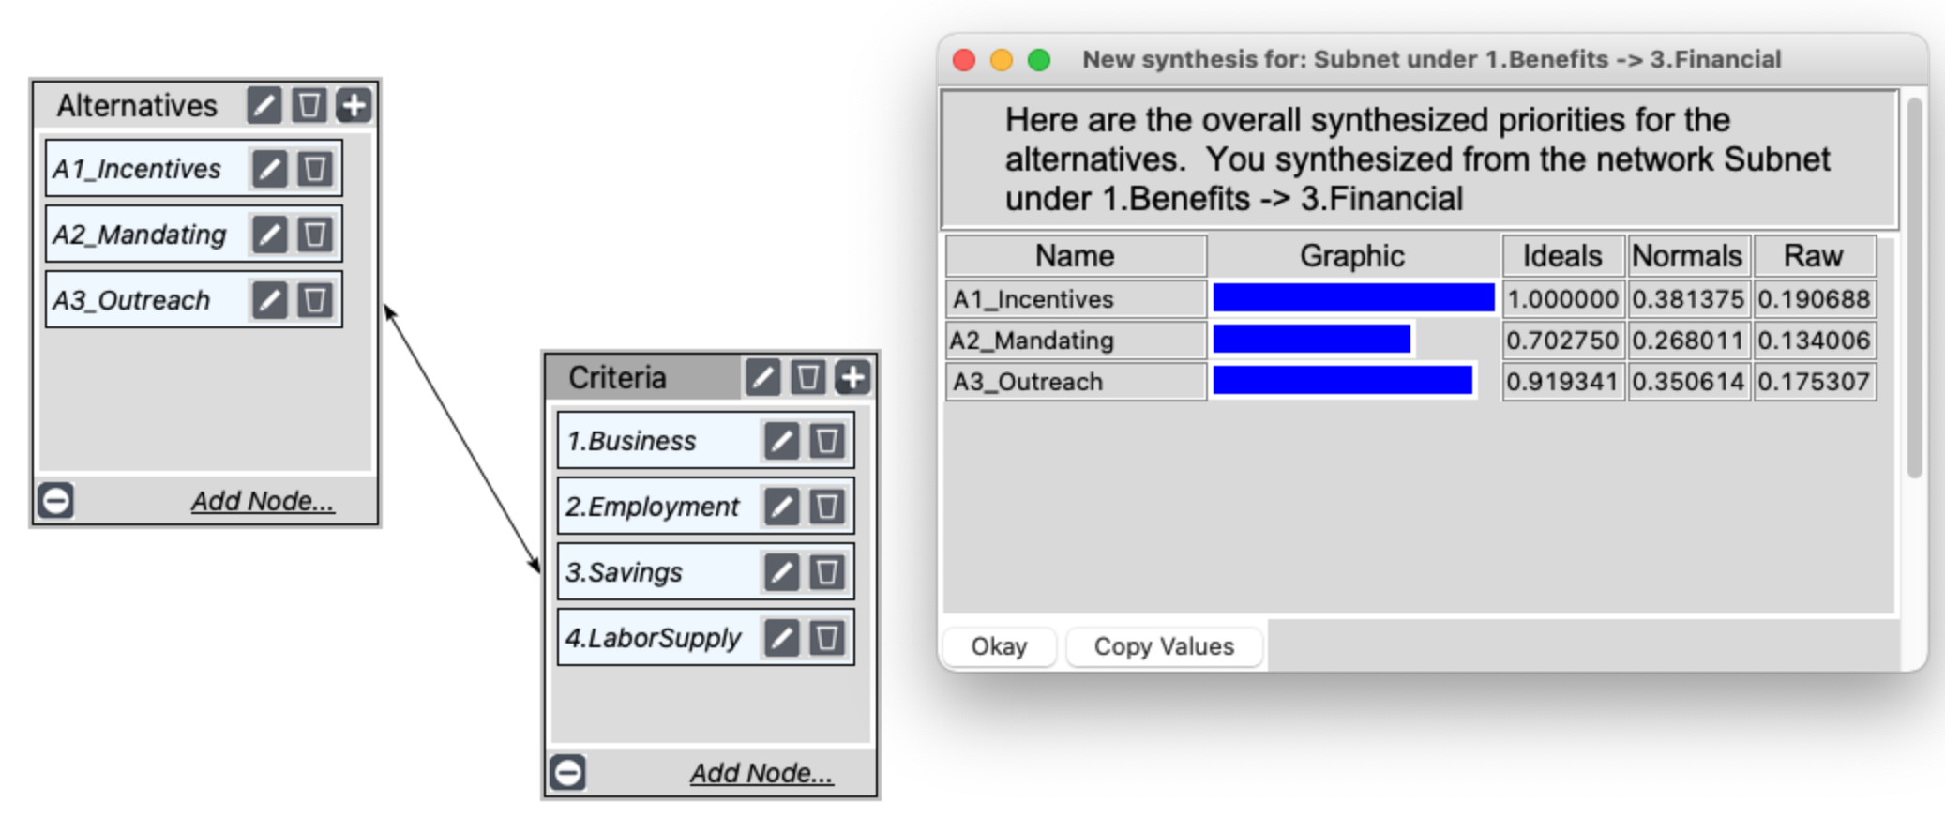
Benefits Subnetwork: Financial

Slide 16
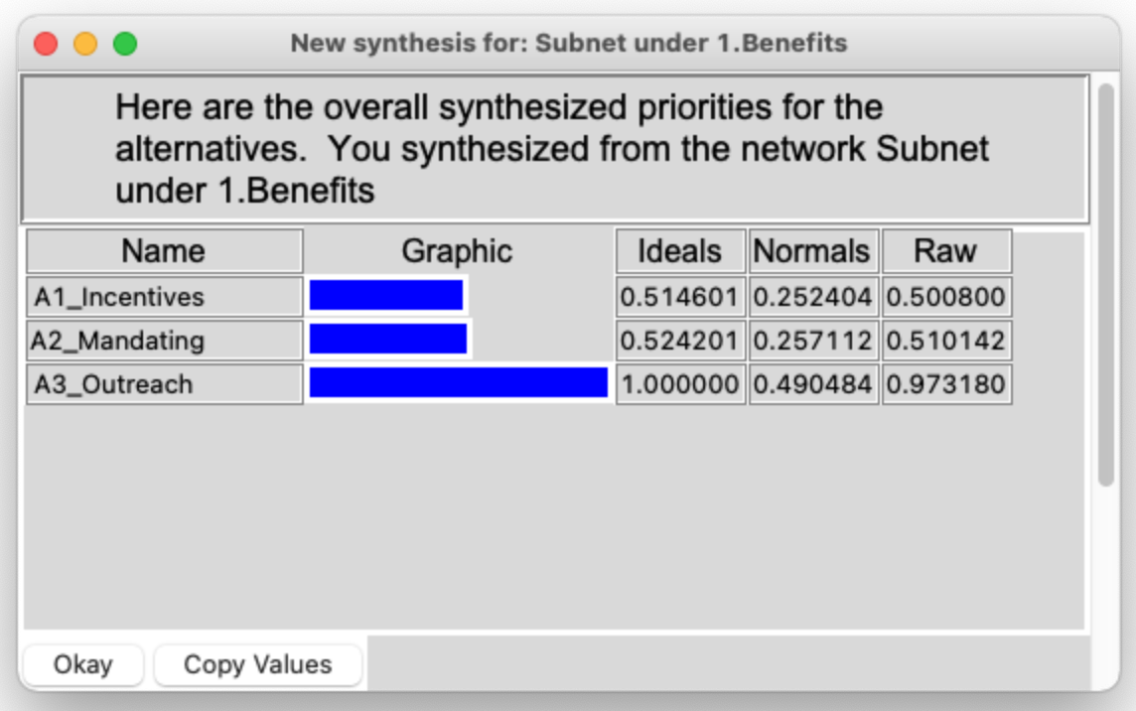
Benefits: Overall

Slide 17
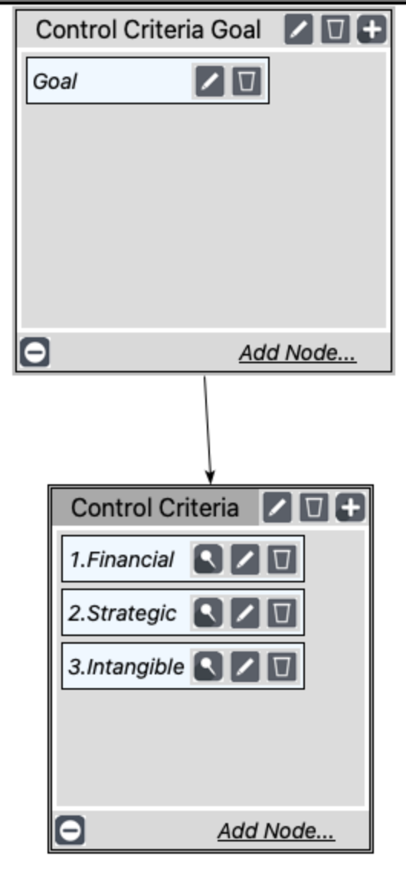
Opportunities Subnetwork

Slide 18
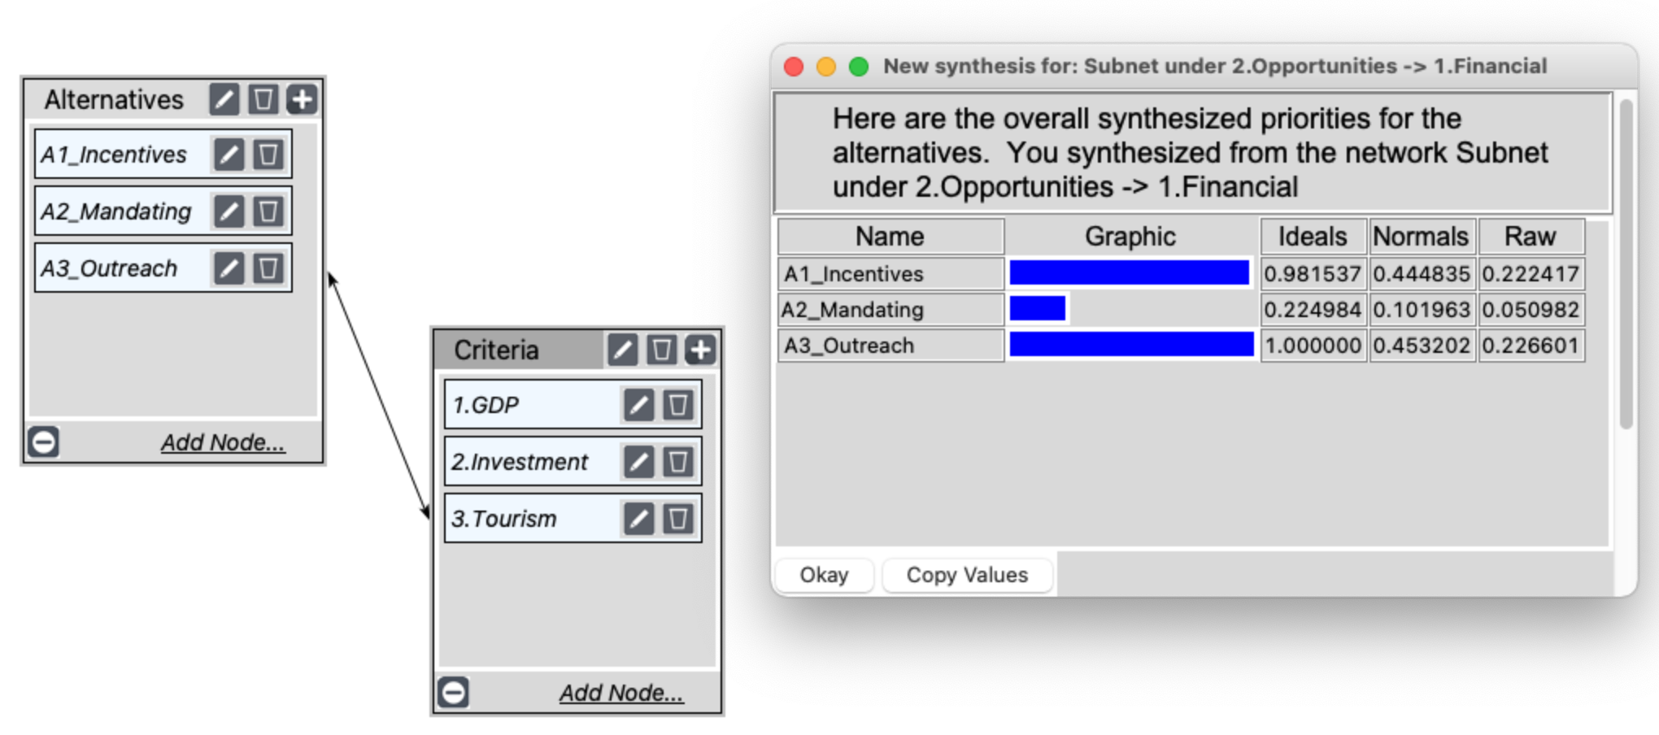
Opportunities Subnetwork: Financial

Slide 19
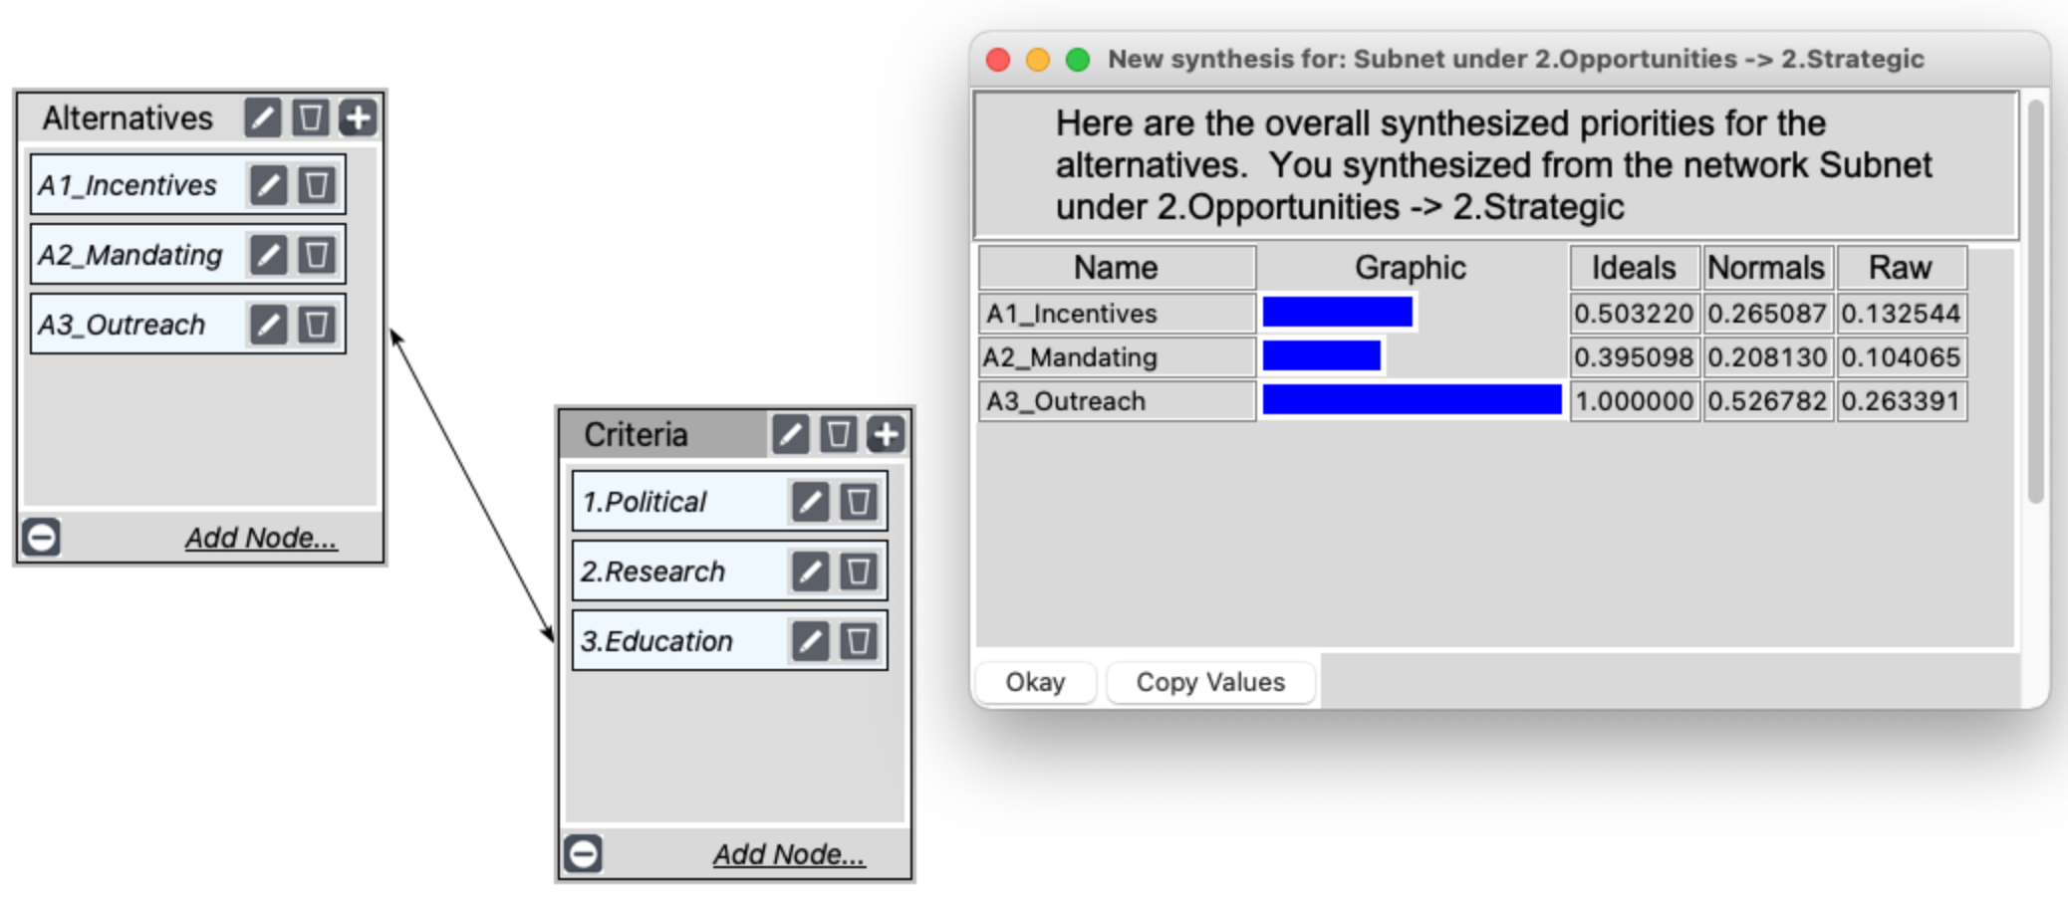
Opportunities Subnetwork: Strategic

Slide 20
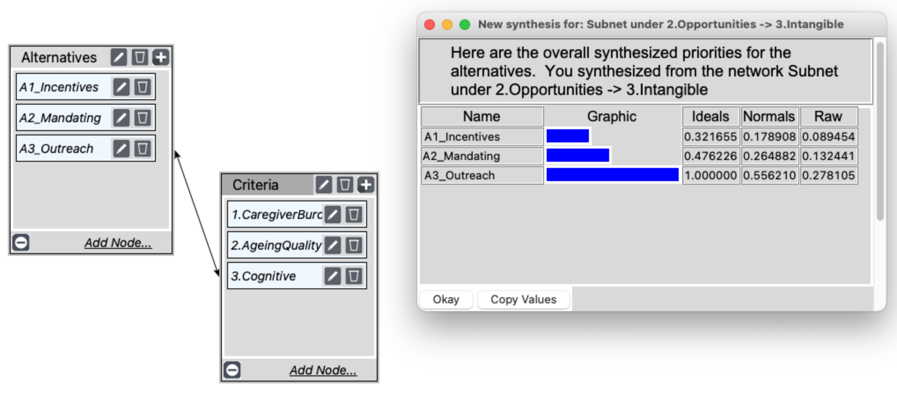
Opportunities Subnetwork: Intangible

Slide 21
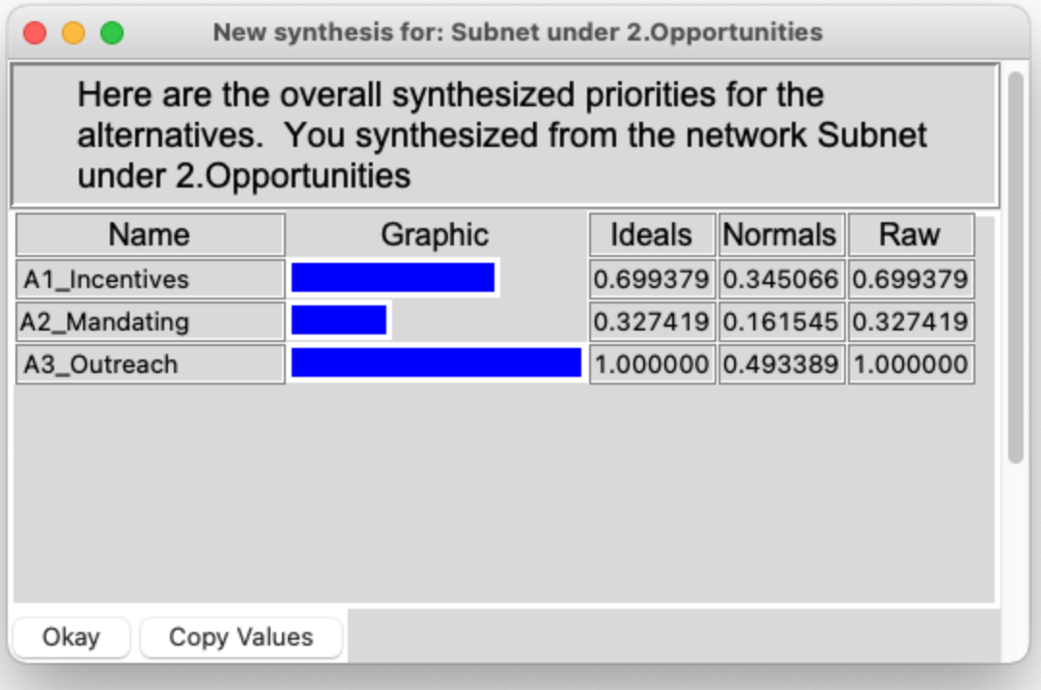
Opportunities: Overall

Slide 22
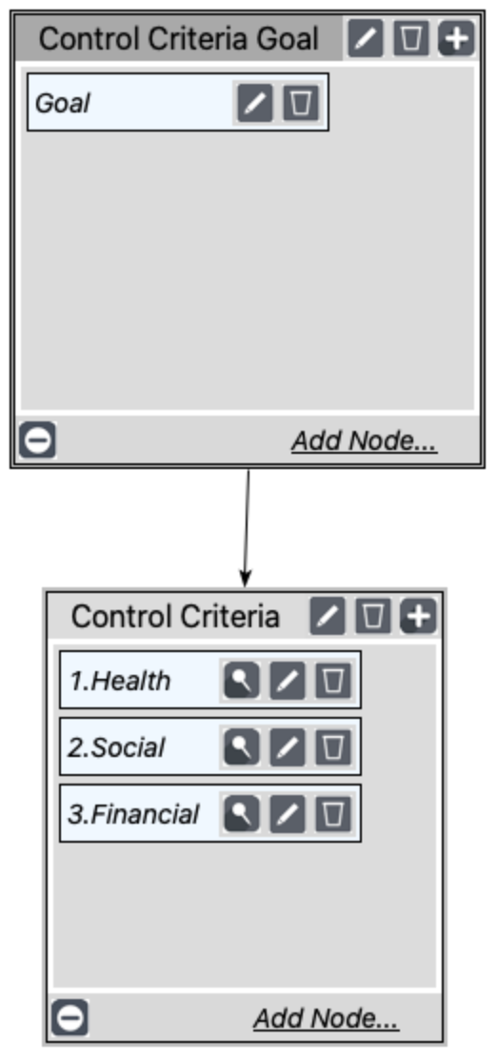
Costs Subnetwork

Slide 23
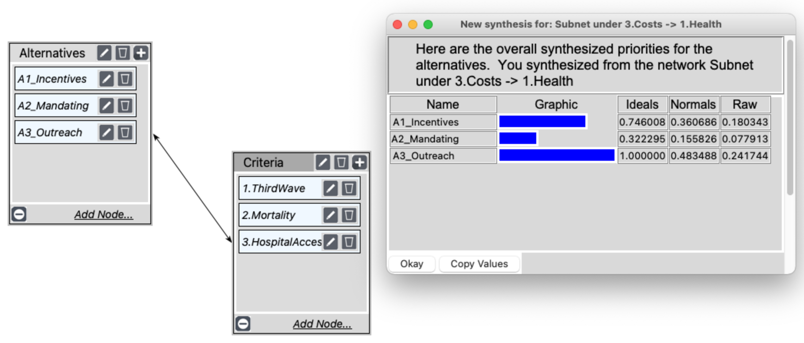
Costs Subnetwork: Health

Slide 24
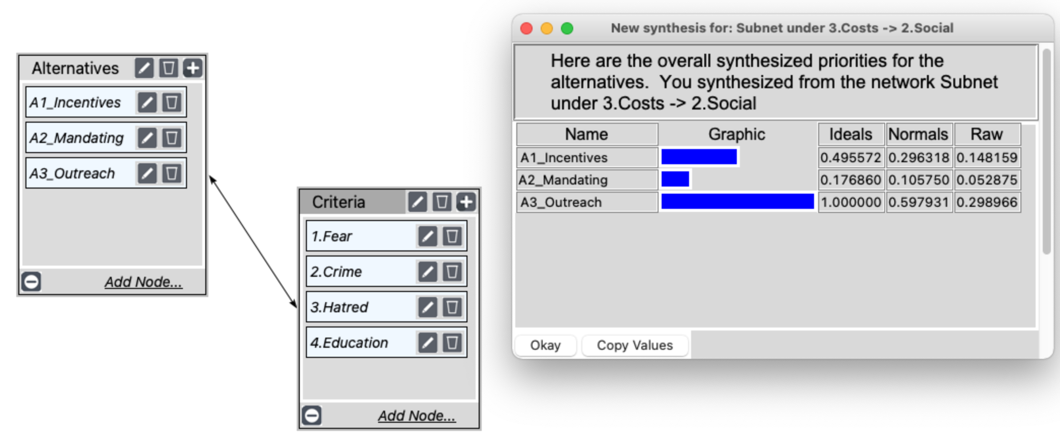
Costs Subnetwork: Social

Slide 25
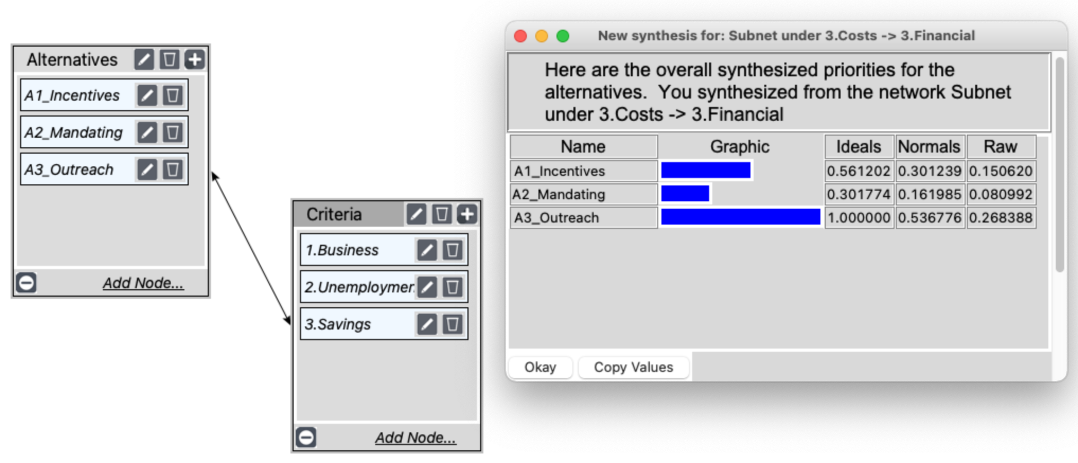
Costs Subnetwork: Financial

Slide 26
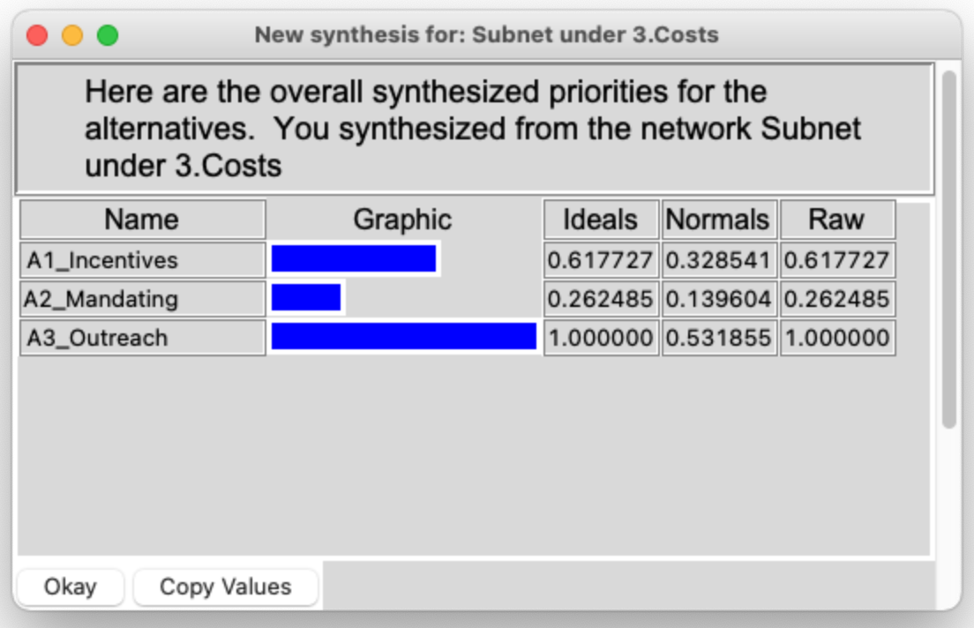
Costs: Overall

Slide 27
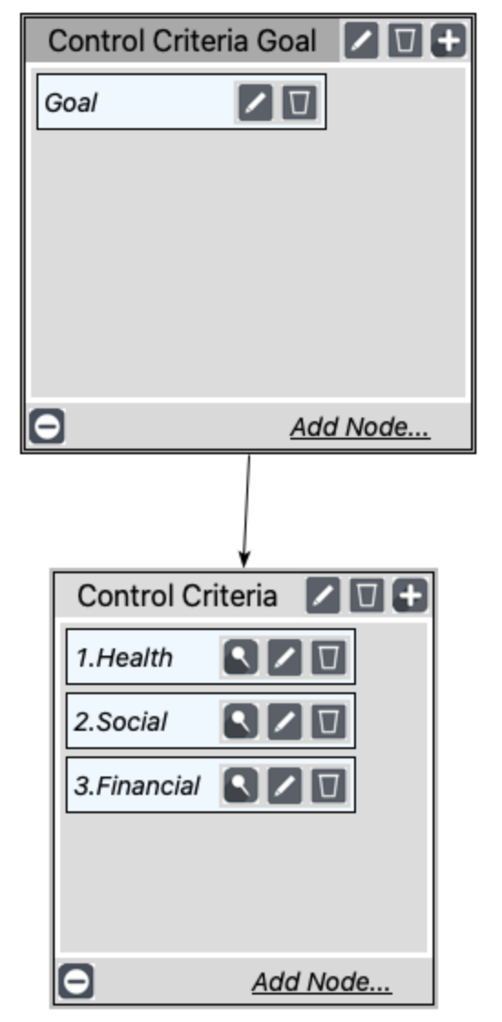
Risks Subnetwork

Slide 28
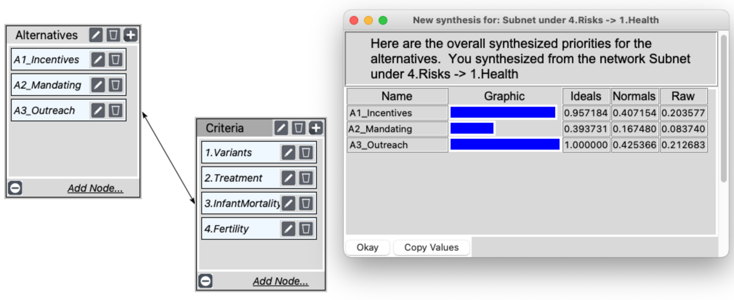
Risks Subnetwork: Health

Slide 29
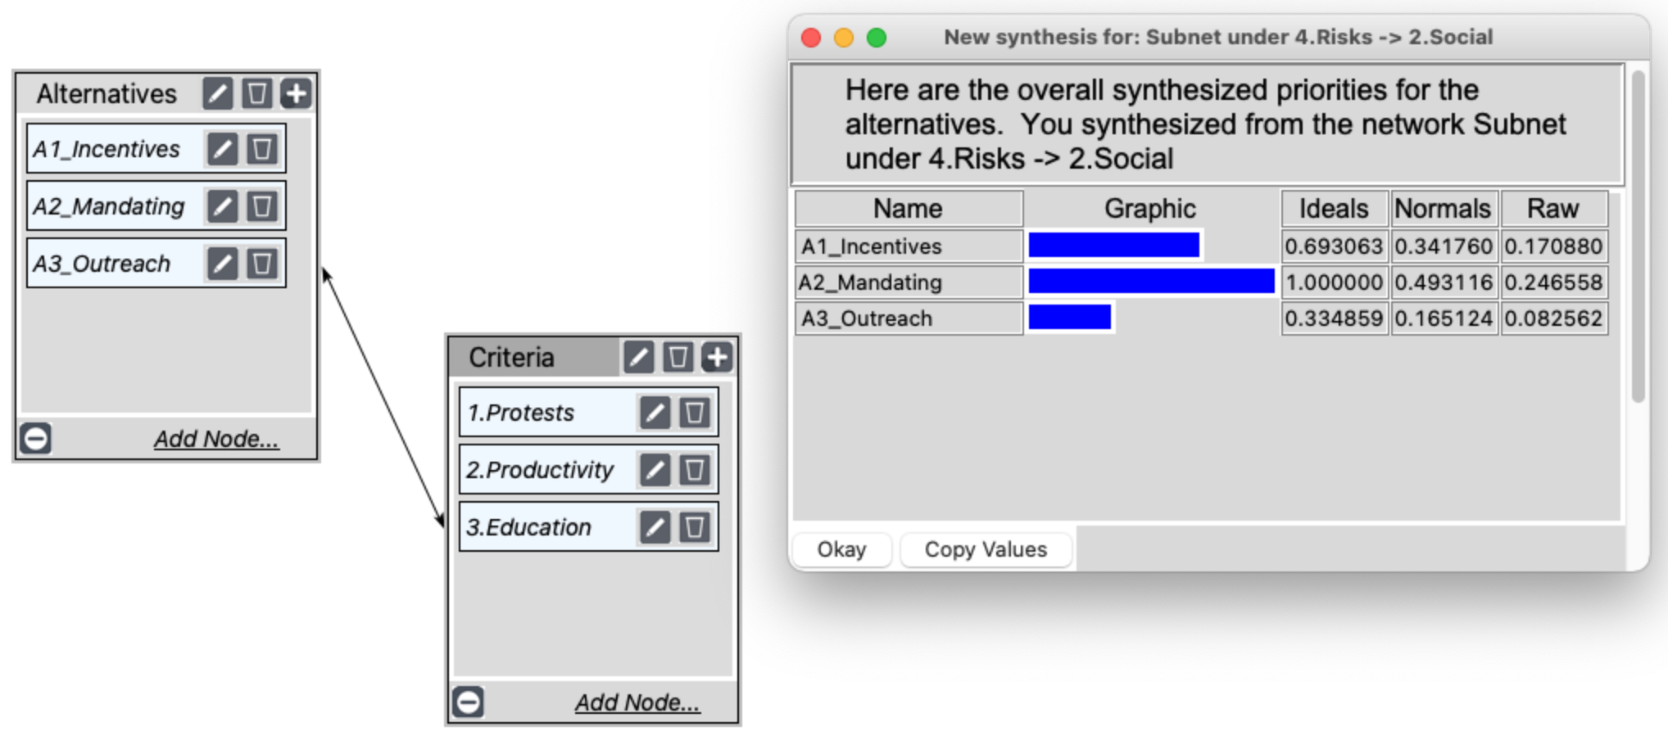
Risks Subnetwork: Social

Slide 30
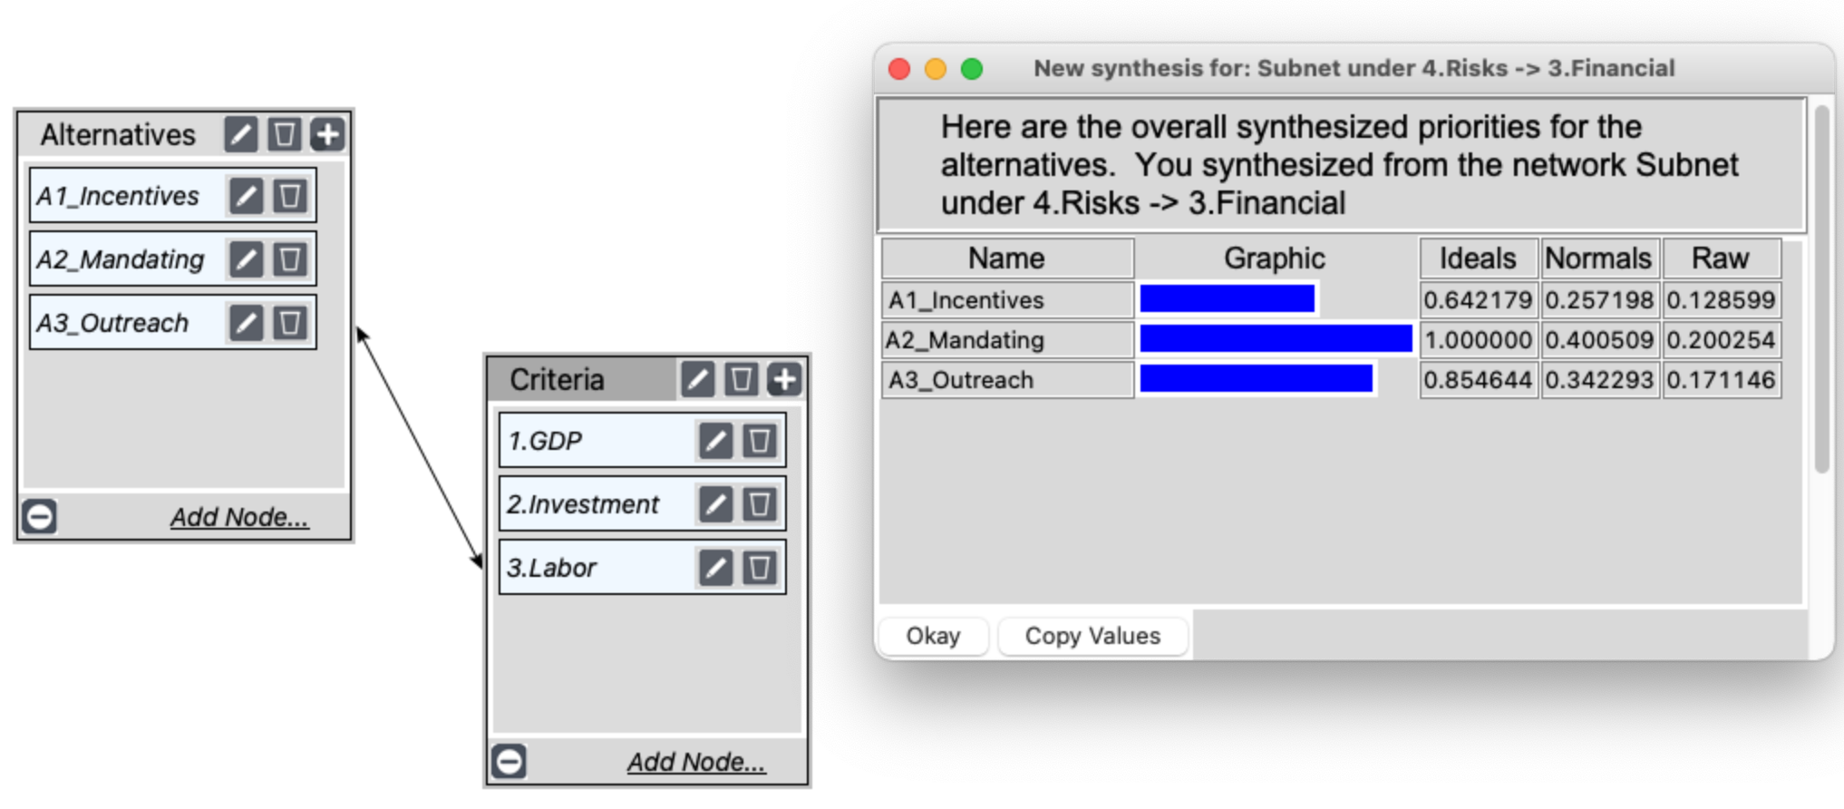
Risks Subnetwork: Financial

Slide 31
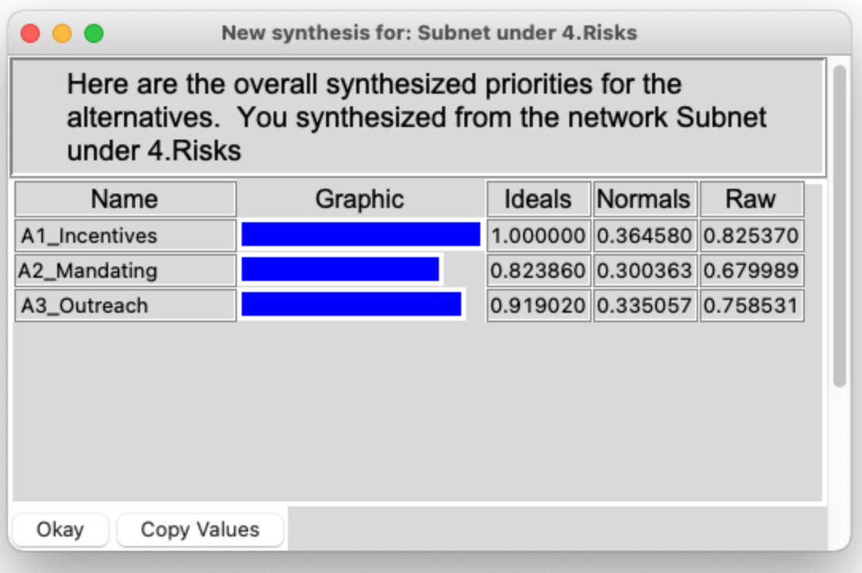
Risks: Overall

Slide 32
Full model

Slide 33
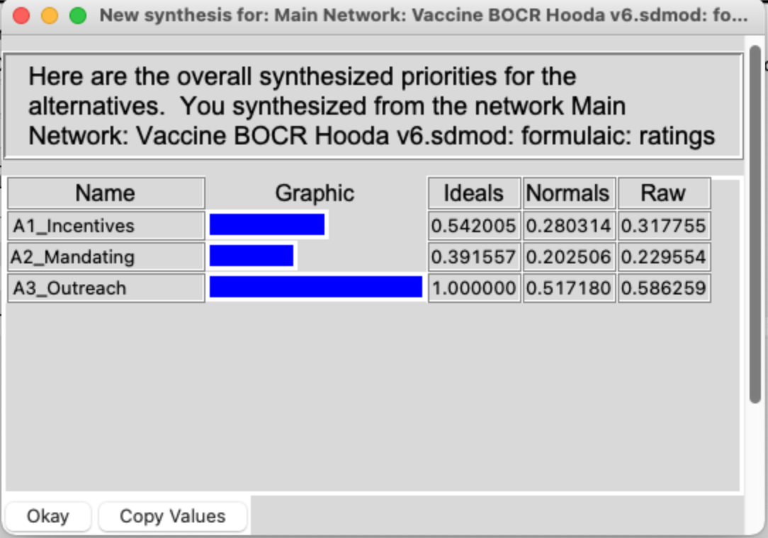
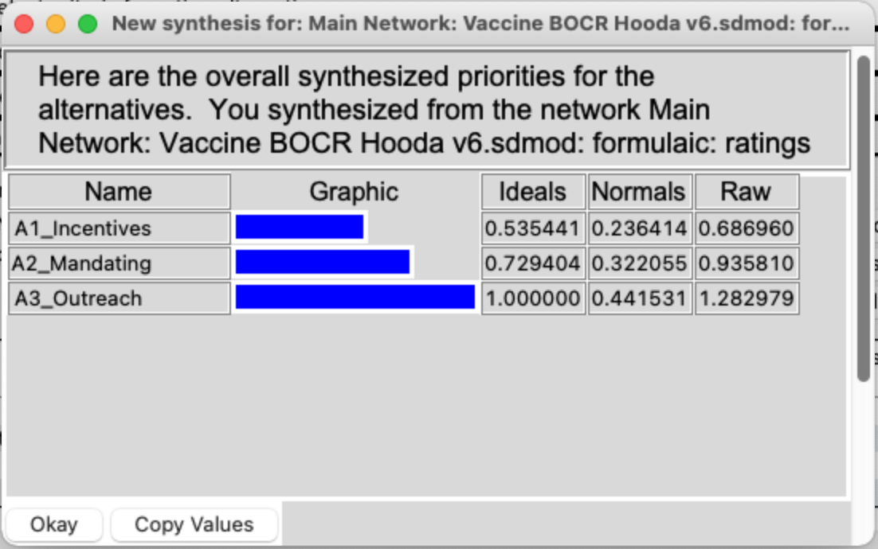
Long-term vs Short-term
Additive (negative) – Long Term
Multiplicative – Short Term

Slide 34
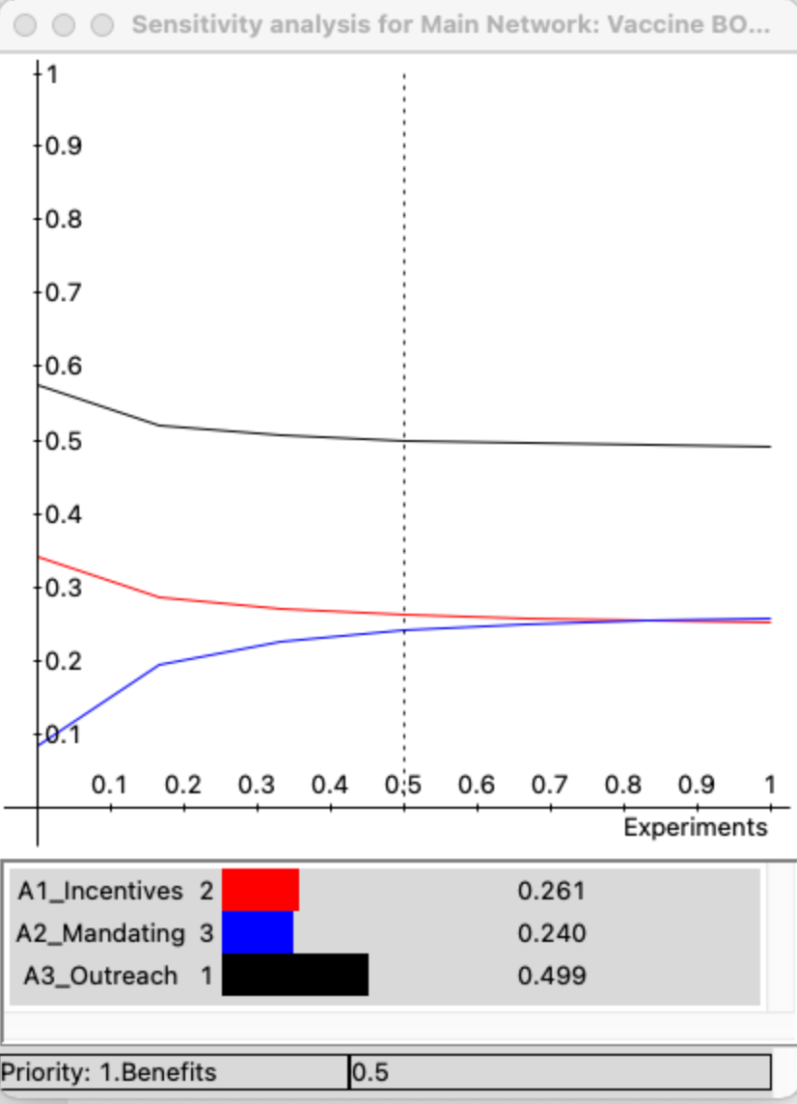
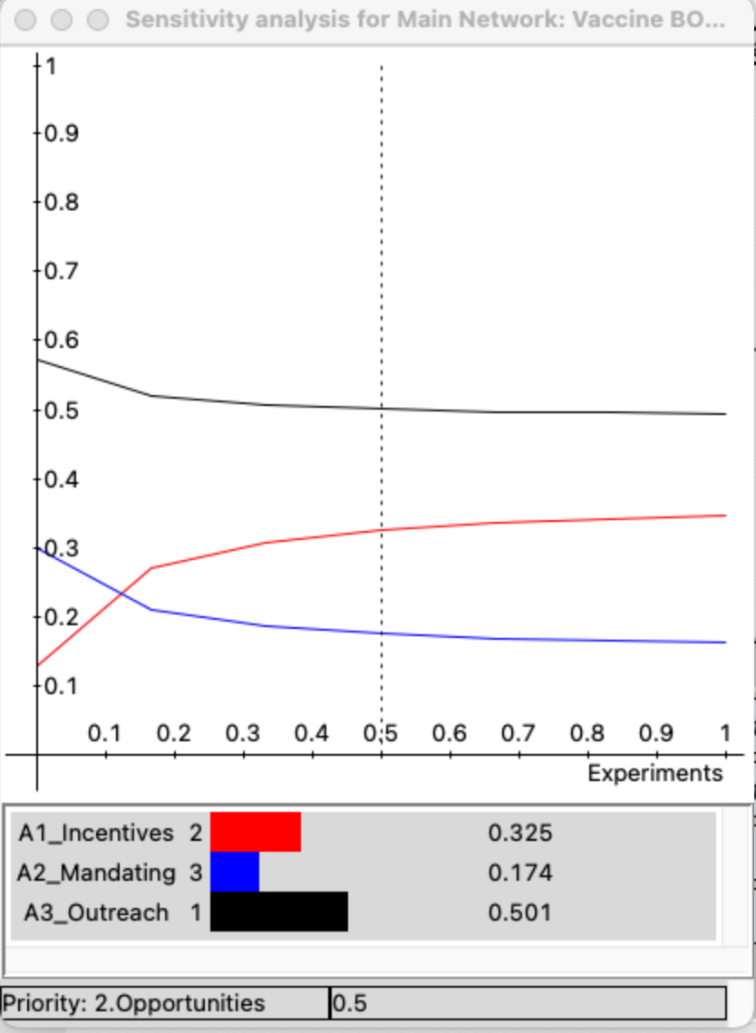
Sensitivity Analysis
Benefits
Opportunities

Slide 35
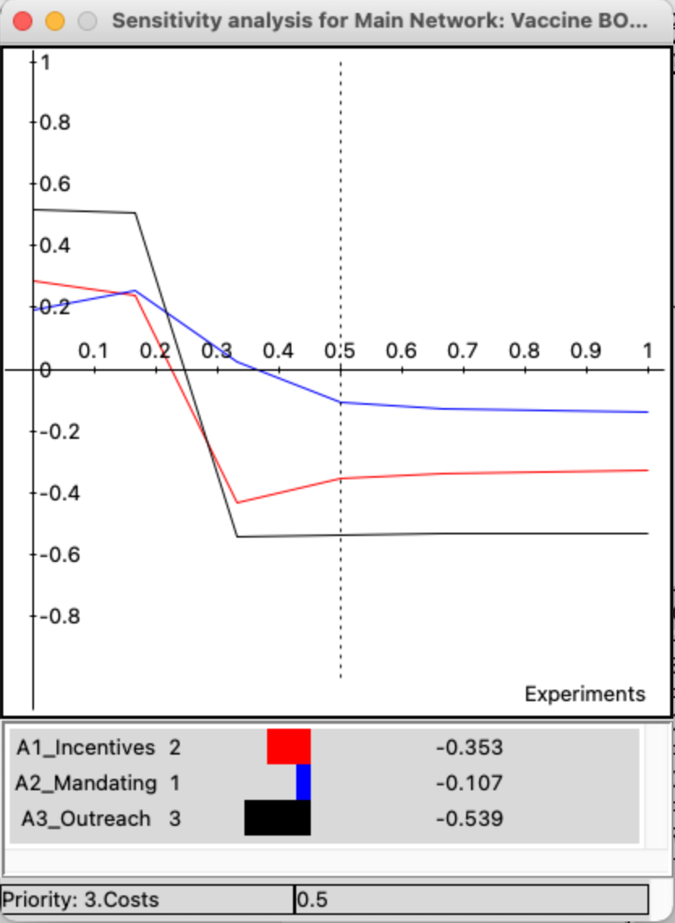
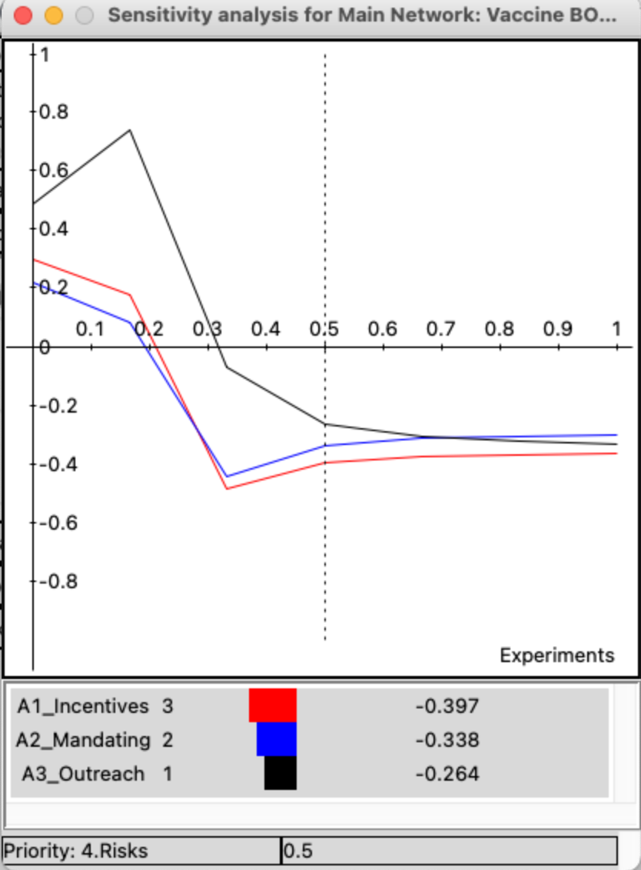
Sensitivity Analysis
Costs
Risks

Slide 36
The Problem

Slide 37
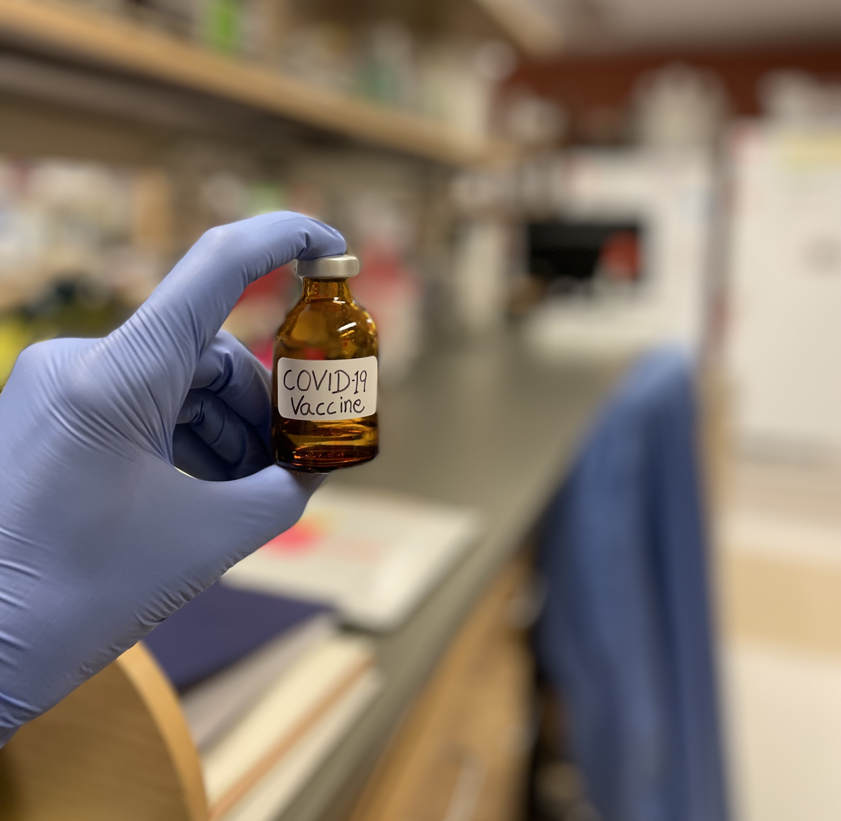
Thank you

