Slide 1

Zika Virus What’s the Best Option to Slow the Spread of the Virus and its Impact?
Jason Hogan – jch79@pitt.edu
Megan Hogan – meganhogan@pitt.edu
April 2016

Slide 2
background
Zika
Issues
Microcephaly
No vaccine or cure
Spread by mosquitos
Pregnancy problems
80% of people who get it don’t show symptoms
Sexually transmittable
Linked to other nervous system impairments
Notes:
Talking points: Although the virus was first discovered in 1947, several factors helped to elevate the significance of contracting the disease:
In 2015, the Zika Virus made headlines around the world when it was linked to microcephaly.
The definitive link to an irreversible, debilitating disease in fetuses – microcephaly – according to the World Health Organization (WHO)
The possible link to premature birth, eye problems and other neurological conditions in babies born to mothers who were infected while pregnant.
The virus does not have a medicinal cure or developed vaccine for prevention
It can be spread through Aedes aegypti mosquitos, which can now be found as far north as San Francisco and New York, and, most recently confirmed, through sexual transmission
The virus only affects one in five people so that symptoms present; the other four out of five people show no symptoms and thus carry the virus unknowingly, which means they could spread it to another person through sexual transmission or through their blood.
Beyond affecting developing fetuses, the virus has been linked to neurological diseases that attach brain cells and the spine, causing paralysis in people and other symptoms that are similar to Multiple Sclerosis (MS).

Slide 3
GOAL
The virus is causing alarm among major health agencies such as the Centers for Disease Control and Prevention (CDC), the European Centre for Disease Prevention and Control (ECDC) and the World Health Organization (WHO).
We’re analyzing this model from the perspective of world health organizations, whose main objective is to:
Stop the spread of disease
Reduce the impact

Slide 4
ALTERNATIVES OVERVIEW
The alternatives that will be considered as the best strategy for slowing or stopping the spread of the Zika virus will be:
DEET Mosquito control
Restrict travel
Education (for everyone)
Increased access to contraception and abortion
Pharmaceutical Option
Do nothing

Slide 5
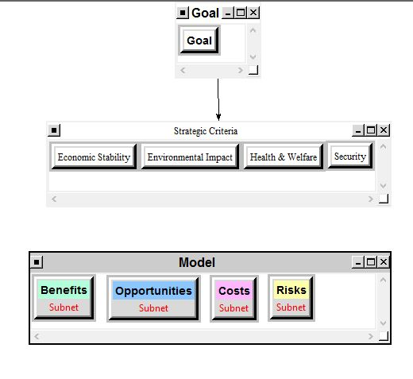
BOCR MODEL

Slide 6
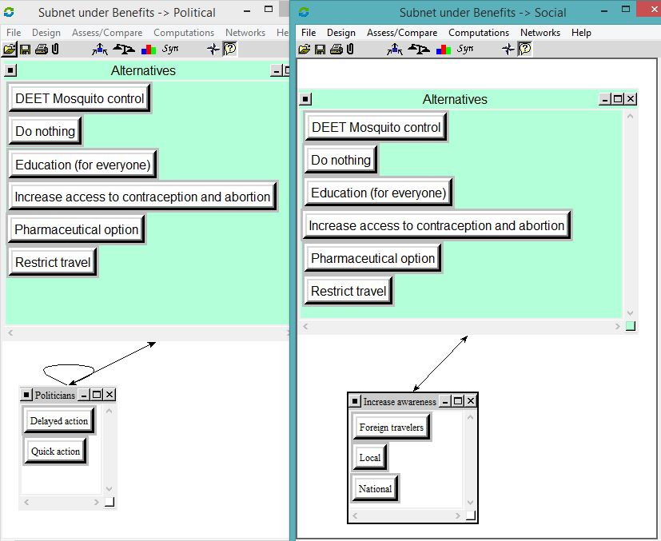
BENEFITS SUBNETS
Notes:
Benefits subnet:
Political – for politicians, there could be quick and delayed benefits, depending on the alternative
Social – do any of the alternatives offer short-term benefits in the increased awareness for foreign travelers, locals and nationals in the regions affected?

Slide 7
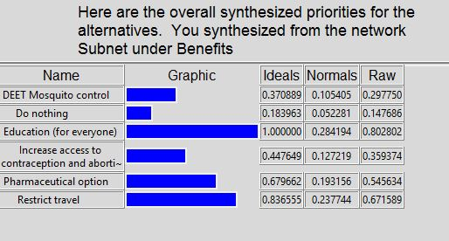
BENEFITS PRIORITIES

Slide 8
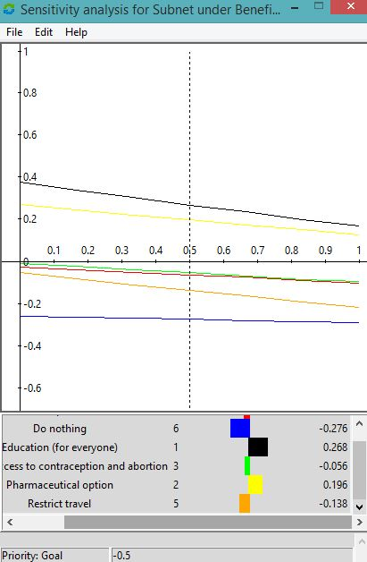
BENEFITS SENSITIVITY
Notes:
From the sensitivity here, under Benefits, education is always the top alternatives, with do nothing consistently as the bottom, signifying that these results are stable.

Slide 9
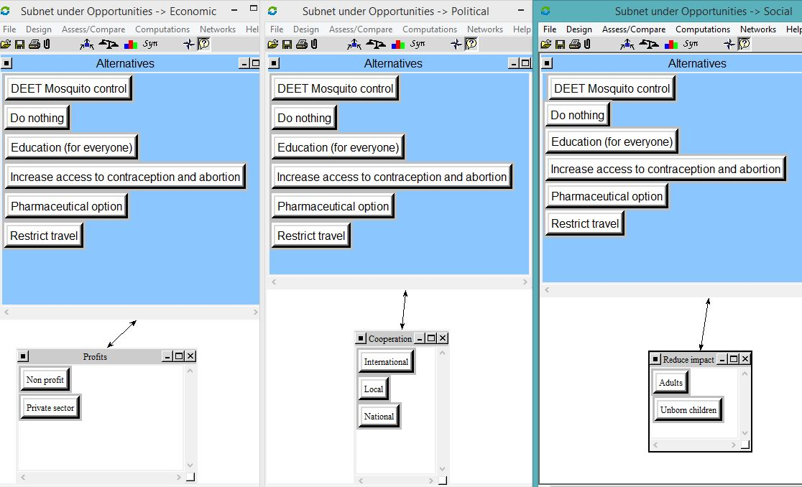
OPPORTUNITIES SUBNETS
Notes:
Economic – each alternative will likely drive profits to a sector – either public or private
Political – any long-term benefits on the international scale (U.S. and Latin America, Latin America and Europe) and National levels (between neighboring countries in areas affected by the virus)?
Social – long-term benefits for reducing the impact for adults (not getting the disease or developing MS-like symptoms) and unborn children (not suffering from microcephaly or other poor development problems)?

Slide 10
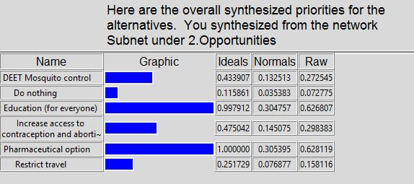
OPPORTUNITIES PRIORTIES
Notes:
Talking points for the pharmaceutical option:
For the purpose of this model, and from a health organization perspective, the pharmaceutical option would be invest millions – possibly billions – of dollars into a Zika virus vaccine. While this may take a lot of money and time to research, develop and test, in the long-term, preventing the virus altogether will have the biggest impact on stopping the spread of the disease and the other effects it is causing such as microcephaly and other nervous system diseases.
The pharmaceutical option may also introduce possible treatments for other viruses that act in a similar manner to the Zika virus, such as targeting the nervous system. It may also introduce some vaccines for diseases that spread in a similar manner (through mosquitos) and also cause flu-like symptoms and possibly death, such as dengue and chikungunya.

Slide 11
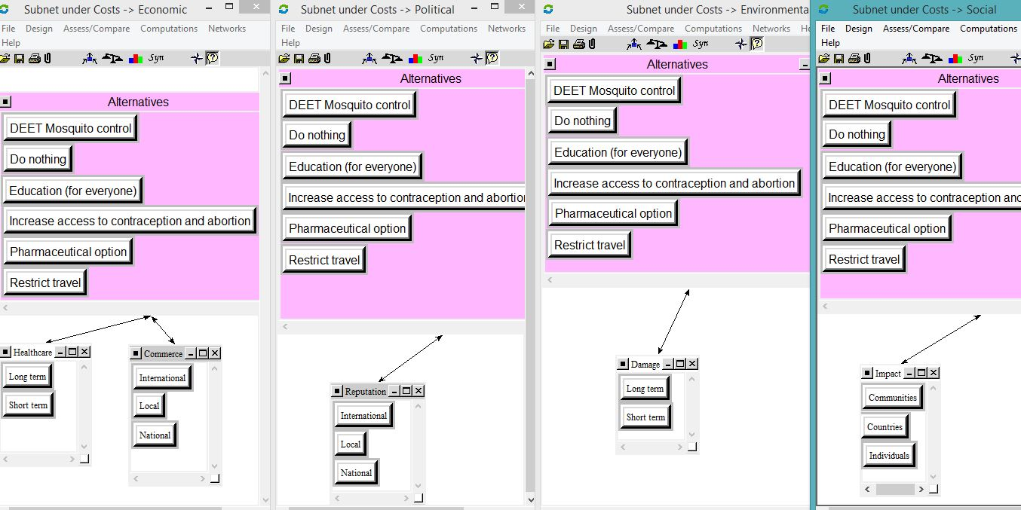
COSTS SUBNETS
Notes:
Economic – is the alternative expensive in the short term? Long term? Could the alternative negatively impact commerce on local, international and national scales?
Political – could the alterative cost politicians, or political parties, with a damaged reputation on a local, national or international level?
Environmental – do the alternatives have the potential for short term damage? Long term damage? To the agriculture/water supplies.
Social – do the alternatives impact individuals, communities or countries where they may gain prevention for the Zika virus but lose part of their culture or way of life?

Slide 12
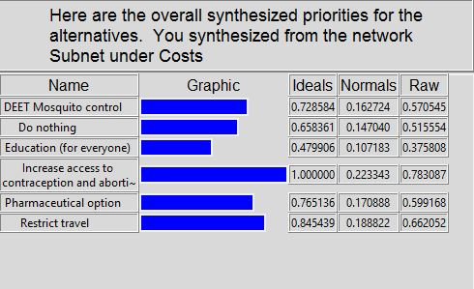
COSTS PRIORITIES

Slide 13
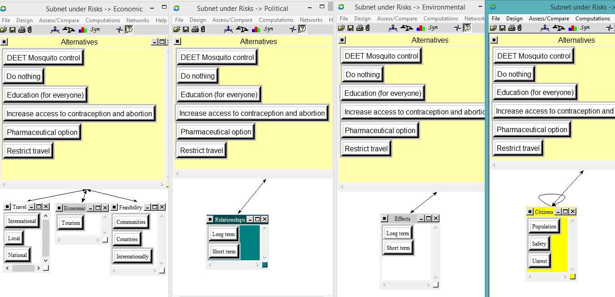
RISK SUBNETS
Notes:
Economic – Are there risks for the alternatives to impact traveling? What about reducing tourism and thus revenue needed to sustain some of the local economies?
Political – do alternatives pose a risk for politicians long-term or short-term? And local/national laws and relationships?
Environmental – do the alternatives pose any unknown or potential risks to the environment, long term or short term?
Social – do the alternatives pose the risk to harm citizens – via population reduction, personal/physical safety, political unrest?

Slide 14
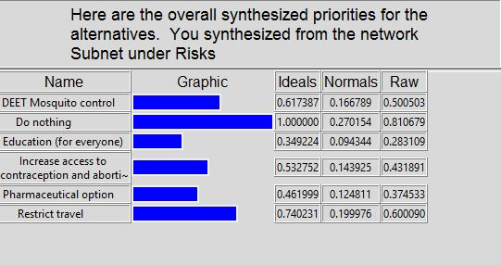
RISK PRIORITIES

Slide 15
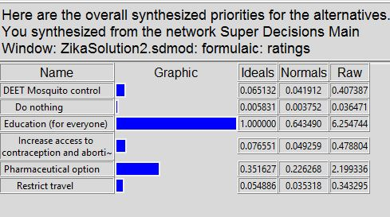
OVERALL SYNTHESIS – Multiplicative
Notes:
(short term – best solution)

Slide 16
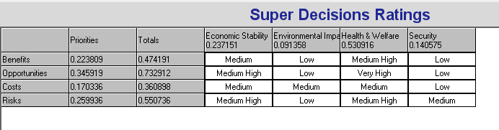
RATINGS

Slide 17
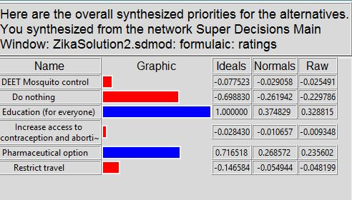
OVERALL SYNTHESIS – ADDITIVE
Notes:
Additive (long term – best solution)

Slide 18
CONCLUSION
Education was found to be the overall best option for slowing or stopping the spread of the Zika virus and minimizing its impact.
A variety of factors influenced this result:
Fiscal cost – low compared to pharmaceutical option
Social cost – low compared to increased access to contraception or abortion
Opportunities – high for long-term, sustained prevention of the spread of the disease; not dependent upon high-cost research (as would be the case for a vaccine or new drug, for example)
Benefits – Actionable ways for people in the regions affected to take steps toward prevention almost immediately; also gives people the chance to delay or avoid travel to areas where the virus has been found, and avoid it altogether

Slide 19
FUTURE RESEARCH
The effectiveness of education as a solution may vary from country to country, and even from region to region within each country. Research to consider if education is the best solution would need to address:
How is the education being deployed? Would its effectiveness be dependent on literacy levels of a population?
With the education, do all populations have access to the materials needed to follow the actions (e.g. screens for windows, insect repellent)?
For people who do not live in areas affected by Zika, but choose to travel there, is the education approach considered ineffective? Are there benefits to being educated and willingly entering an area where the virus is present?

Slide 20
Questions?

