Slide 1
Best strategy to deal with the refugees
What would be the best decision for the German government?

Slide 2
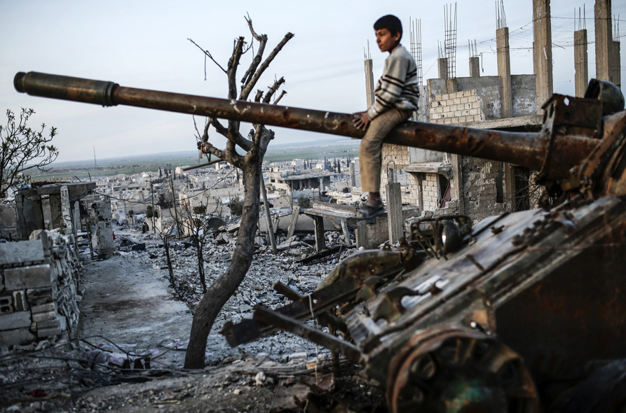

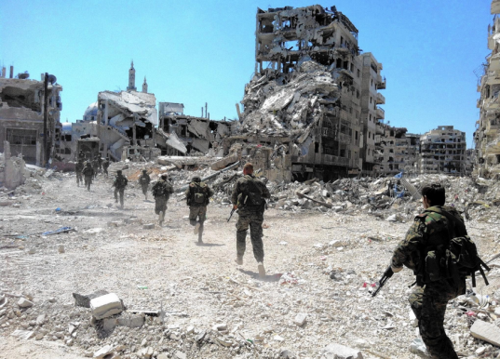
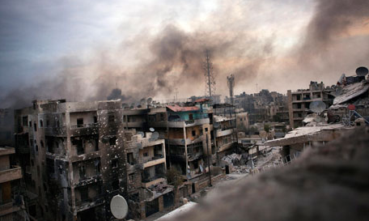
Syrian Civil War
Starting point „Arab Spring“ early 2011
Rise of ISIS
12 million people from Syria are on the run
4 million people already left Syria
8 million are still there trying to find a peaceful place to stay

Slide 3
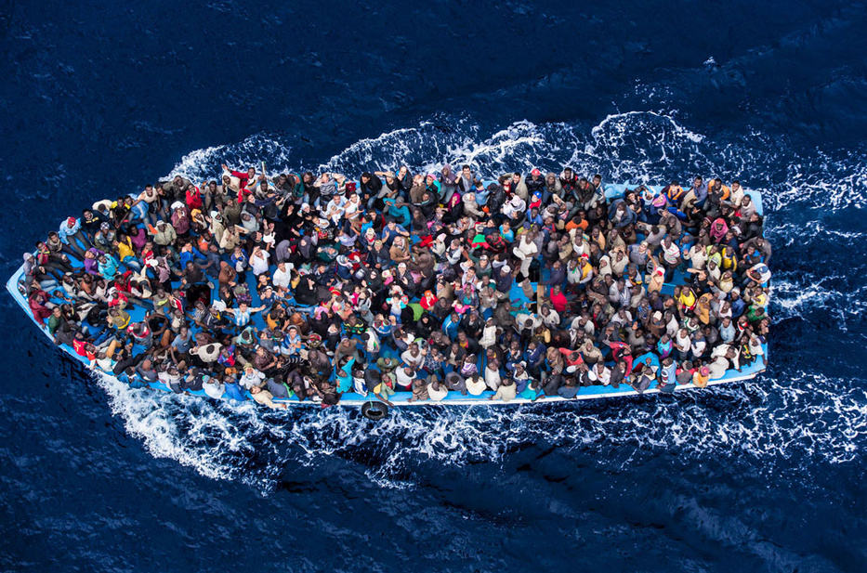
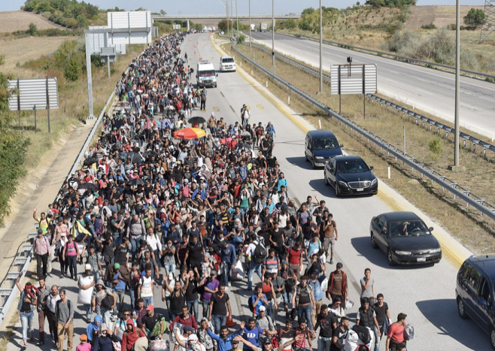
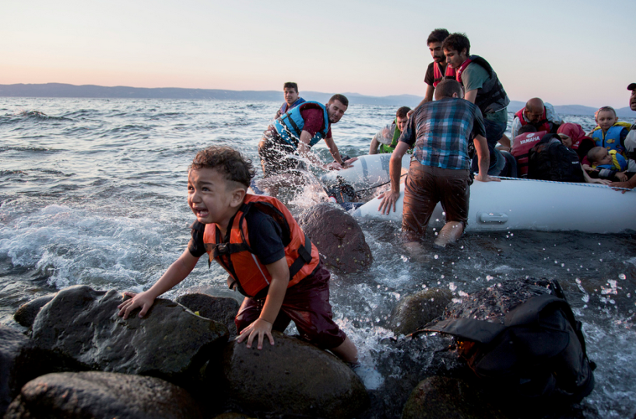
Refugees on their way
From the beginning refugees tried to reach Europe
Crossing the seas many of them drowned
Criminal traffickers are a real problem

Slide 4
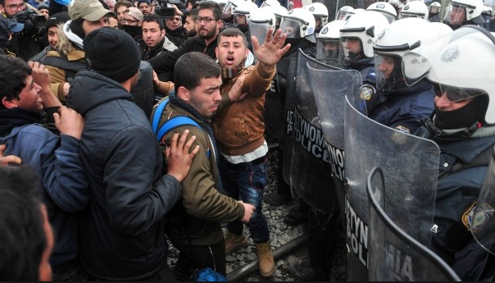
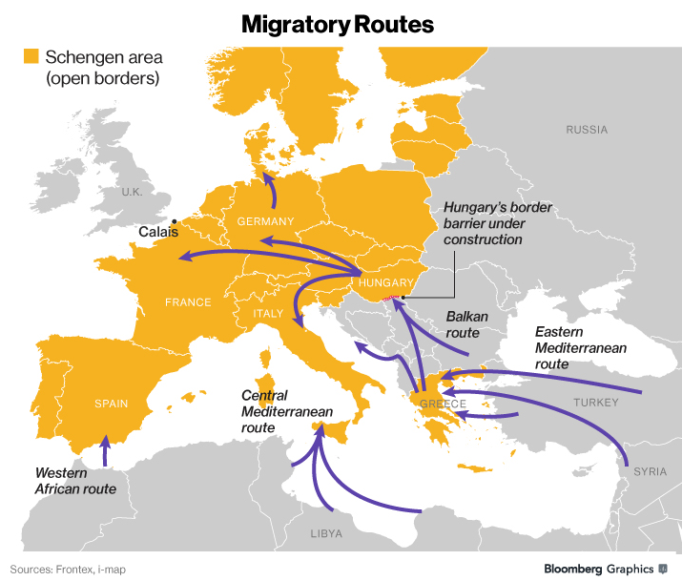
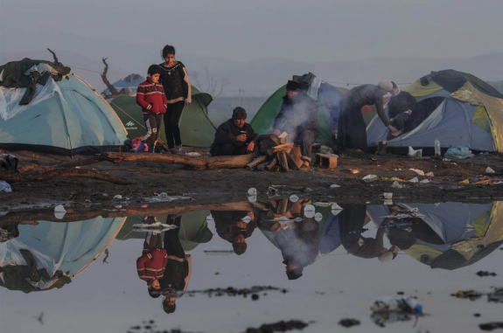
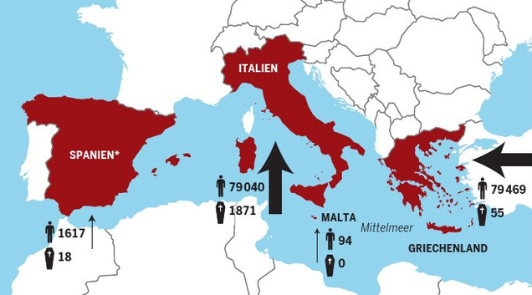
Destinations of refugees
If not drown they arrive in Italy, Greece or Turkey
Heading for countries like Sweden or Germany
Camps in Greece, Italy and Turkey overflow

Slide 5
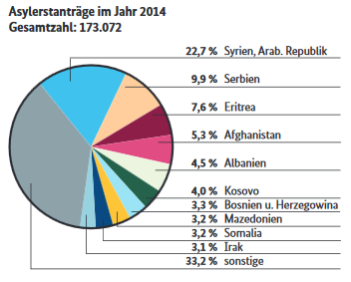
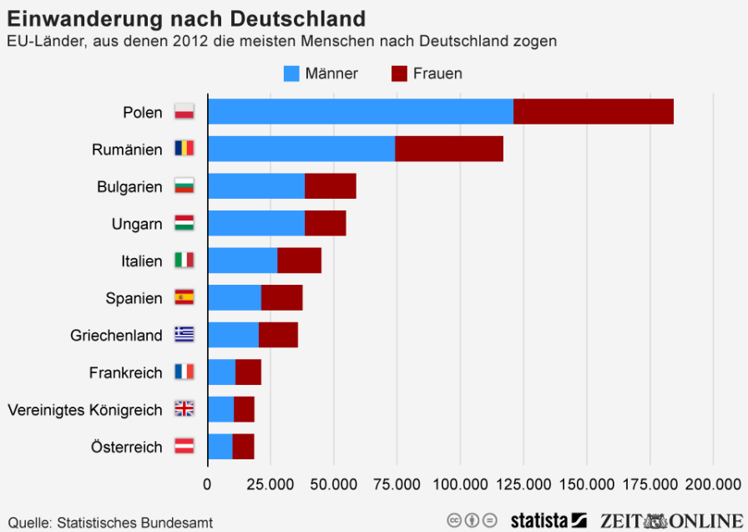
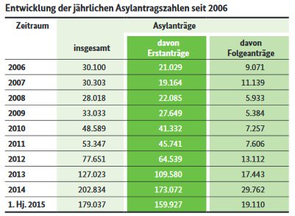
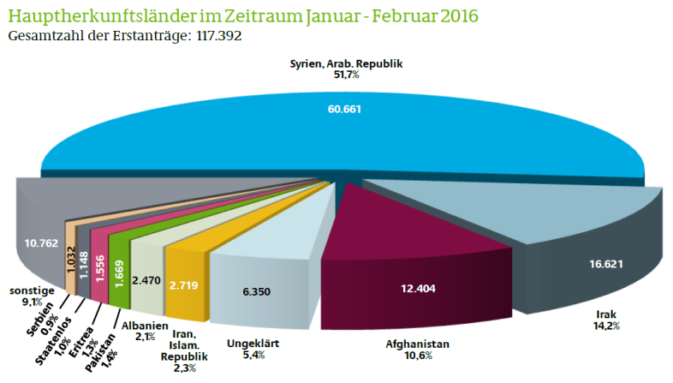
Immigration in Germany
There has always been immigration in Germany
But in 2015 1 million people came to Germany

Slide 6
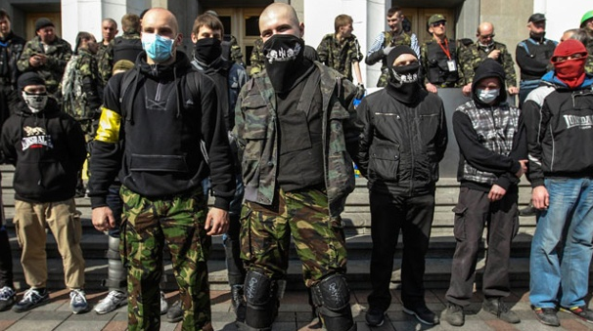

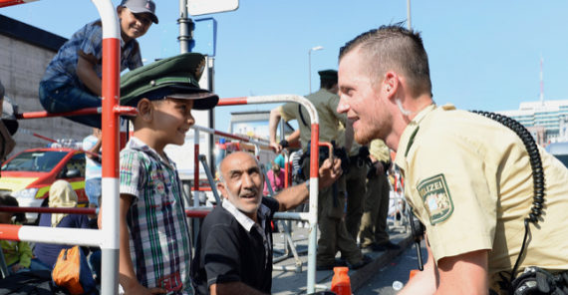
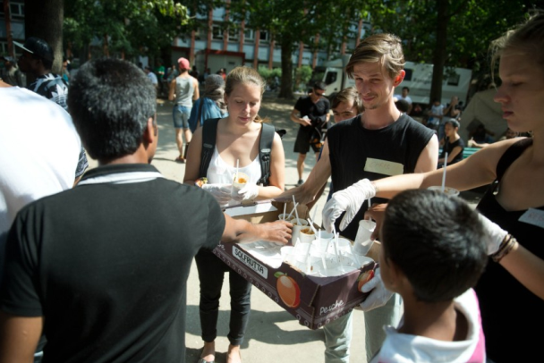
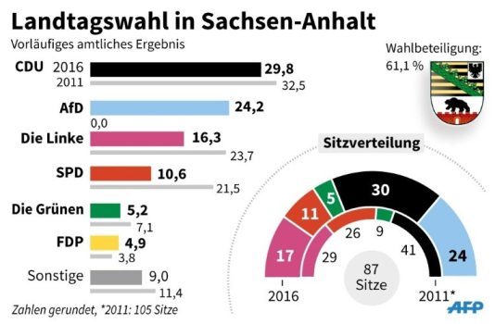
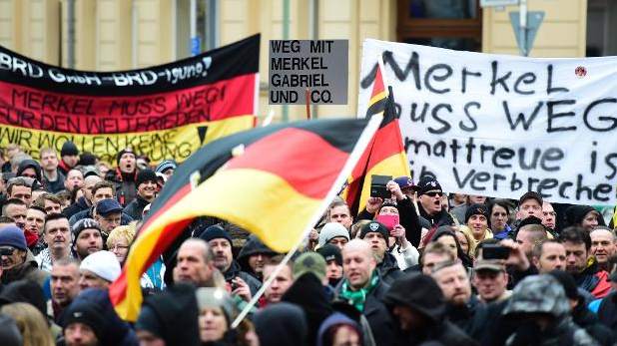
Reactions of the Germans
Huge amount of people (over 2700 each day)
Open borders
No pass controls
The country is divided (a lot of rumors & a lot of incidents [harassment in Cologne, refugee brawls])

Slide 7
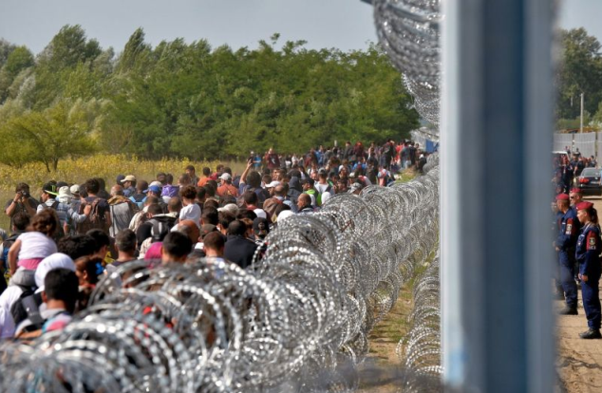
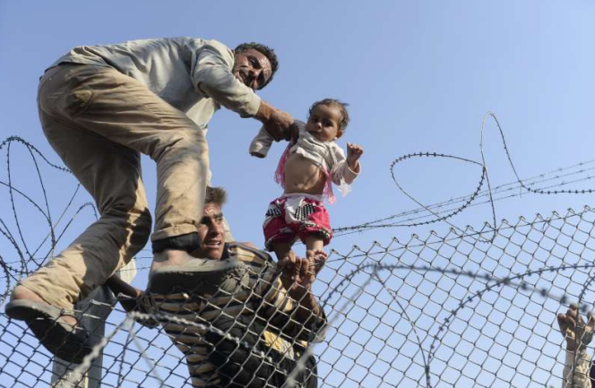
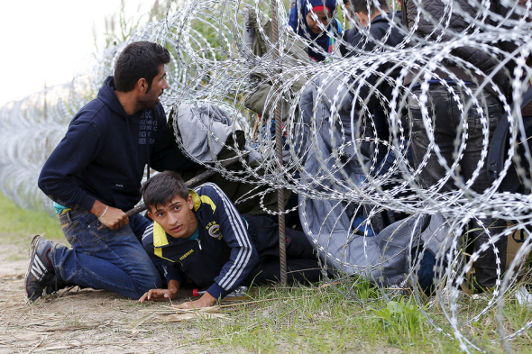
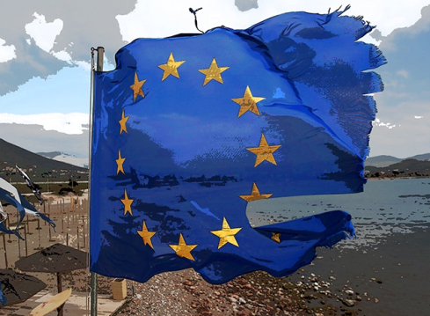
Reactions from other countries
Sweden also welcomed a lot of refugees
Hungaria & other Balkan route countries built fences
Austria decided to have a ceiling of 37,500 people
Poland and others refuse to accept refugees at all
Not only Germnay is devided but also the EU

Slide 8
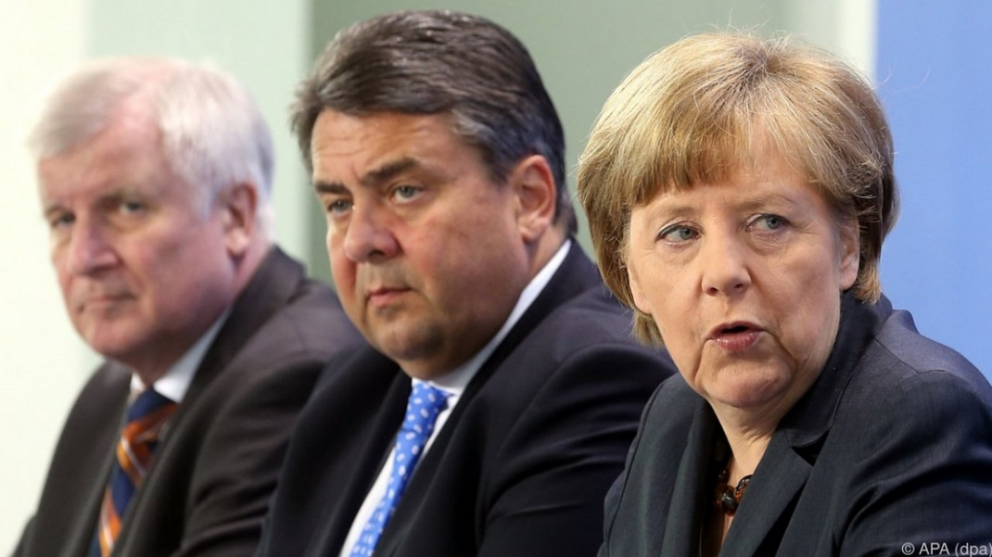
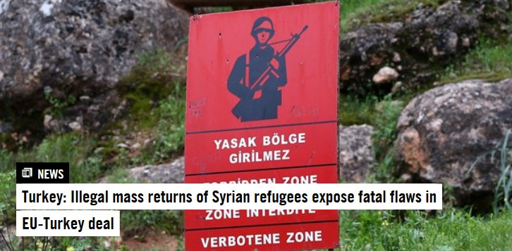
How best to deal with the refugee situation?
What should the German government do in this situation?
Remember: There are elections in 2017 (!)
They already „led“ the EU into a deal with Turkey
But is this the best option?

Slide 9

Live Demo

Slide 10

Thanks

Slide 11
References
https://www.bundesregierung.de/Webs/Breg/DE/Themen/Fluechtlings-Asylpolitik/4-FAQ/_node.html?id=GlossarEntry1671930
https://www.bundesregierung.de/Content/EN/Reiseberichte/2016/2016-03-16-europaeischer-rat-maerz.html?nn=709674
http://www.bamf.de/SharedDocs/Anlagen/DE/Publikationen/Flyer/flyer-schluesselzahlen-asyl-halbjahr-2015.pdf?__blob=publicationFile
http://www.tagesanzeiger.ch/ausland/europa/EU-verpasst-bescheidene-Ziele/story/16331547
https://en.wikipedia.org/wiki/Syrian_Civil_War
http://de.statista.com/statistik/daten/studie/1239/umfrage/aktuelle-arbeitslosenquote-in-deutschland-monatsdurchschnittswerte/
http://de.statista.com/statistik/daten/studie/1223/umfrage/arbeitslosenzahl-in-deutschland-jahresdurchschnittswerte/
https://www.amnesty.org/en/what-we-do/people-on-the-move/
http://www.welt.de/politik/deutschland/article146452109/Die-Fluechtlingskrise-aus-der-Perspektive-des-Jahres-2017.html
http://www.handelsblatt.com/politik/deutschland/fluechtlinge-in-deutschland-bayern-bereitet-sich-auf-moegliche-grenzschliessung-vor/13025054.html
http://www.handelsblatt.com/politik/deutschland/gastbeitrag-von-dagmar-woehrl-fuenf-schritte-zur-loesung-der-fluechtlingsfrage/11678706.html
http://www.lpb-bw.de/fluechtlingsproblematik.html
http://info.kopp-verlag.de/hintergruende/geostrategie/michael-morris/das-fluechtlingsdrama-laeuft-nach-plan-auf-dem-weg-in-die-neue-weltordnung.html
http://info.kopp-verlag.de/hintergruende/deutschland/peter-harth/deutschlands-fluechtlingsproblem-das-schweigen-ueber-die-importierte-gewalt.html
http://www.zeit.de/politik/ausland/2016-01/fluechtlingspolitik-oesterreich-reinhold-mitterlehner-beschraenkung
http://www.focus.de/politik/deutschland/asylpolitik-im-vergleich-so-gehen-andere-laender-mit-fluechtlingen-um_id_4866879.html
http://www.zeit.de/politik/ausland/2016-03/eu-gipfel-tuerkei-abkommen-fluechtlinge-angela-merkel

