Slide 1
DMCE Final Project Strategies to Defeat ISIS
Chris Sproull, Andrew Hazlett
April 19, 2016

Slide 2
Background on ISIS - Past
Institutional voids and power vacuums have taken on great significance in Iraq and Syria
Arab Spring
Controversial Governments
Radical Islamists in the area took advantage, winning many people’s support
A terrorist group was formed to create a strict Islamic State in a significant part of Iraq and Syria
Named for this goal: ISIS – The Islamic State in Iraq and Syria
This group become infamous for radical tactics
Even other terrorist organizations like Al Qaeda have criticized them
ISIS has launched strikes to take much ground in these two countries
They have been largely successful in taking territory, most notably Iraq’s second largest city of Mosul

Slide 3
Background on ISIS - Present
At present they continue to hold much land and call themselves a legitimate government
Established a de facto capital in the Syrian city of Raqqa
Provide their forms of government services
ISIS sustains itself through very strong cash flows in the form of oil and other seized assets
Uses the black market to facilitate its efforts
It has shifted its sites to global influence, planning and encouraging terrorist attacks in other countries
ISIS is believed to have been responsible for many human rights atrocities over the years, along with a ballooning humanitarian crisis

Slide 4

What to do?
Photo Credit: http://screenrant.com/captain-america-civil-war-iron-man-bleeding-edge-armor/

Slide 5
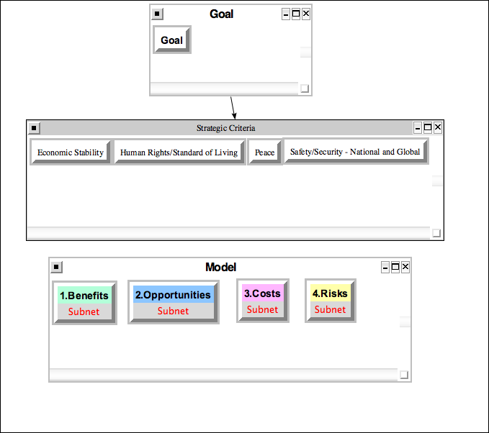
Model At A Glance

Slide 6
Alternatives
Military and/or covert action
Empowerment of those living in the area
Economic warfare
Supporting the local governments already in power
Global alignment and cooperation of people and governments against ISIS

Slide 7
Interested Parties
China, Russia, and United States
Europe
Middle East
Local Inhabitants

Slide 8
Benefits
Human rights advances
Increased safety and security
A better chance for the local political processes to work
Elimination of financial costs associated to contend with ISIS
Time and resources freed up to deal with other pressing issues

Slide 9
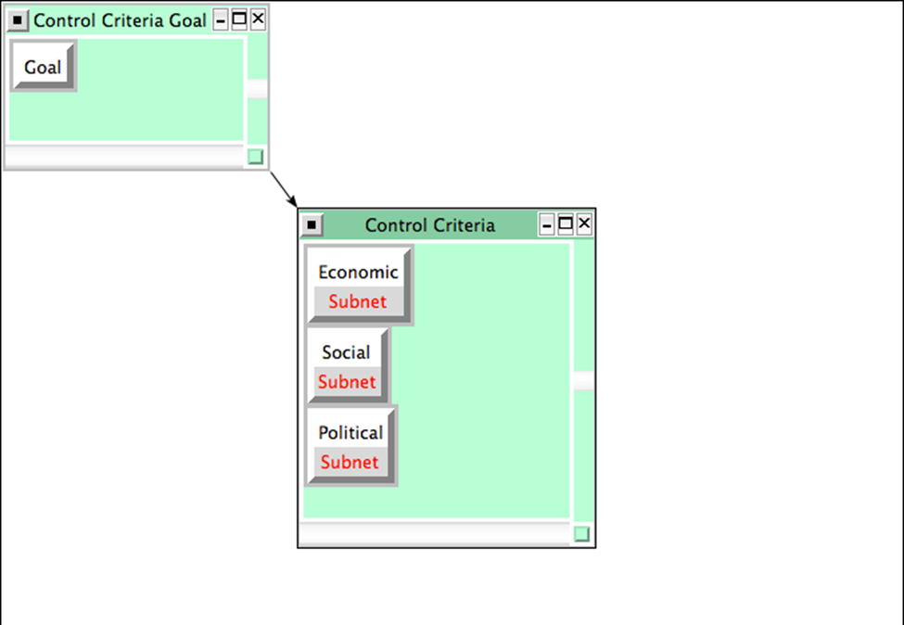
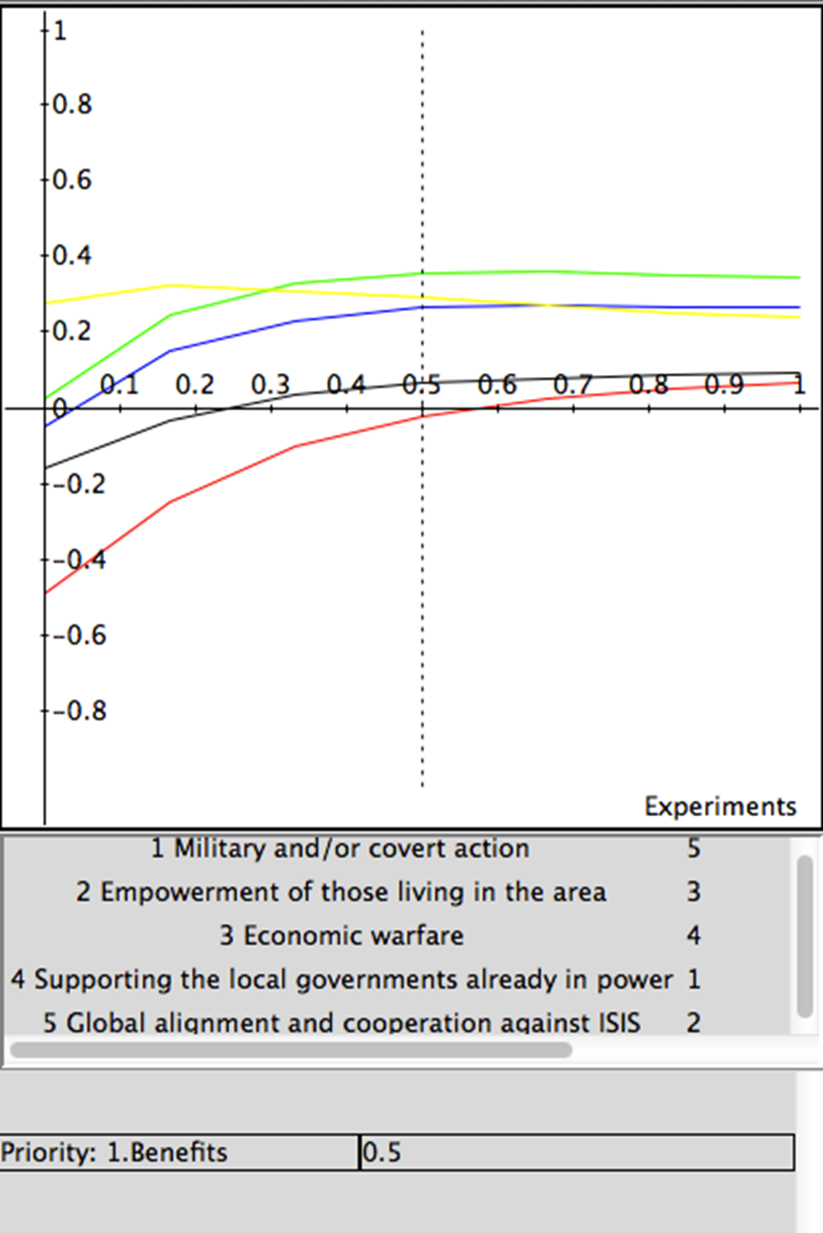
Benefits subnet and sensitivity

Slide 10
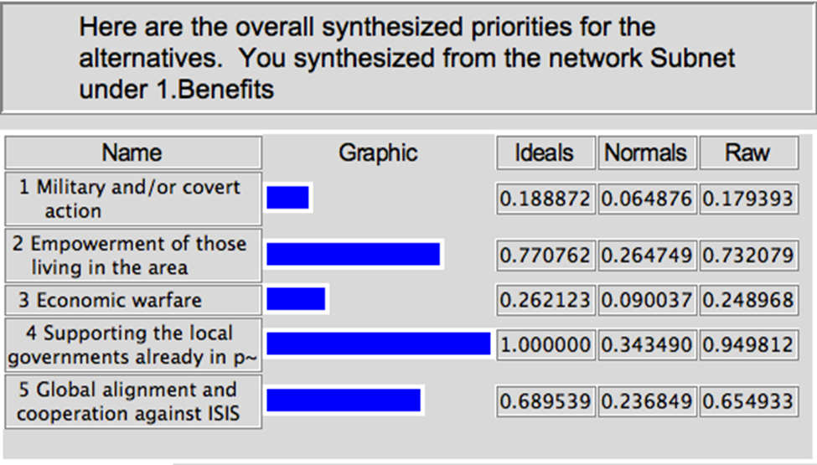
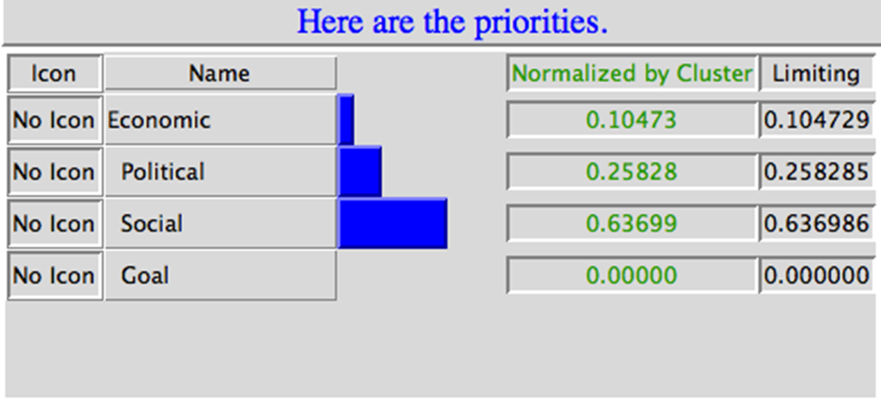
Benefits Results

Slide 11
Opportunities
Integrating more countries safely
Better understanding among those in the Middle East
Better global political cooperation
A gateway for getting rid of all terrorism
World peace

Slide 12
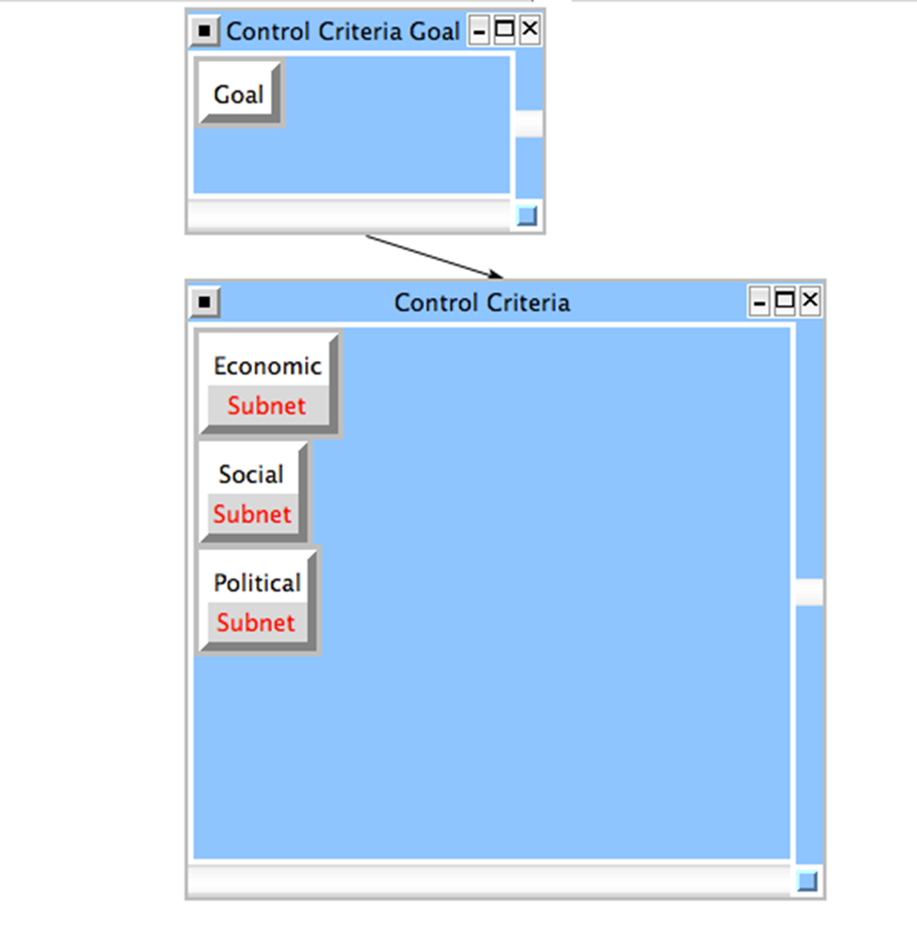
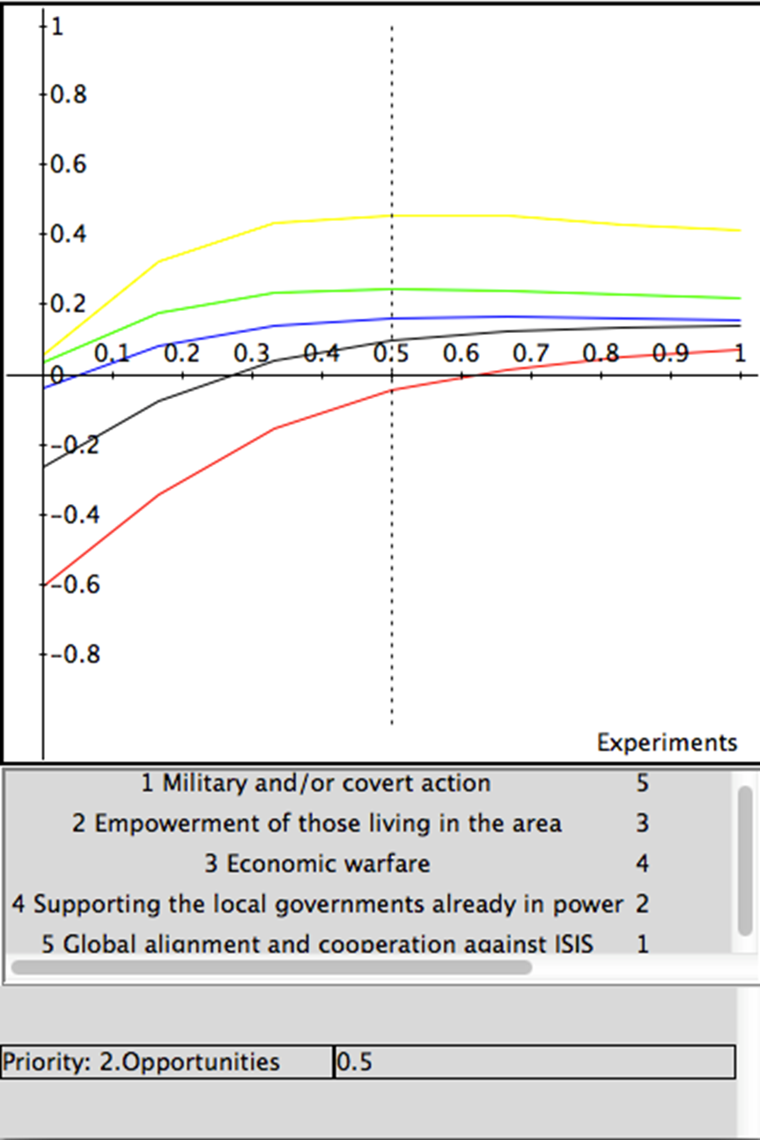
Opportunities Subnet and sensitivity

Slide 13
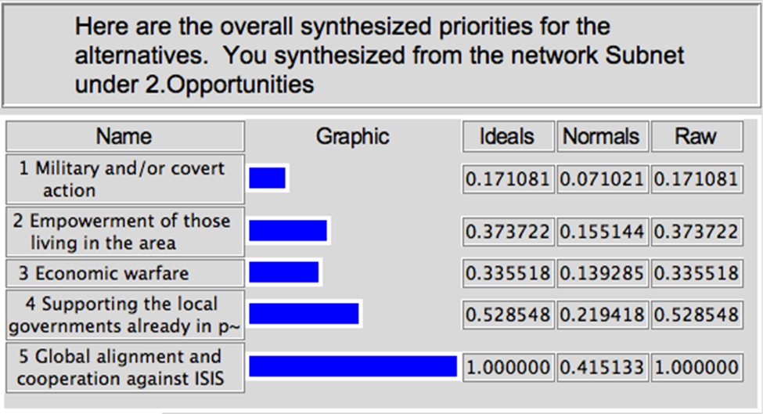
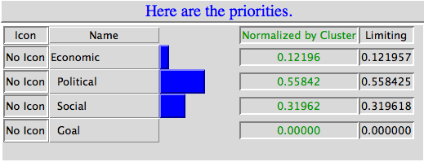
Opportunities results

Slide 14
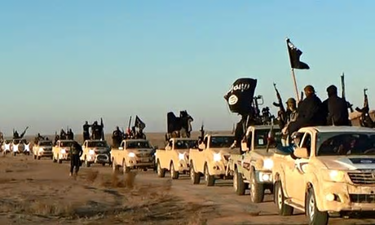
Costs
Likely collateral damage
Financial impacts
Retaliation from ISIS
Casualties of troops
Political tensions
Photo Credit: http://www.theguardian.com/world/2014/jun/11/isis-too-extreme-al-qaida-terror-jihadi

Slide 15
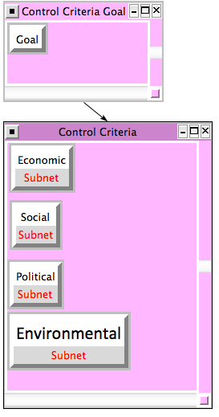
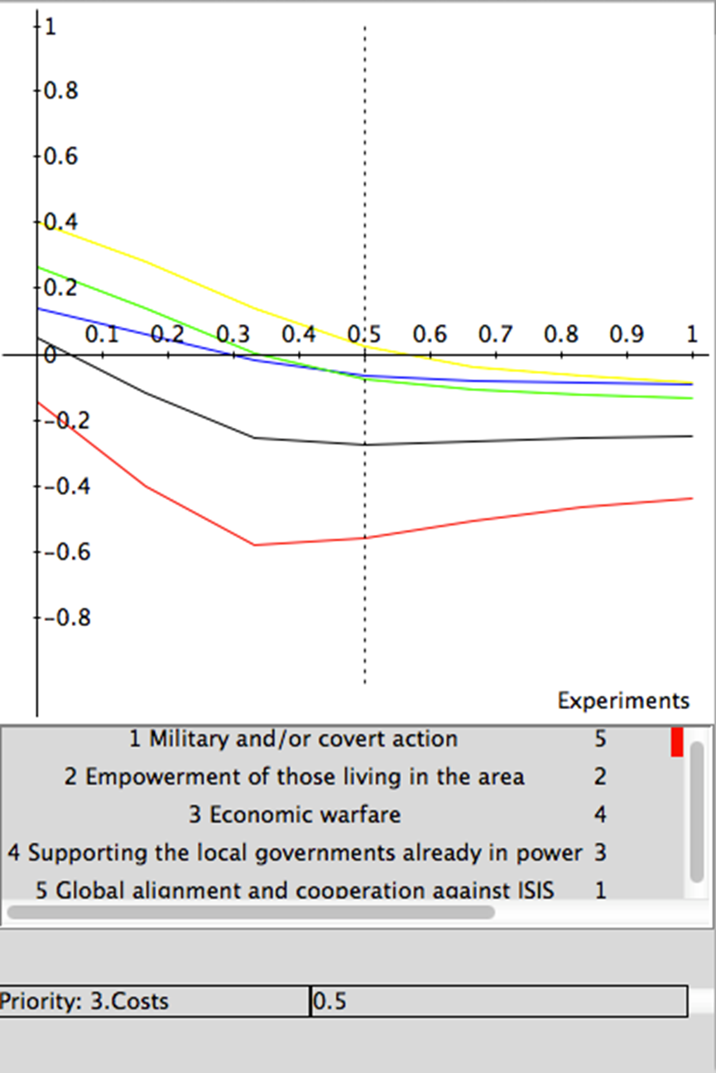
Costs Subnet and sensitivity

Slide 16
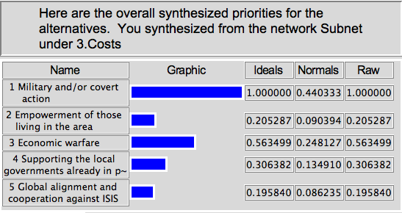
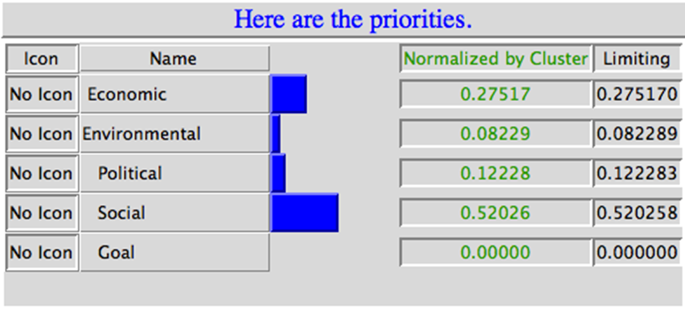
Costs results

Slide 17
Risks
Worsening public sentiment against those pursuing solutions
Egregious human rights violations
Increased despotism in the Middle East
Continuing power vacuum and/or institutional voids
Worsening relationships with Islam and the Middle East
Increased support for ISIS
Making enemies of impacted parties

Slide 18
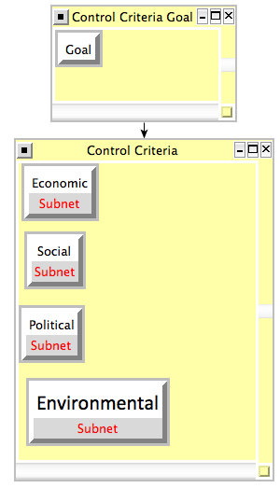
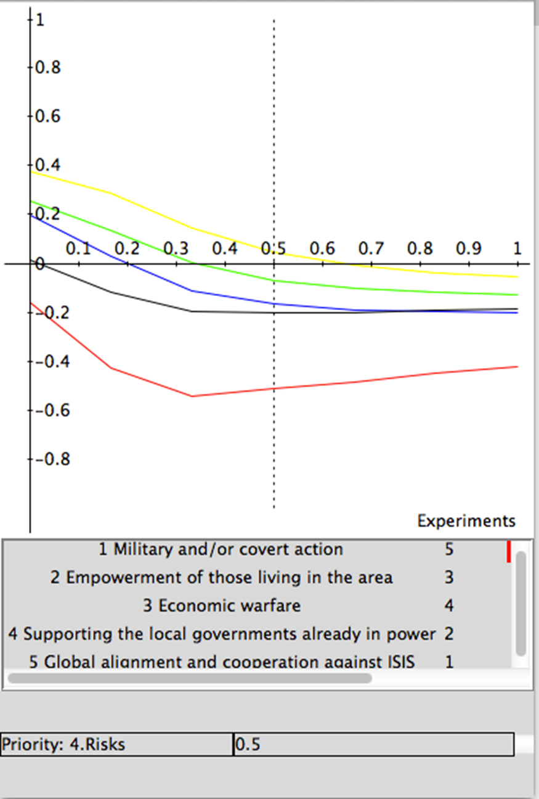
Risks Subnet and sensitivity

Slide 19
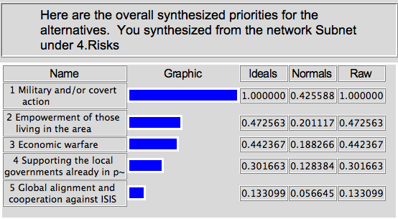
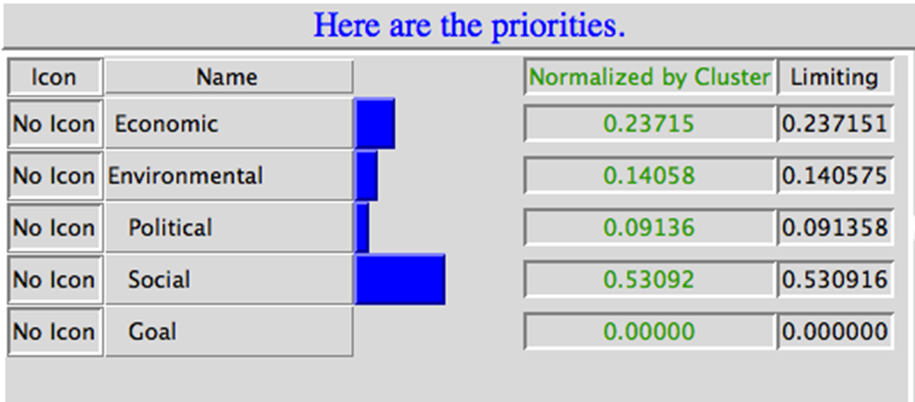
Risks results

Slide 20
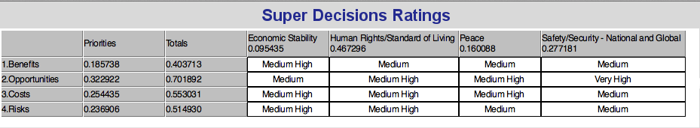
Strategic Criteria
Economic Stability
Human Rights/Standard of Living
Peace
Safety/Security – National and Global

Slide 21
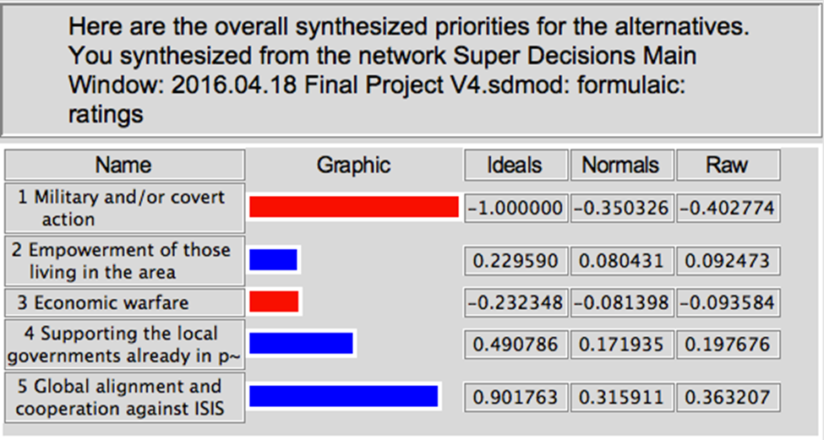
Overall Decision - Additive

Slide 22
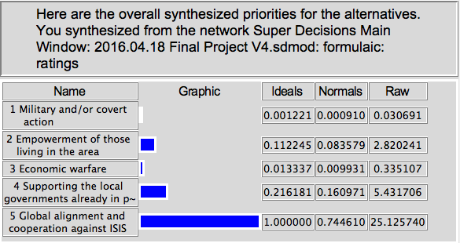
Overall Decision - Multiplicative

Slide 23
conclusion
The safest approach is global alignment and cooperation against ISIS
This is primarily due to Benefits and Opportunities
Not surprisingly, military and/or covert action was the least favorable alternative
There were significant Costs and Risks because of the interest parties, lives lost, economic hardship into a war, and environmental consequences
Supporting the local governments already in power looks to be the next best result as that can boast the fight to drive ISIS out of these countries, especially with the backing with a global force and alignment.
With these results in mind, the safest approach is to align the globe against and to cooperate against ISIS by supporting the governments in power to drive them from their land and from power

Slide 24
Questions
?

Slide 25
References
Bartlett, E. (2015, December). 10 alternative ways to defeat Isis that aren't air strikes. In indy100. Retrieved from http://indy100.independent.co.uk/article/10-alternative-ways-to-defeat-isis-that-arent-air-strikes--WknFKxYmqg
Burke, J. (2015, November 30). Truth bombs: eight alternatives to airstrikes on Isis. Retrieved from http://www.theguardian.com/world/2015/nov/30/eight-alternatives-airstrike-isis-syria
Katzman, G. (2015, August 22). Captain America: Civil War: Iron Man to Use Bleeding Edge Armor?. In ScreenRant. Retrieved from http://screenrant.com/captain-america-civil-war-iron-man-bleeding-edge-armor/
Terrorist Bombings Strike Brussels: What We Know (2016, March 22). In NPR. Retrieved from http://www.npr.org/sections/thetwo-way/2016/03/22/471391497/what-we-know-terrorist-bombing-at-brussels-airport
Tran, M. (2014, June 11). Who are Isis? A terror group too extreme even for al-Qaida. In The Guardian. Retrieved from http://www.theguardian.com/world/2014/jun/11/isis-too-extreme-al-qaida-terror-jihadi

