Slide 1
MUNICIPAL PARK UPGRADES
September
2020
Steve Kralik

Slide 2
Community Background
Peaceful, suburban area that is further from city, but still within driving distance.

Slide 3
Park Background
Currently a well-maintained park in small suburban area.
There are crushed stone walkways, tennis court, volleyball court, pond, ball field, pavilions, etc.
Township requesting input on upgrading local park to include paved walkways, gazebos (weddings), nature trails, amphitheater, etc.
MISSION: Create recreation areas while fostering safe and orderly development and long-term future growth of the community.

Slide 4
Decision Point
Perspective: Township Officials
Alternatives:
  Upgrade the park with their initial proposed changes.
    Amphitheater, wedding gazebo
  Upgrade the park, but with only non-invasive upgrades
    Paved trails, exercise stations
  Not upgrade the park at all
    Maintain status quo
Should the township update the municipal park?
Should the township update the park?
A1:
Full upgrade
A2:
Partial upgrade
A3:
No upgrade

Slide 5
Strategic Criterion
Community Development, Neighborhoods, Township Impact, Political Impact, Security
Community Development
Political Impact
How changes will contribute to current community and make it better (affects residents: make them healthier, etc.)
How will upgrades affect a candidate’s political campaign platform.
Neighborhoods
Security
Changes may have ripple effects on surrounding areas (neighboring areas)
Will additions bring in additional outside visitors and lead to the need to additional police presence?
Township Impact
Effects on stores and any increased traffic.

Slide 6
Control Criteria
Benefits
Opportunities
Costs
Risks

Slide 7
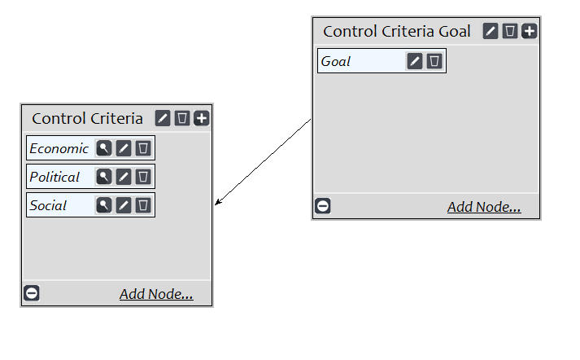
Benefits
Subnetworks:
  Economic
  Political
  Social

Slide 8
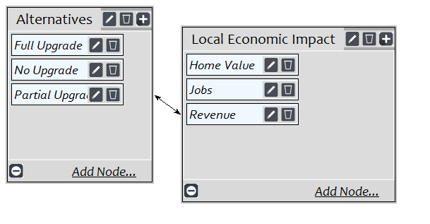
Benefits: Economic
Home value
Jobs
Revenue
Notes:
Revenue- increased revenue in the township

Slide 9
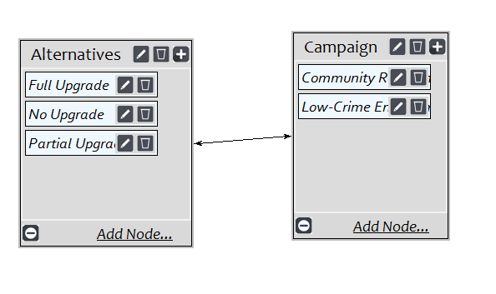
Benefits: Political
Community relations
Maintaining a relatively low- crime environment

Slide 10
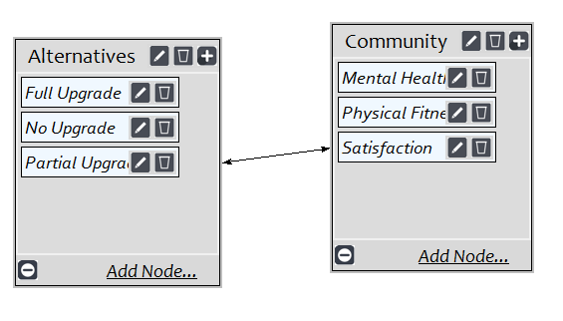
Benefits: Social
Mental Health
Physical Fitness
Community Satisfaction

Slide 11
Opportunities
Subnetworks: Economic, Political, Social

Slide 12
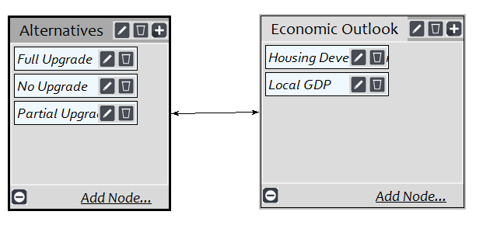
Opportunities: Economic
Housing Development
Local Gross Domestic Product (GDP)

Slide 13
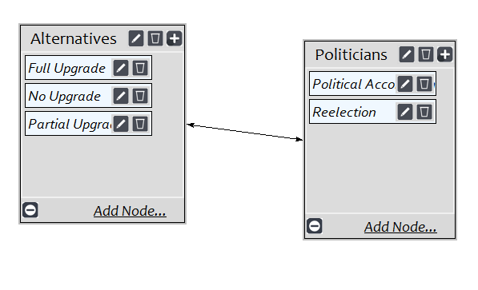
Opportunities: Political
Political Accomplishments
Reelection

Slide 14
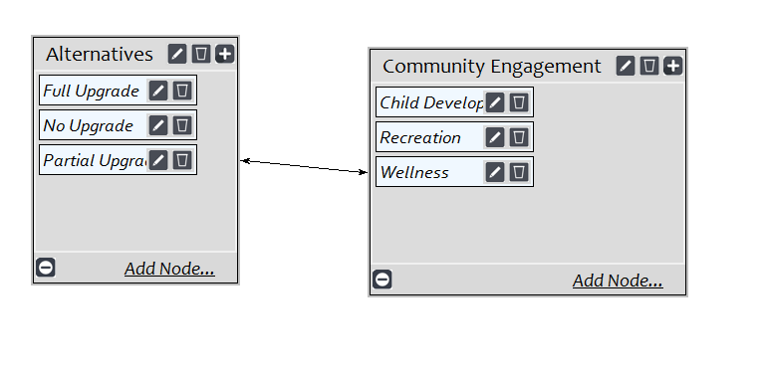
Opportunities: Social
Childhood Development
Recreation Quality
Improved Wellness

Slide 15
Costs
Financial

Slide 16
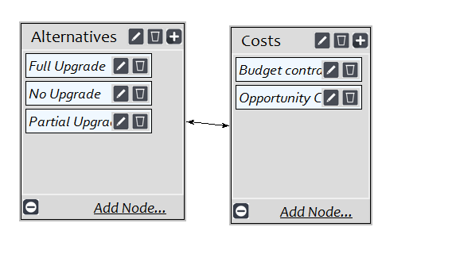
Costs: Financial
Budgeting Constraints
Opportunity Costs -i.e. Dollar spent on this park upgrade is a dollar not spent on another upgrade

Slide 17
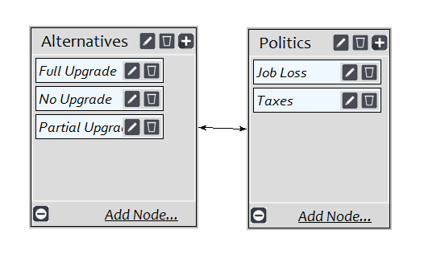
Costs: Political
Job Loss
Taxes

Slide 18
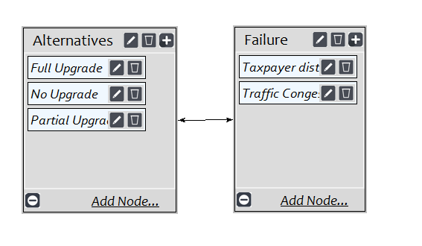
Costs: Social
Taxpayer Distrust
Traffic
Notes:
Altered traffic patterns

Slide 19
Risks
Financial

Slide 20
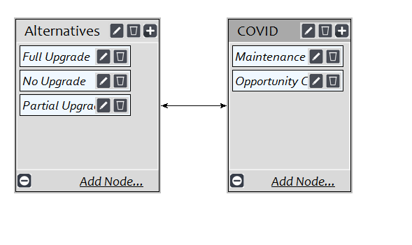
Risks: Financial
Maintenance Costs
Longer-Term Opportunity Costs
  May arise since we are unable to know how long the COVID-19 budgetary constraints will last.

Slide 21
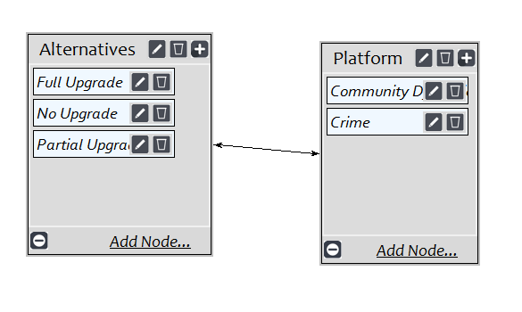
Risks: Political
Community Dynamics
  Transforming the park into something that does not align with the community image.
Crime

Slide 22
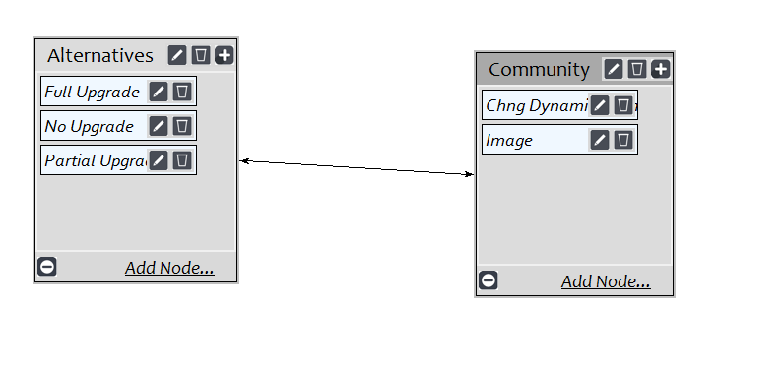
Risks: Social
Changing Dynamics
  More people visiting the park for large events.
Park Image
  Commercialized park

Slide 23
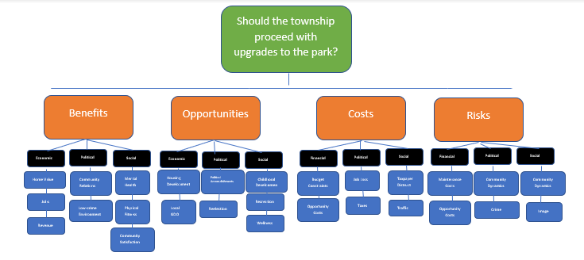

Slide 24
FINAL RESULTS

Slide 25
Final Results
BOCR highly influenced by economic & financial factors.
Benefits- Full Upgrade
  revenue & job creation are highly influential on economic impact | Priority of 0.637
Opportunities- Full Upgrade
  Local GDP opportunities greatly benefit economic impact | Priority 0.627
Costs- No Upgrade
  Opportunity cost |Priority 0.465
Risks- Full Upgrade
  Financials outweigh both the political and social risks associated with transforming the park | Priority 0.743

Slide 26
Ratings
Opportunities and Risks
  Top priority (.29 and .30) are the most important to the township officials.
  Opportunities
    Community Development
    Township Impact
  Risks
    Political Impact
    Security
Benefits and Costs
  Lower short-term priority
Notes:
Opportunities and Risks about equal priority; L/T control criteria prevailed- opps had good influence on comm development and township impact, while risks were strongly associated for political impact and security.

Slide 27
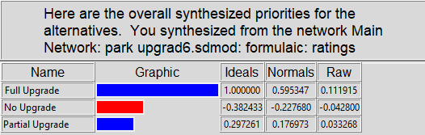
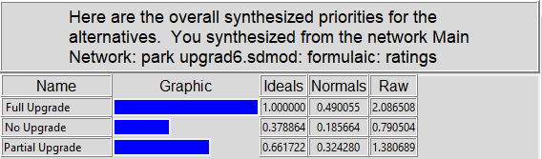
Synthesized Results
Short-Term

Slide 28
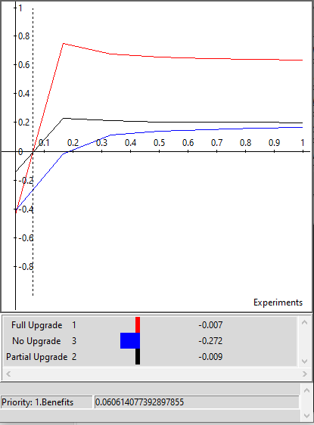
Sensitivity Analyses: Benefits
If benefits have a low priority, Partial Upgrades is the best option, however, as more importance is placed on benefits, the full upgrade is clearly the best option at the 6% level and remains the best option thereafter.

Slide 29
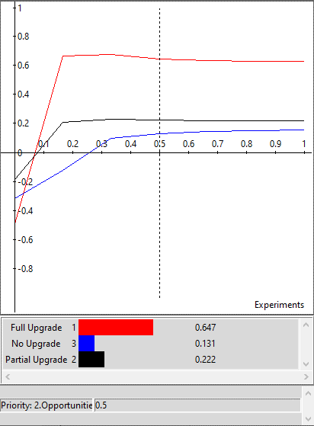
Sensitivity Analyses: Opportunities
Similarly to the benefits sensitivity analysis, at low levels of opportunity priority, partial upgrade is the best option, but after about 7.5%, the Full Upgrade is overwhelming the best options for all levels thereafter.

Slide 30
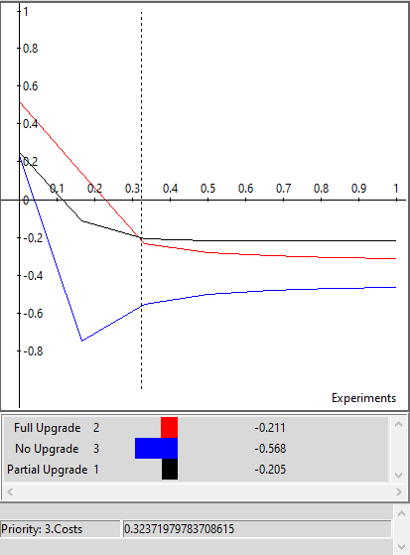
Sensitivity Analyses: Costs
As costs becomes more significant, the partial upgrade becomes the better option to the township officials. This can be seen just past the 30% level. This is most likely expected because the partial upgrade is the minimally invasive option.

Slide 31
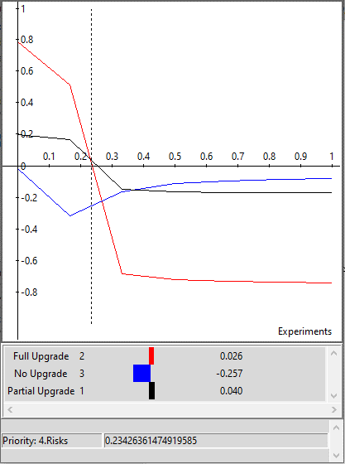
Sensitivity Analyses: Risks
As risk becomes a higher priority, the Full Upgrade option becomes much less desirable very quickly, and the partial upgrade becomes the best option. As the priority for risk increases, or put another way, the township’s tolerance for risk decreases significantly, then the No Upgrade option becomes the most appropriate.

Slide 32
Summary

Slide 33
References
https://penntwp.org/about/
https://www.bestplaces.net/city/pennsylvania/penn_township_(westmoreland_cnty)
www.census.gov
https://statisticalatlas.com/county-subdivision/Pennsylvania/Westmoreland-County/Penn-Township/Employment-Status
https://pittsburgh.cbslocal.com/2020/02/12/study-two-western-pa-communities-ranked-safest-in-the-state/#:~:text=Westmoreland%20County%27s%20Penn%20Township%20is,nonexistent%E2%80%9D%20level%20of%20property%20crime

Slide 34
THANK YOU!

