Slide 1

What Should the City of Pittsburgh do with Regard to the Pittsburgh Penguins’ Mellon Arena?
Dave Dunsavage
Brian Marflak

Slide 2
Overview of Presentation
Introduction / Background
Model
Results
Sensitivity
Conclusion

Slide 3
Introduction
Purpose: To develop an ANP model to determine what the city of Pittsburgh should to with regard to the Penguins’ Mellon Arena, with the following alternatives:
Build New Arena
Refurbish Existing Arena
Keep Existing Arena

Slide 4
Background
Team may leave city due to low revenues
Oldest arena in the National Hockey League
Lacks large number of club seats / luxury boxes
Other teams in PGH have new stadiums
HOK Sport, Inc. hired to study options
Refurbishing arena not viable (no place to play)
New arena was recommended

Slide 5
Background
Historic Status Designation for Arena
Retractable Dome
Deemed unlikely by city legislature
Financial Issues
Public Funding (Taxes)
Private Investment
Government Funding (some $$ allocated)
Cost is estimated to be $270 million

Slide 6
Model
Strategic Criteria set up as:
Financial, Image, Social, and Competitive Adv.
Financial
Increased Revenue, Taxes, Public Debt
Social
Entertainment, Landmark, Activities
Competitive Advantage
Better Players, Retain Players, Higher Payroll

Slide 8
Model
BOCR set up with control criteria
Team, Community, City for each
Interesting Parameters in Network
Increased Jobs
Team Retention (Tourism)
Costs (Public, Ticket, Maintenance)
Attendance
Public Perception

Slide 12
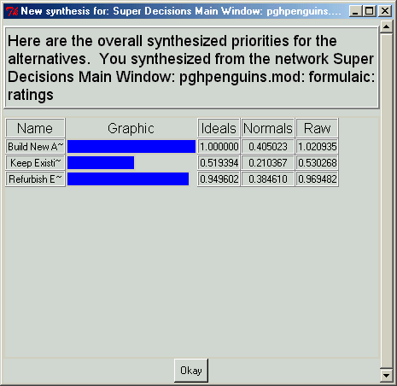
Results
Multiplicative Formula
Small Percentage difference between Build New Arena/Refurbish Existing Arena
Decision could be affected by Human Error within Comparisons

Slide 13
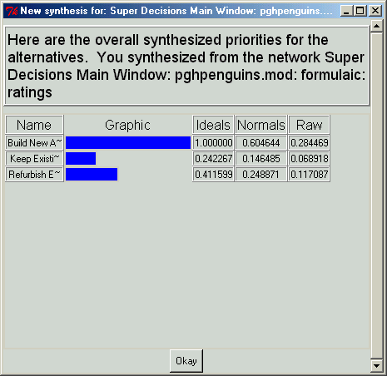
Results
Subtractive Formula
Build New Arena Clear Choice
Keep Existing Arena 46% less favorable option

Slide 14
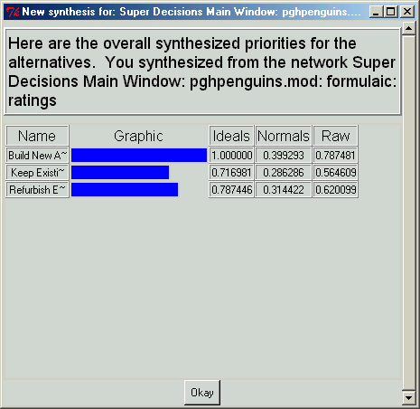
Results
Additive Formula
Build New Arena Optimal Choice
Percentage difference small between all choices

Slide 15
Sensitivity Analysis
Analysis of all factors yield similar results
Full Model Sensitivity confirms “Build New Arena”
“Build new Arena” sensitivity analysis displays a decrease as Benefits/Risks Increase

Slide 16
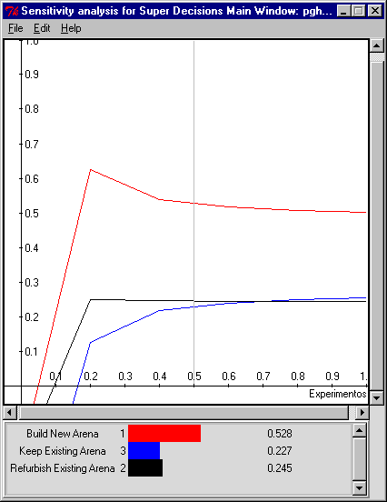
Sensitivity Analysis

Slide 17
Conclusion
All portions of model produce “Build New Arena” choice
Sensitivity analysis confirms the choice of the model
Benefits and Risks adversely impacts the choice of Building a new Stadium
Conclude that Pittsburgh should build the Penguins a new Arena

