Slide 1
ANP BOCR - CHOOSING THE BEST MANUFACTURING FOR A MEDICAL DISPOSABLE PRODUCT
ALTERNATIVES:
Injection molding
Machining
Casting
Extrusion

Slide 2
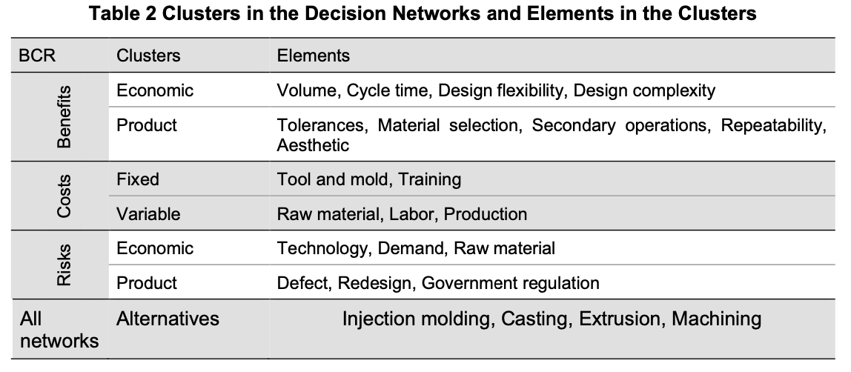
Model – BOCR subnets

Slide 3
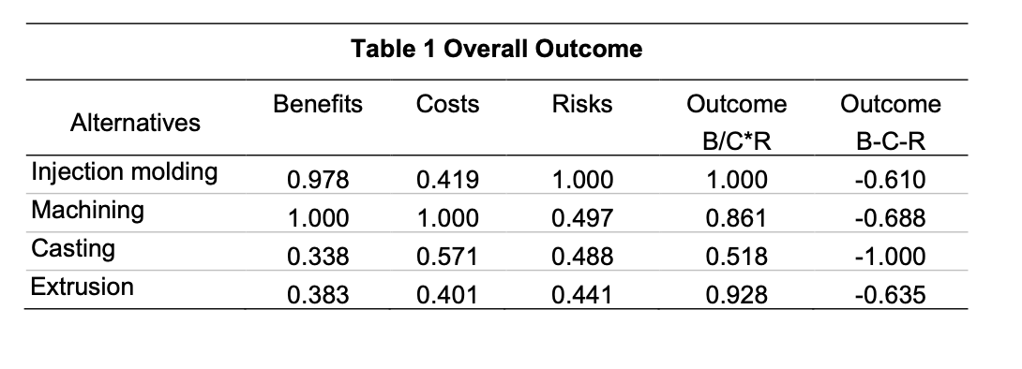
Result

