Slide 1
ANP BOCR - TRAVEL DECISIONS IN THE USA
ALTERNATIVES:
Telecommuting
Auto, High speed rail
Conventional rail
Airline

Slide 2
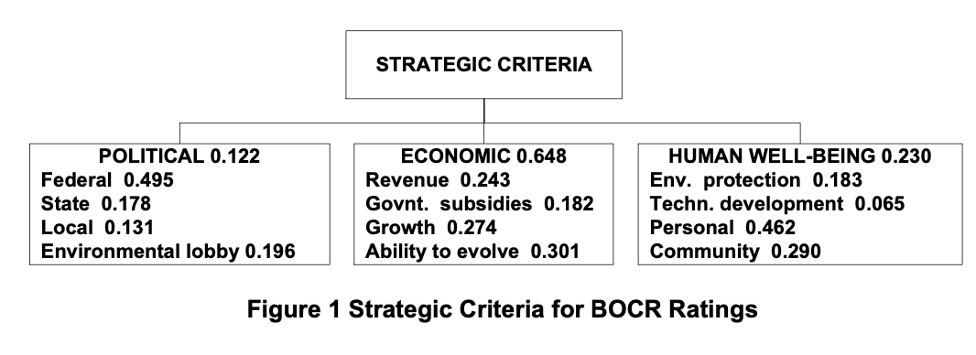
Strategic Criteria

Slide 3
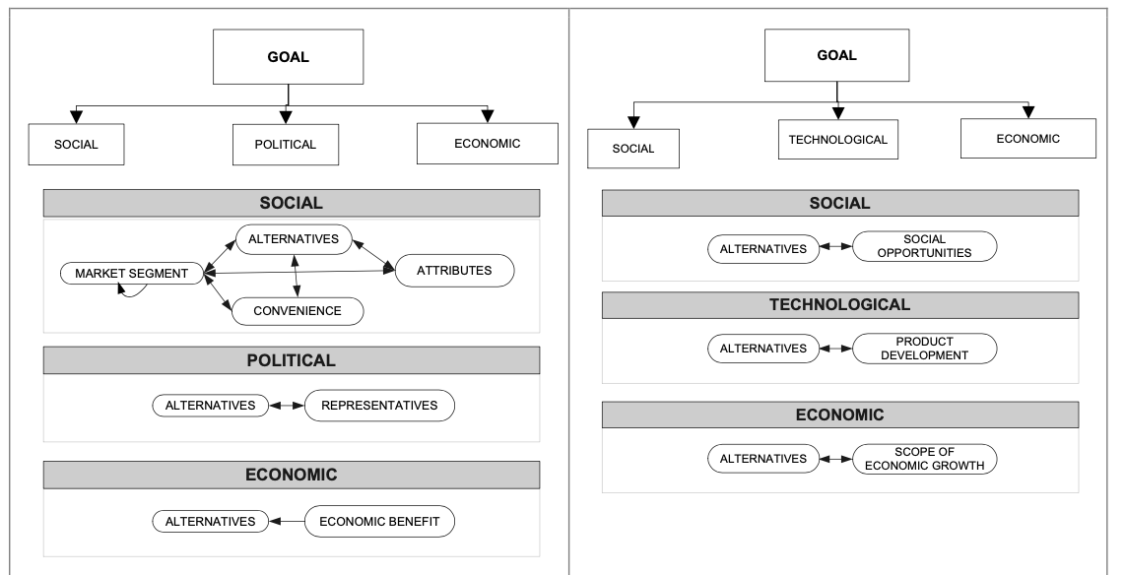
Model – BOCR subnets

Slide 4
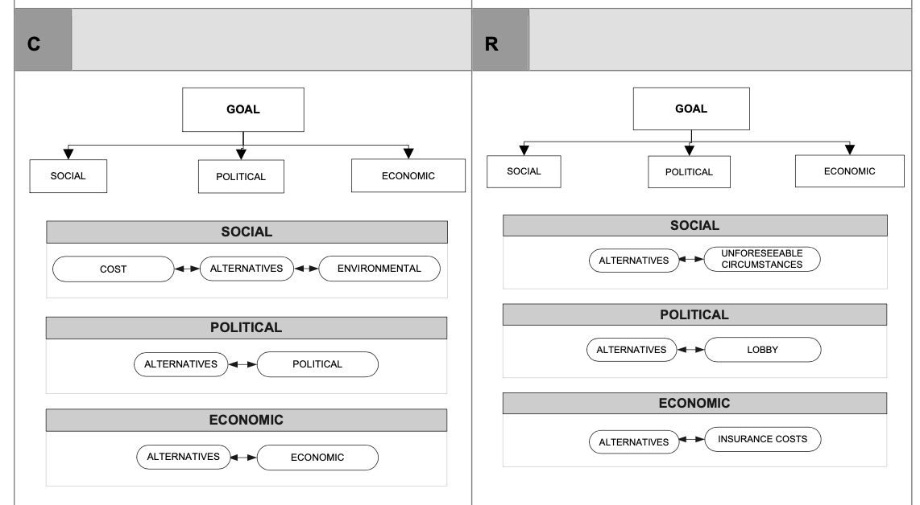
Model – BOCR subnets

Slide 5
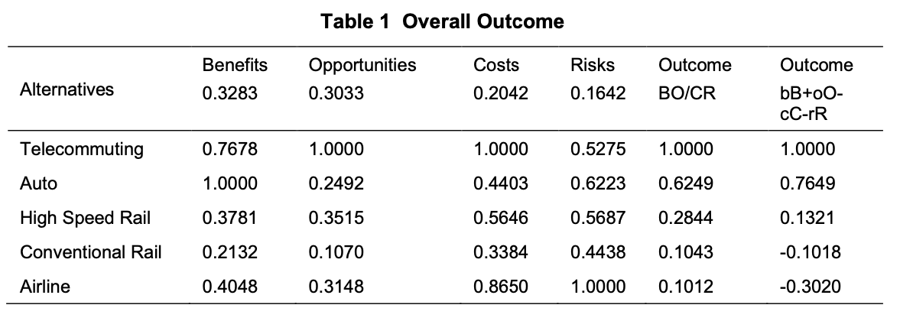
Results

