Slide 1

The relationship between Turkey and the EU
Decision Making in Complex Environments
Mirko Daum and Anna-Maria Hartnagel

Slide 2
Agenda
Introduction
Goal of the Model
Model Overview
Example of a BOCR Network
Synthesized Results for BOCR
BOCR Weight Development
Overall Result

Slide 3
Introduction
Model was created in 2005
What has changed so far:
Economic crisis and question whether Europe has to many countries which drain resources
Elections won by right leaning parties in Europe
Increase in honor killings
Trouble with Iran and Turkey wants to mediate
Still problems regarding Cyprus and Armenia
These events led us to the reassessment of the existing model

Slide 4
Goal of the model
From the point of the existing EU member states, which solution regarding the relationship between Turkey and EU is best?
Affiliate Turkey in the EU
Reject Turkey as EU member
Offer Turkey special partnership.

Slide 5
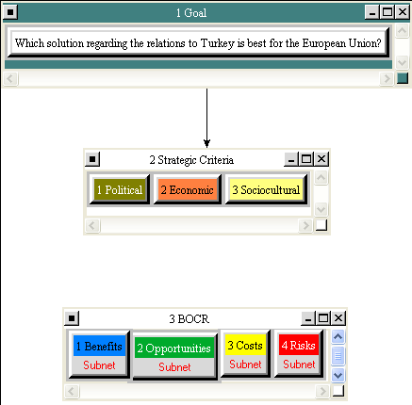
Model Overview

Slide 6
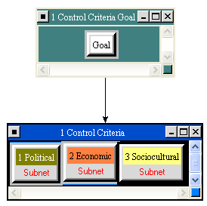
Example of BOCR
Benefit Subnet

Slide 7
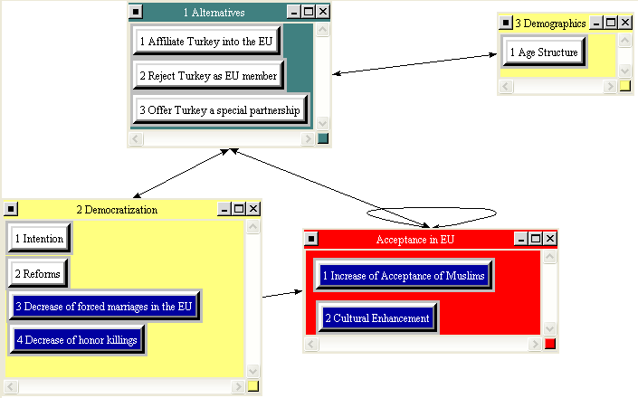
Example of BOCR
Benefit Subnet --> sociocultural
Notes:
Benefit Sociocultural

Slide 8
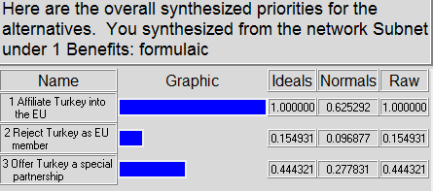
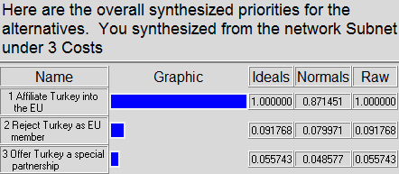
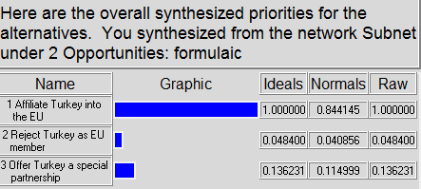
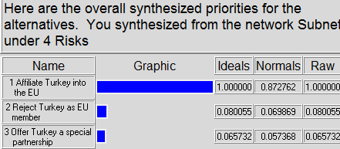
Results of BOCR

Slide 9
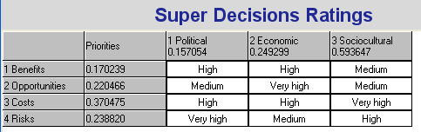
Ratings

Slide 10
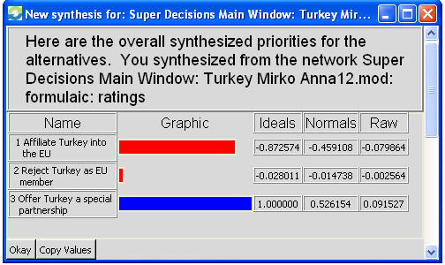
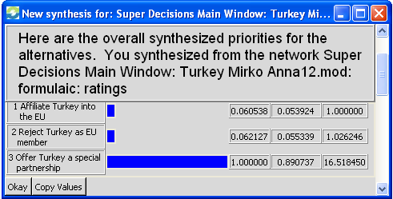
Result

Slide 11
Questions

Slide 12
Thank you for your attention!

Slide 13
Back Up

Slide 14
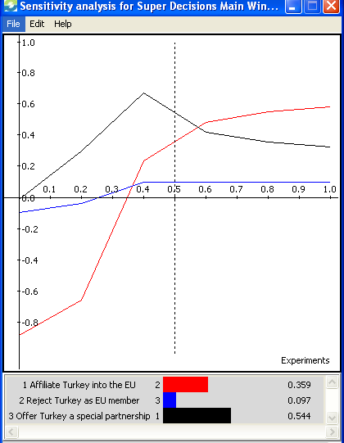
Sensitivity Analysis
Benefit

Slide 15
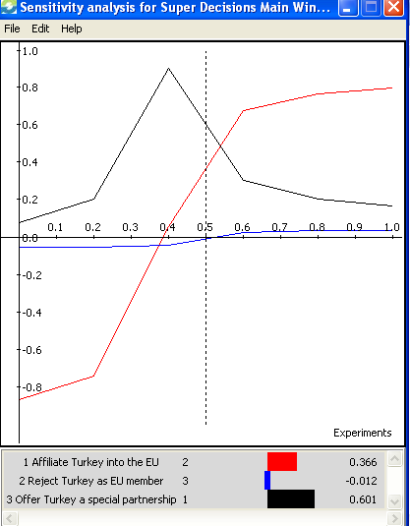
Sensitivity Analysis
Opportunities

Slide 16
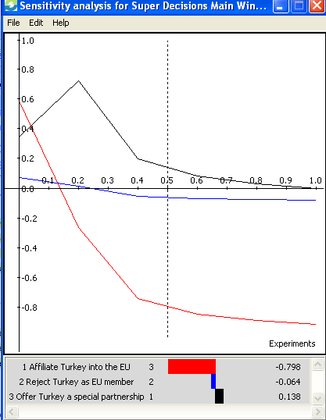
Sensitivity Analysis
Costs

Slide 17
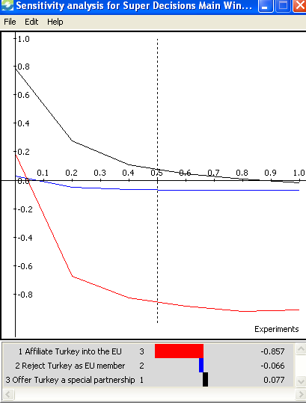
Sensitivity Analysis
Risks

