Slide 1
ANP BOCR - CHOOSING WHETHER OR NOT TO PURSUE PRODUCING VULCANIZED THERMOPLASTIC
ALTERNATIVES:
Pursue TPV
Do not pursue TPV

Slide 2
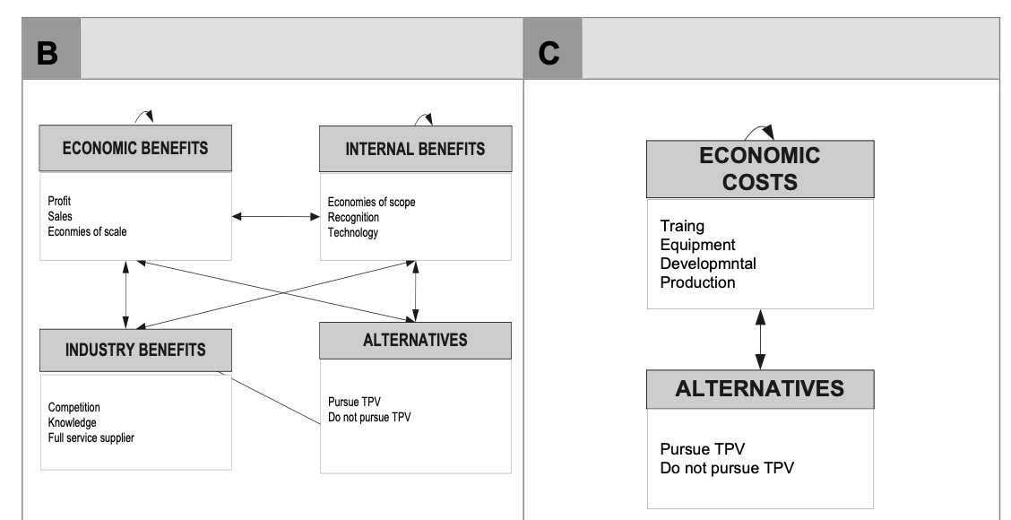
Model – BOCR subnets

Slide 3
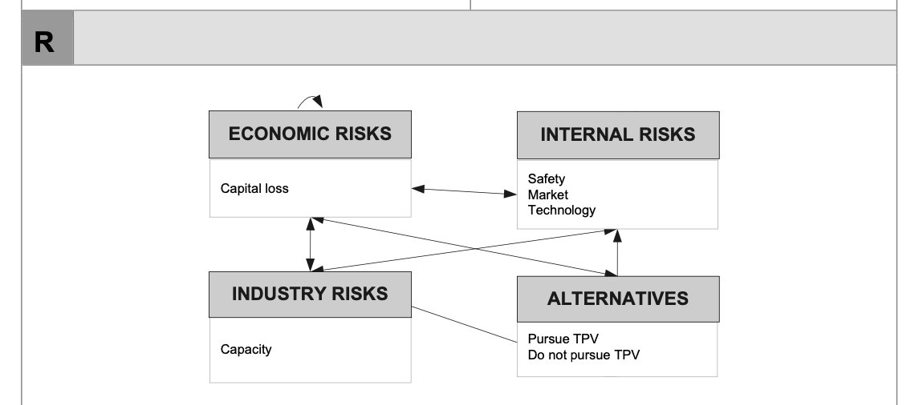
Model – BOCR subnets

Slide 4
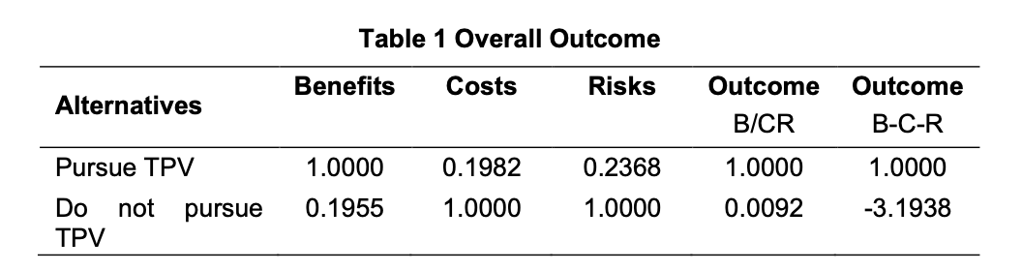
Results

