Slide 1
ANP BOCR - STEM CELL RESEARCH FUNDING
ALTERNATIVES:
Adult SCR
Do not fund
Leftover embryos
Research only embryos

Slide 2
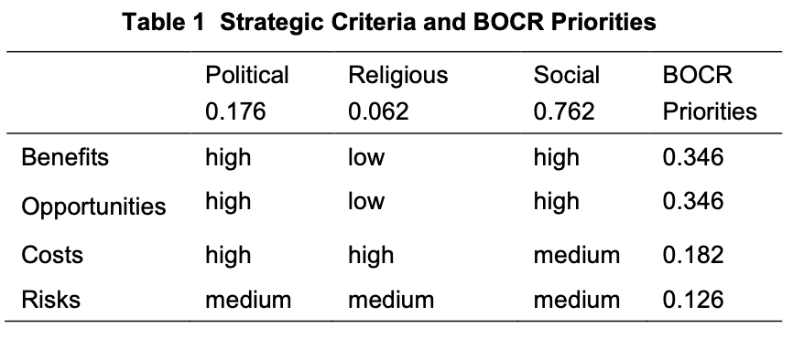
Strategic Criteria

Slide 3
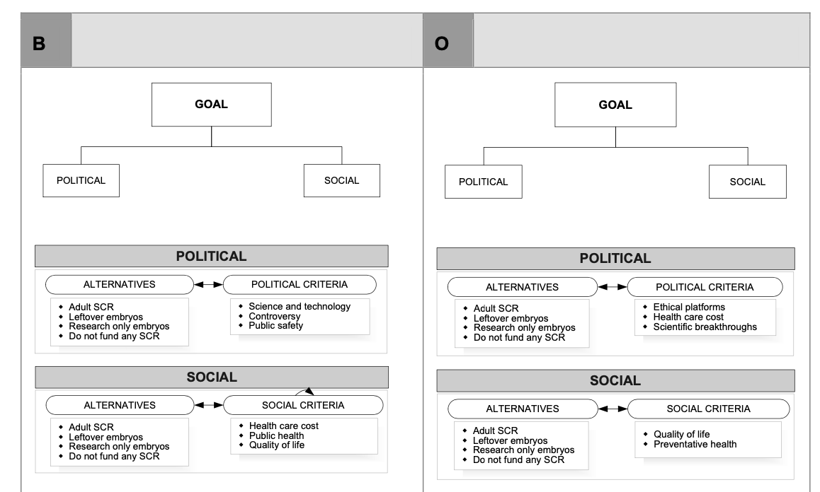
Model – BOCR subnets

Slide 4
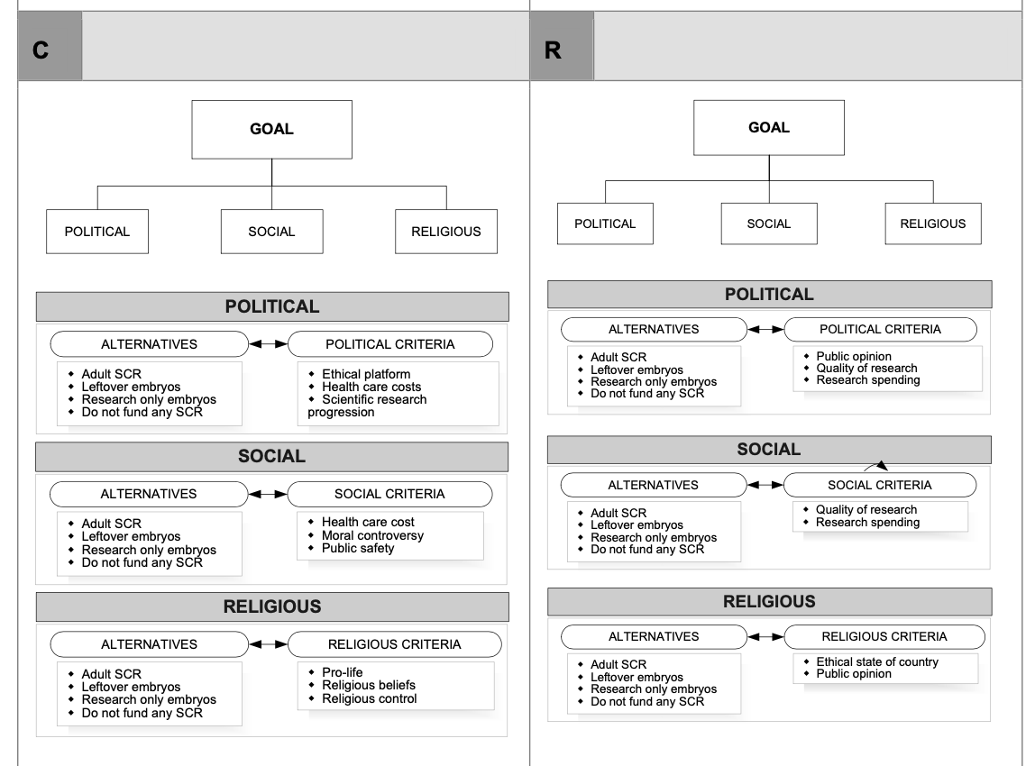
Model – BOCR subnets

Slide 5
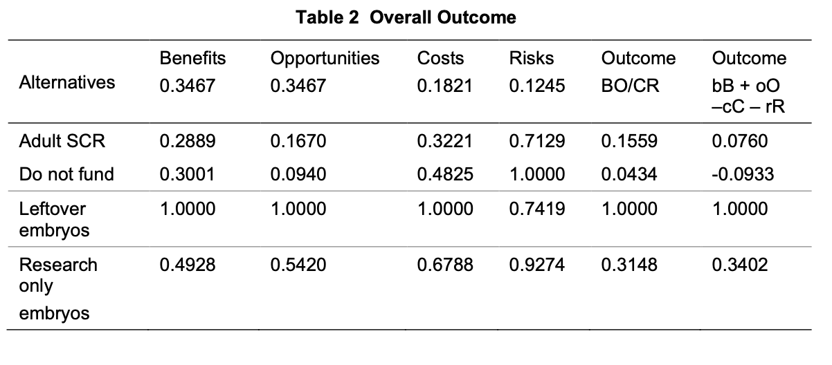
Results

