Slide 1
Capital Budgeting and the AHP
October 6, 2003
David Hackworth
Industrial Engineering Deptartment
University of Pittsburgh

Slide 2

One Parent Company – Three (3) Subsidiaries
Question: How to allocate limited Capital Budget $?

Slide 3

Capital Budgets
Competing projects vie for limited capital resources. Because resources are limited, a methodology must be devised for testing the merit of each project. Traditional allocation methods depend on quantifiable measures of:
NPV
IRR Hurdle Rates
Payback Period

Slide 4
Capital Budgets
Traditional projects contain an expenditure in year 1, followed by a stream of positive cash flows. Resulting projects are then compared with other projects along these quantifiable measures (tangible measures). For example:
These tangible measures are used to make decisions between competing projects.

Slide 5

AHP and Capital Budget Allocations
Capital Budgeting methods often fail to reflect:
Risk of project
Priorities between business units and subsidiaries
Priorities within groups
Discretionary vs. Required projects

Slide 6
AHP and Capital Budget Allocations
Many projects are simply difficult to asses using traditional methods:
Both projects are necessary for the long run survival of the company but can not be put into a “normal” financial return model.
How to decide between these projects (intangibles)?

Slide 7
The Problem: $19.4 Million in Projects $11.5 Million in Capital

Slide 8
The Problem: Lots of Projects

Slide 9
The Old Solution: Meetings, Meetings, Meetings!
Each department head argues for his department’s projects.
Each Company General Manger argues for his company’s projects.
CEO decides whose arguments are best and then creates budget.

Slide 10

“This is no way to run a railroad!”
Methodology for weighing:
Expansion vs. Replacement
Among departments within company
Priorities within department

Slide 11
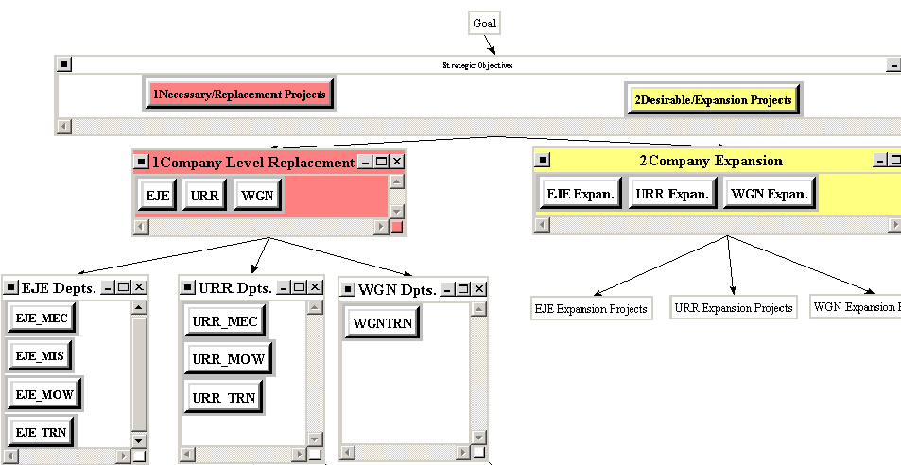
Decision Levels:

Slide 12
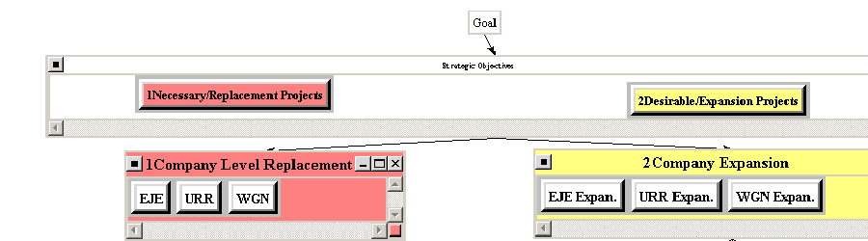
CEO Priorities
Decide between
Expansion and replacement
Between Operating Companies in each category

Slide 13
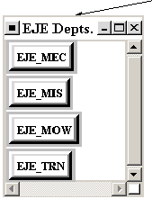
Operating Company General Manger Priorities
Between Individual Departments of Company:
Maintenance of Equipment
MIS
Maintenance of Way
Transportation

Slide 14
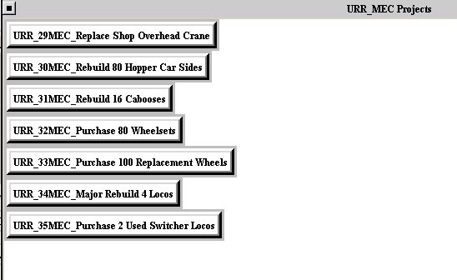
Department Head Priorities
Prioritization of projects within department.

Slide 15
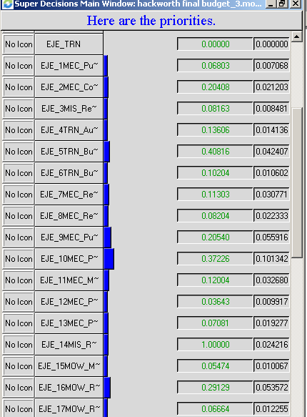
The Results
Prioritization of projects company- wide.
Projects can then be placed into a linear program to maximize effectiveness of available budget.

Slide 16
The Results
Similar projects can have very different results depending on the company, competing projects within the department, rank of department within the company.

Slide 17
The Results
Critical business decision where judgments are often made without formal evaluation of alternatives.
AHP/ANP Creates organization and forces a process upon decision makers.
Very quickly change and adjust priorities as business environment and company situation change.

