Slide 1
ANP BOCR - CHOOSING THE BEST ALTERNATIVE FOR
REDEVELOPING THE WORLD TRADE CENTER
ALTERNATIVES:
Build a memorial to the victims
Rebuild the Twin Towers exactly as they existed
Rebuild the area as commercial property with a memorial included

Slide 2
Model – BOCR subnets

Slide 3
Model – BOCR subnets

Slide 4
Strategic Criteria

Slide 5
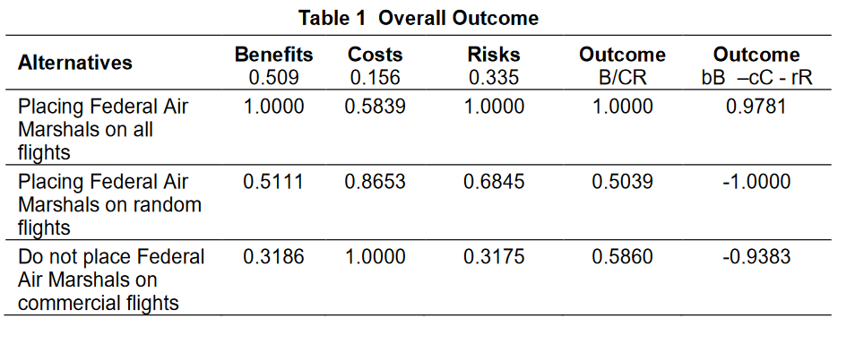
Results

