Slide 1
ANP BOCR - ASSIGNING FEDERAL AIR MARSHALS TO FLIGHTS
ALTERNATIVES:
Placing Federal Air Marshals on all flights
Placing Federal Air Marshals on random flights
Do not place Federal Air Marshals on commercial flights.

Slide 2
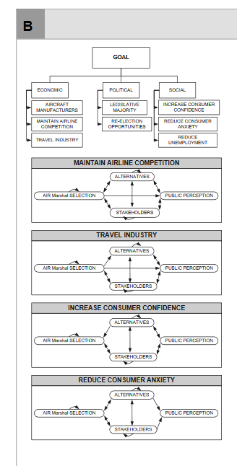
Model-BOCR subnets

Slide 3
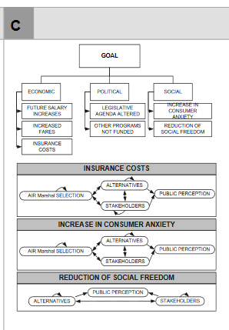
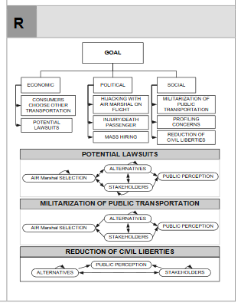
Model – BOCR subnets

Slide 4
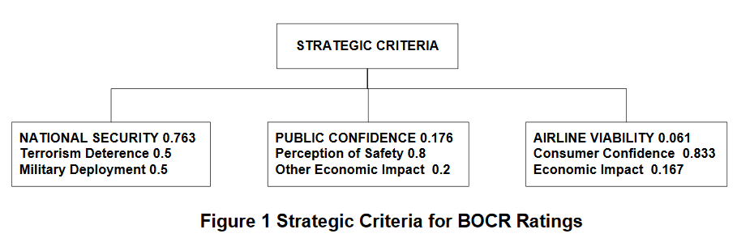
Strategic Criteria

Slide 5
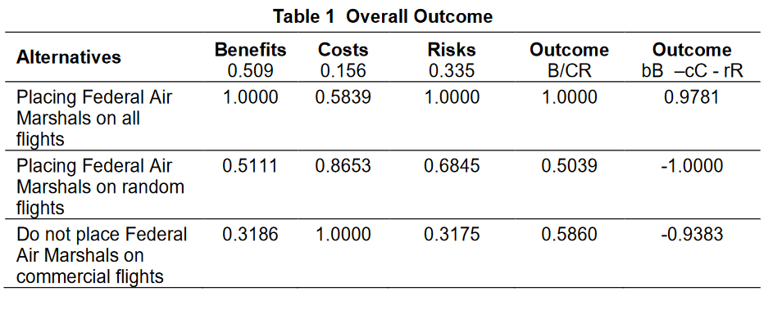
Results

