Slide 1
ANWR
Arctic National Wildlife Refuge

Slide 2
ANWR Situation
ANWR- Arctic National Wildlife Refuge
Size- 19 Million Acres; Area 1002-1.5 Million Acres of Coastal Plain
Protected in 1960-Eisenhower
Land Compromise Carter Admin.
Efforts to Re-open for Exploration- Bush
Counter efforts to stop Exploration

Slide 3
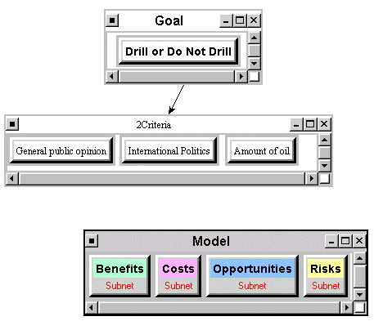
Overview of Model

Slide 4
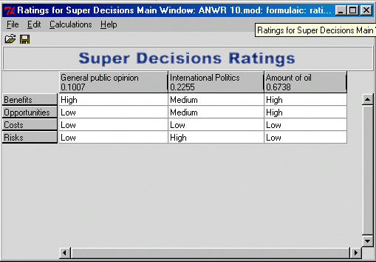
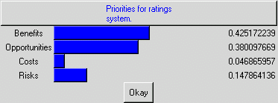
Ratings for BOCR
Ratings
Priorities

Slide 5
Cluster Matrix Overview

Slide 6
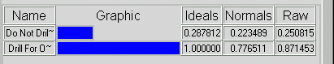
Results
Our Results...
Alaskan Poll Results
Regional

