Slide 1
Should a company outsource its fieldservice function

Slide 2
Overview – The Problem
Many companies have large world wide product installation bases.
Emergency Service and Preventative Maintenance must be provided.
  On site Fault Isolation
  Logistics Support
    Spares availability
  Technical Support
  Depot Repair
How does a company provide service to its installation base in the most effective manner.

Slide 3
Goal / Alternatives
Goal: How should a company deploy service
Alternatives
  Do not outsource the service function (field)
  Outsource the entire service function (field)
  Outsource the service function (field) in hard to reach locations

Slide 4
The Model
How should Companies Deploy Service
Strategic Criteria
Benefits | Opportunities
Costs | Risks

Slide 5
Strategic Criteria / Priorities
Strategic Criteria / Rating
Priorities
Cost of Service | 0.278516
Company Morale | 0.037545
System Availability | 0.442611
Quality of Service | 0.092964
Potential For Future Revenue Generation | 0.148365
Benefits | 0.346142
Opportunities | 0.246566
Costs | 0.229592
Risks | 0.177720

Slide 6
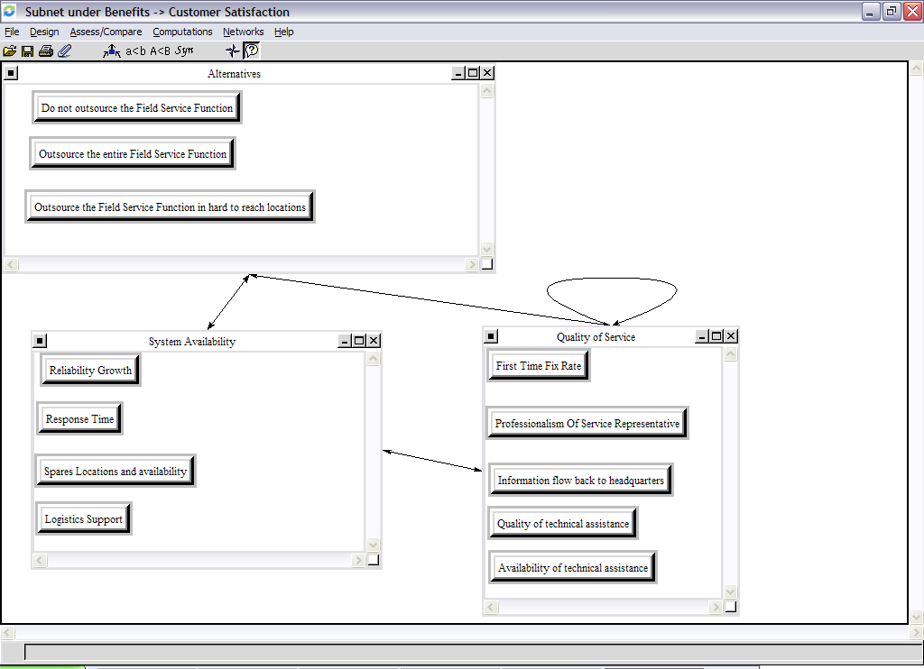
Benefits Node – Customer Satisfaction Subnet

Slide 7
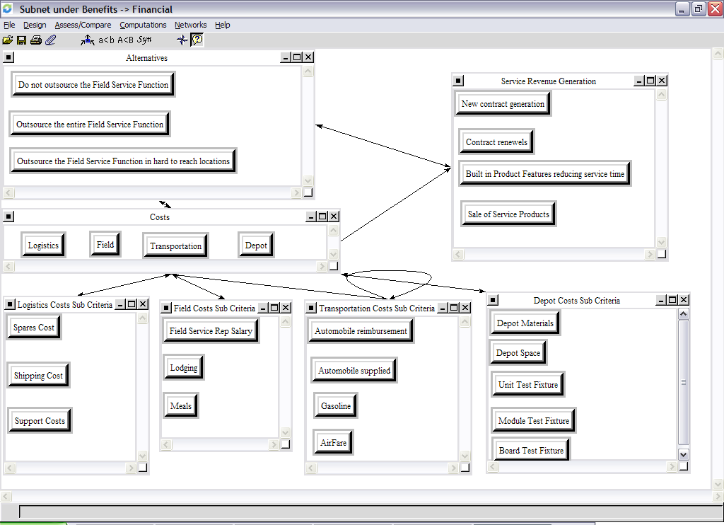
Benefits Node – Financial Cluster

Slide 8
Opportunities Node
Same Subnets as Benefits Node

Slide 9
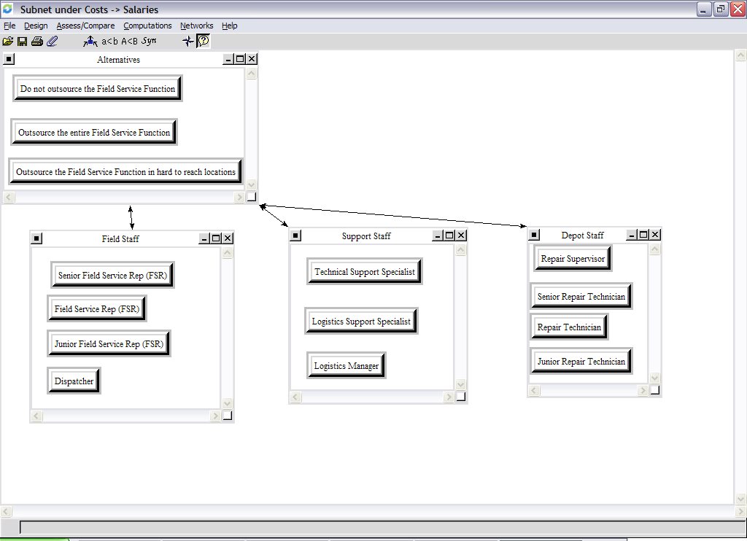
Costs Node – Salaries Subnet

Slide 10
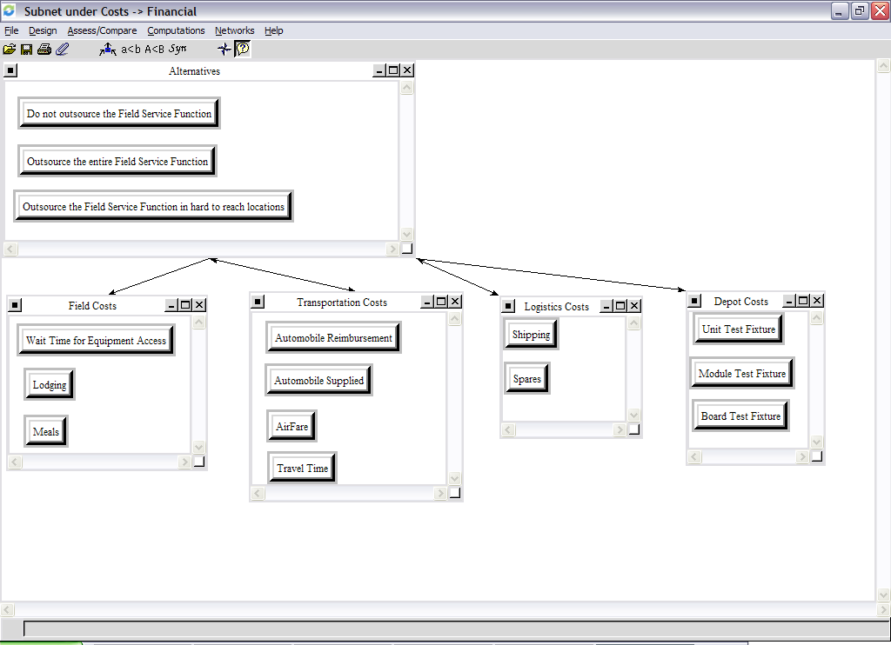
Costs Node – Financial Subnet

Slide 11
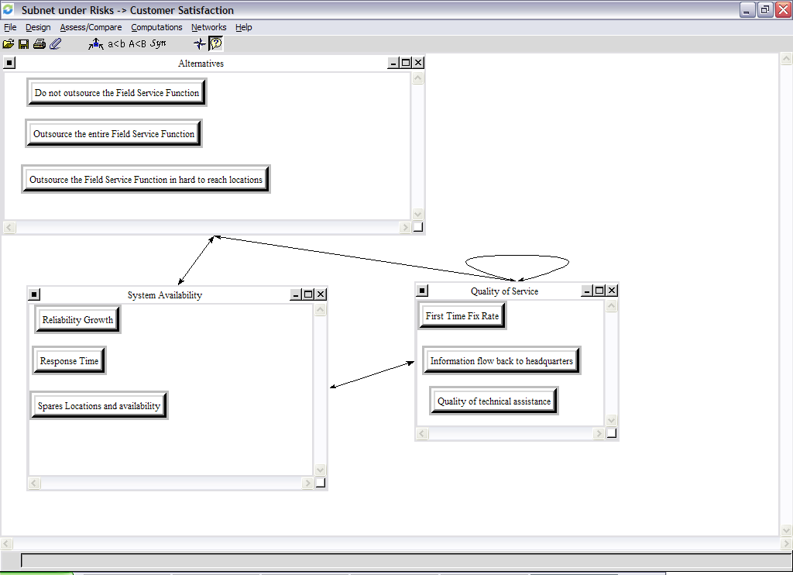
Risks – Customer Satisfaction Subnet

Slide 12
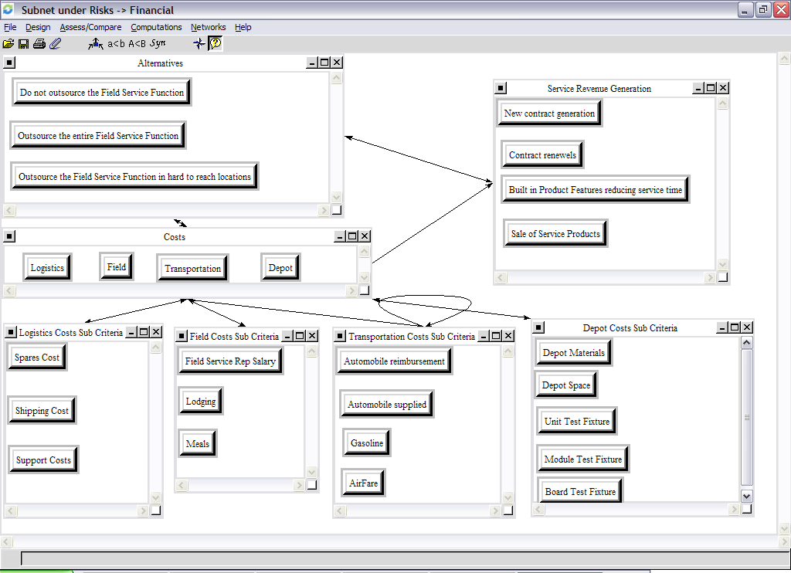
Risks – Financial Subnet

Slide 13
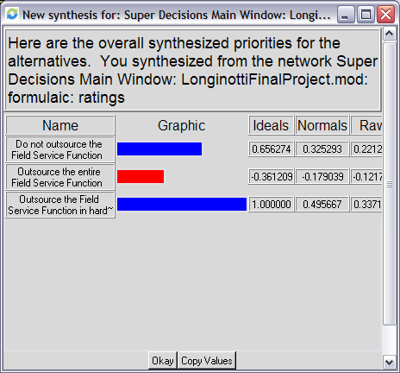
Results additive (negetive)

Slide 14
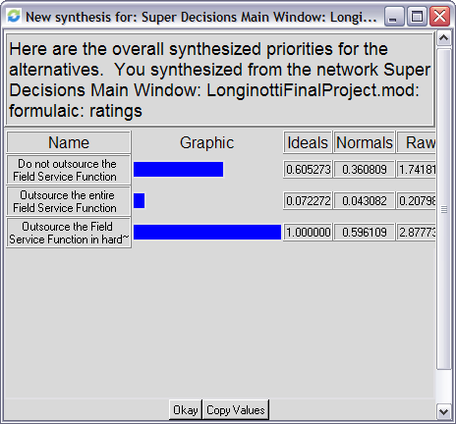
Results - Multiplicitive

