Slide 1
Housing Decision AHP
BQOM2521
Decision Making in a Complex Environment
Stephanie Shaheen
Jim West

Slide 2
Housing Alternatives
1. Live at Home
2. Buy a House
3. Rent an Apartment

Slide 3
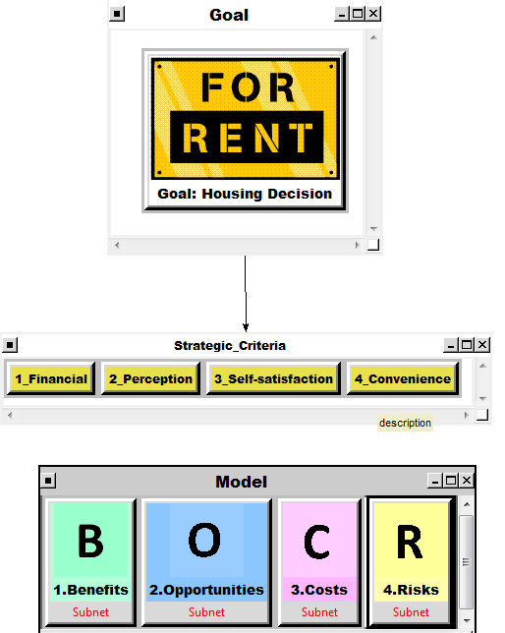
Housing Model Overview

Slide 4
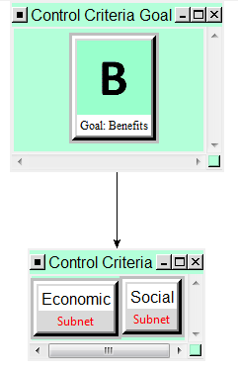
Subnet View
Control Criteria
Social
Economic

Slide 5
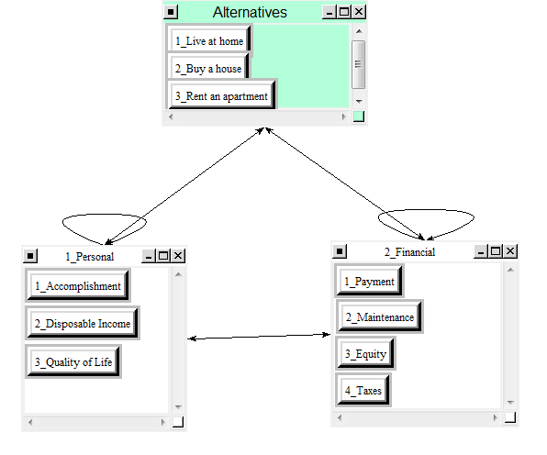
Subnet Criteria Examples – Economic Benefits

Slide 6
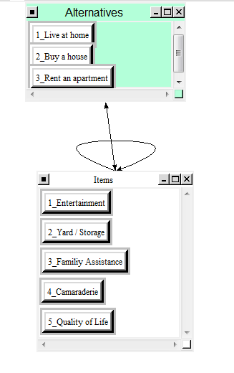
Subnet Criteria Example – Social Benefits

Slide 7
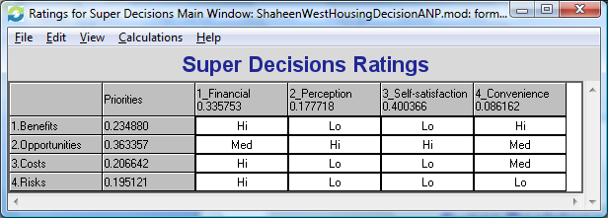
Housing Decision Ratings

Slide 8
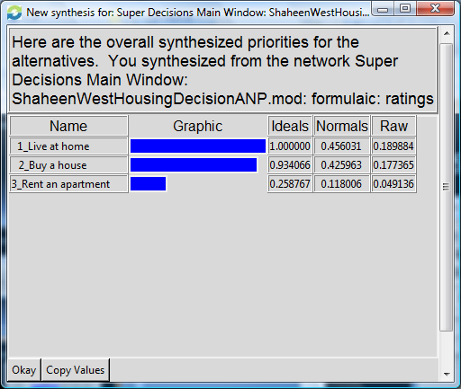
Housing Decision Synthesis

Slide 9

Thank You!

