Slide 1
Best movie to produce
Staci Gratton (SDG28@pitt.edu )
&
Deborah Lauro (DFL5@pitt.edu)

Slide 2
The Decision
From the perspective of a movie producer, which of the following novels should be made into a movie…

Slide 3

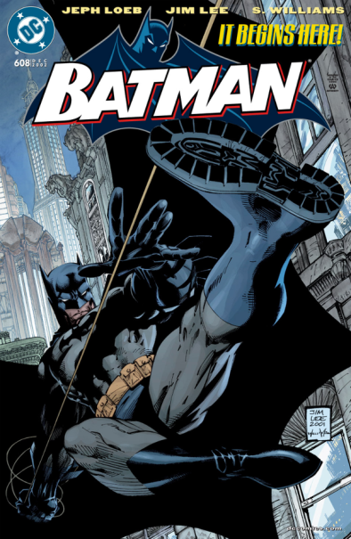
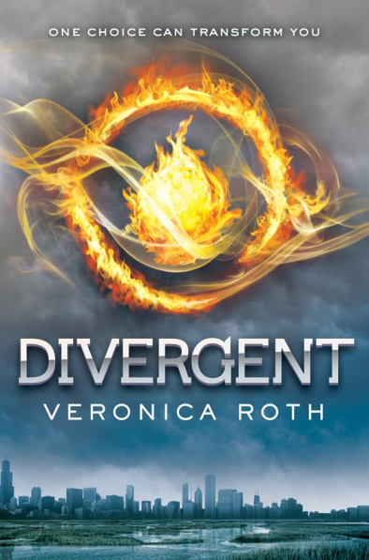
alternatives
Classic Novel
Well Established Comic
Young Adult Series

Slide 4
Strategic criteria
Fan Base
Entertainment Value
Affordability
Marketability

Slide 5
Bocr model
Most Beneficial: Batman
Most Costly: Batman
Most Opportunity: Divergent
Most Risky: Divergent

Slide 6
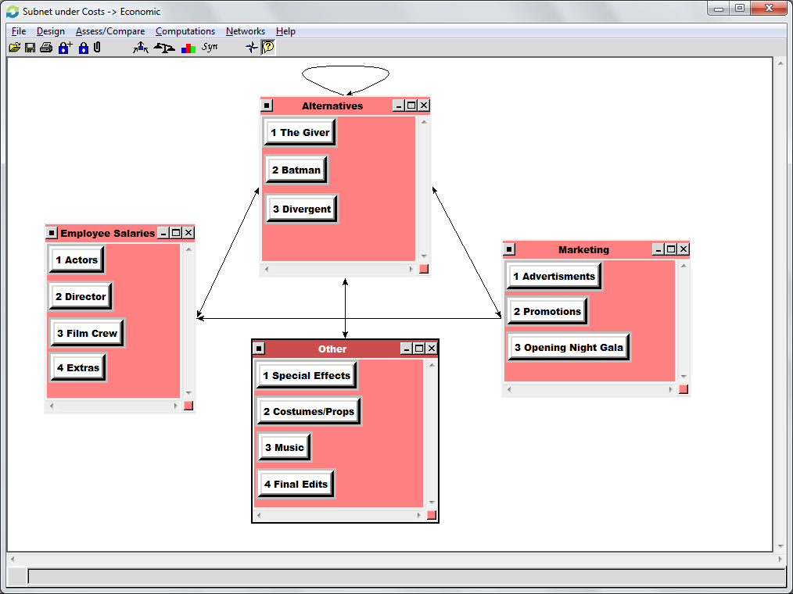
Economic cost example

Slide 7
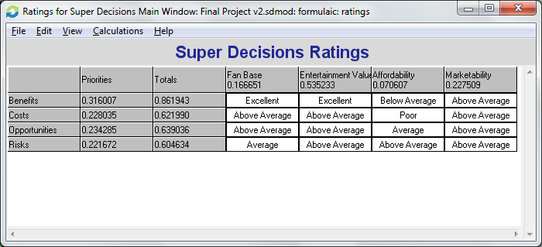
Ratings model

Slide 8
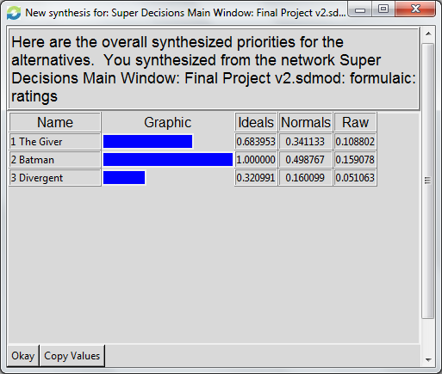
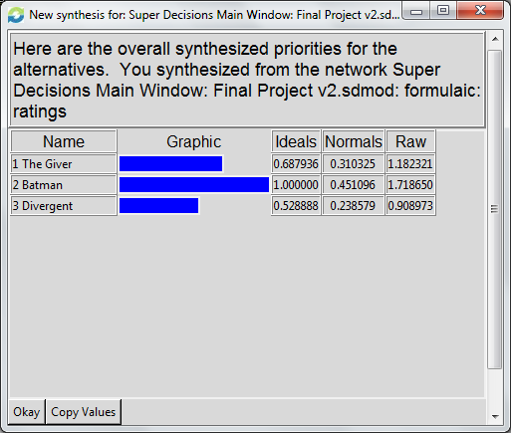
Overall results
Additive / Negative Formula Results: Long Term
Multiplicative Formula Results: Short Term

Slide 9
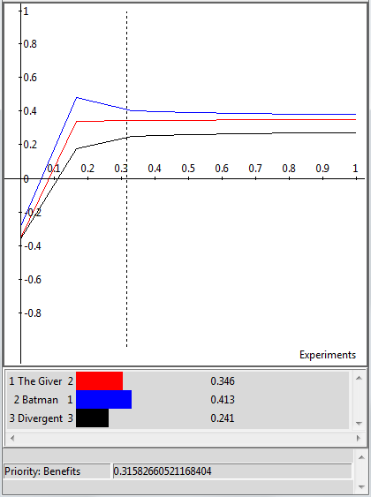
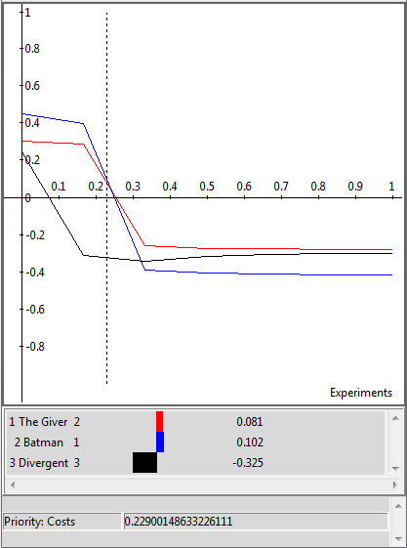
Sensitivity analysis
Benefits
Costs

Slide 10

Questions?

