Slide 1
International Manufacturing
China vs India
Rachel Sheridan and Russ Greer

Slide 2
Company Background
BCI Engineering
International Contract Manufacturer & Supply Chain Management Company
Established in 2006 with Headquarters in Pittsburgh, PA
Offices/partners around the world: China, Malaysia, Hong Kong, Mexico, and Italy
Primary business is manufacturing steel components for solar racking systems
  Majority of manufacturing is in China
  Primary delivery locations are in the US, with increasing demand in India

Slide 3
Problem Background
Decision - Should BCI Engineering expand their contract manufacturing business into India to better serve the increased demand in India?
Alternatives - Do nothing (continue manufacturing in China) or Expand manufacturing into India
Decision Maker - High-level management at BCI Engineering

Slide 4
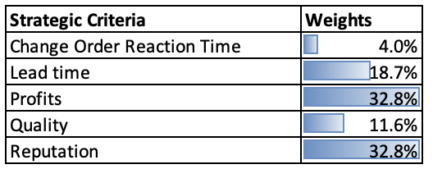
Strategic Criteria

Slide 5
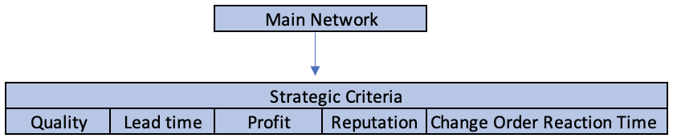
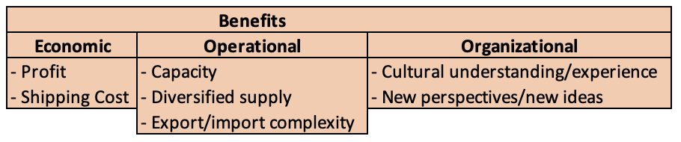
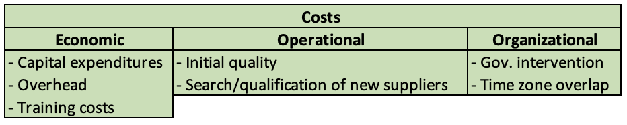
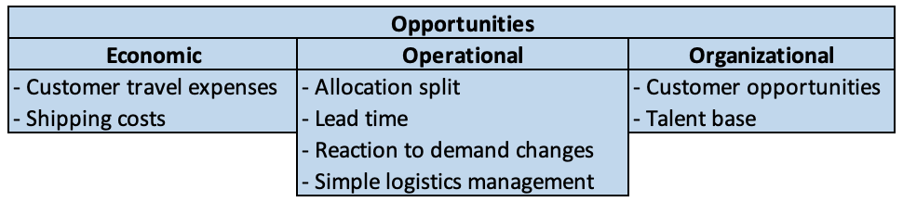
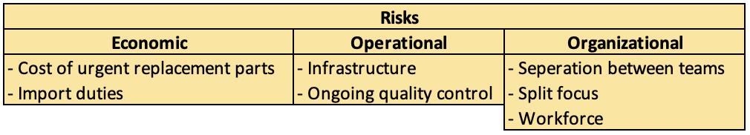
BOCR Model Overview

Slide 6
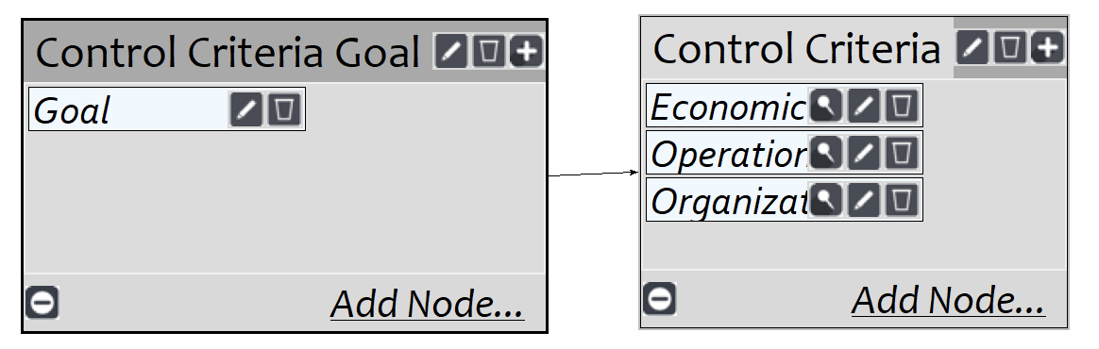
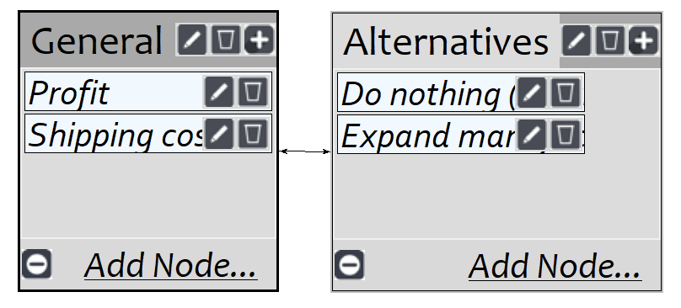
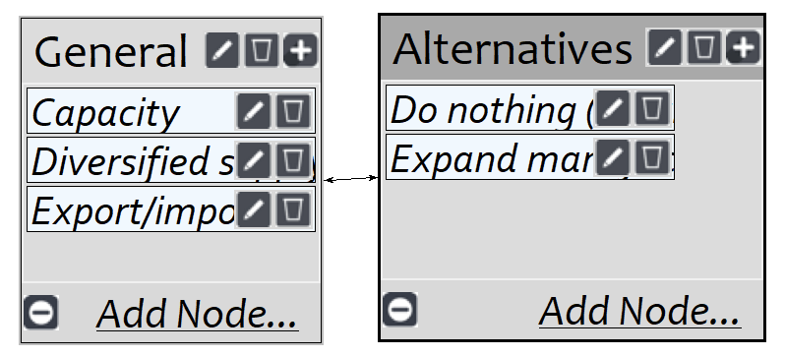
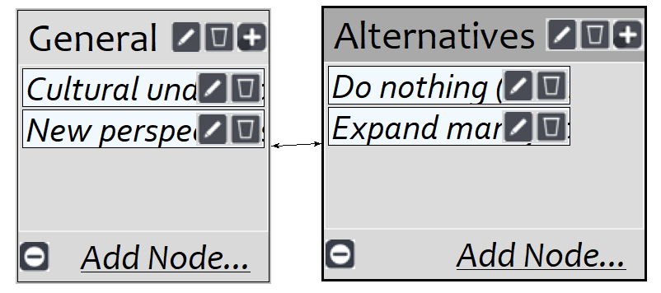
Benefits

Slide 7
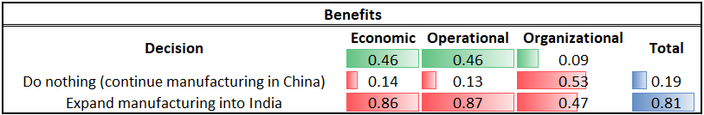
Benefits - Results

Slide 8
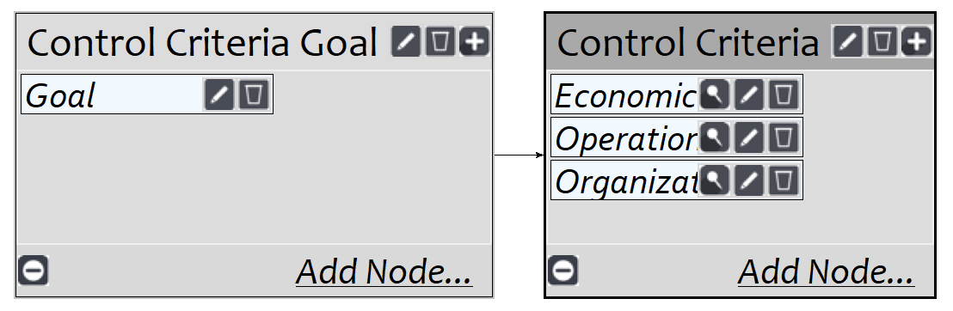
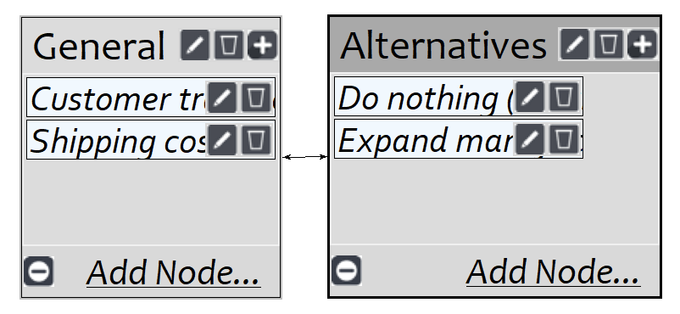
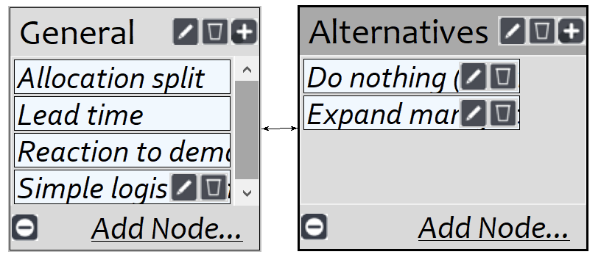
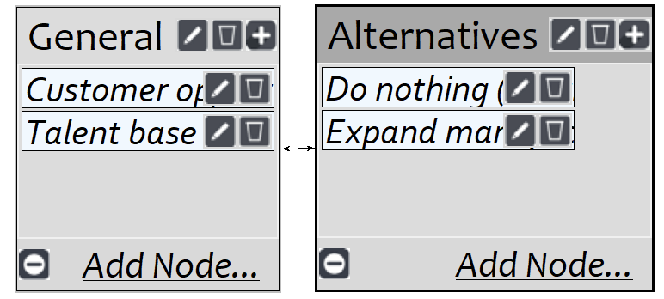
Opportunities

Slide 9
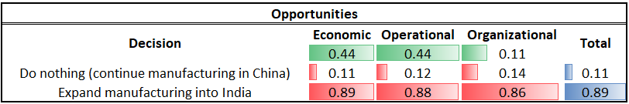
Opportunities - Results

Slide 10
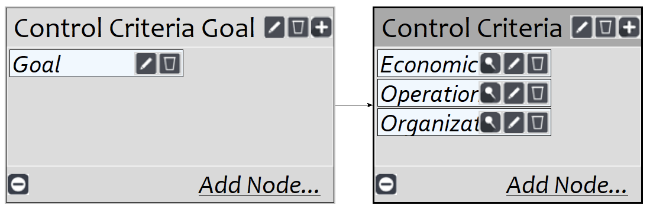
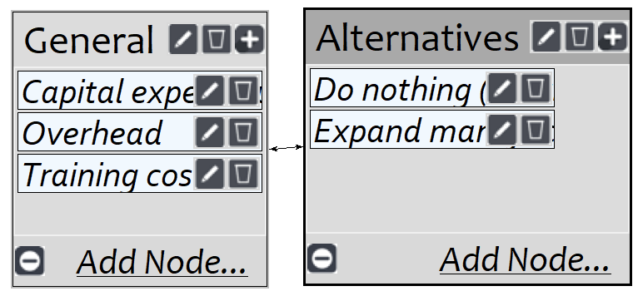
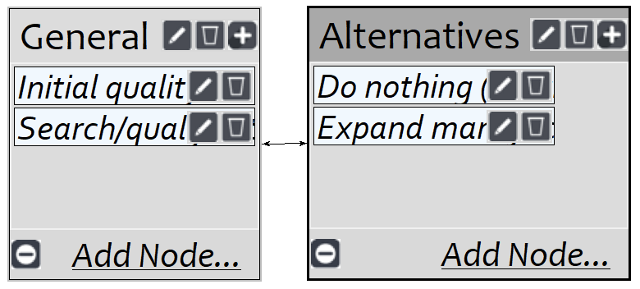
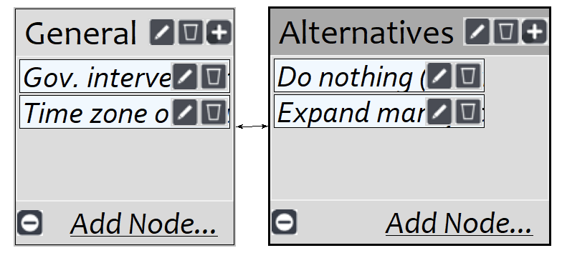
Costs

Slide 11
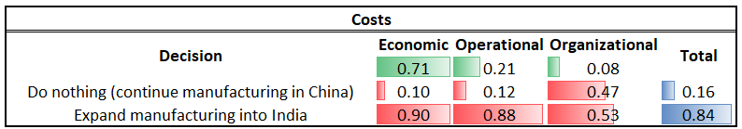
Costs - Results

Slide 12
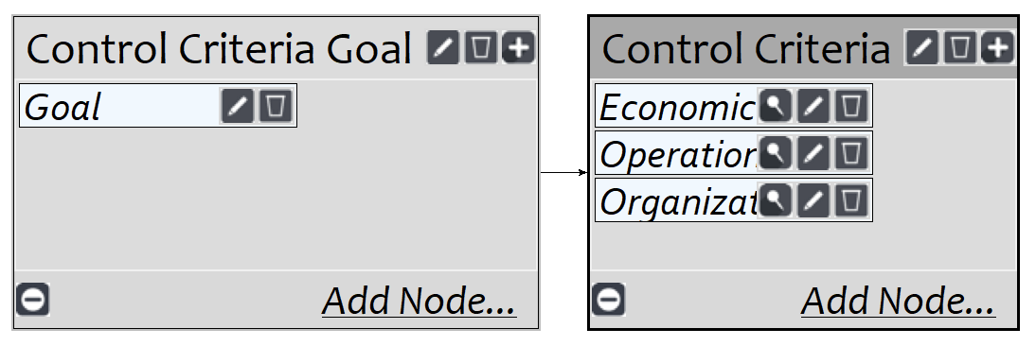
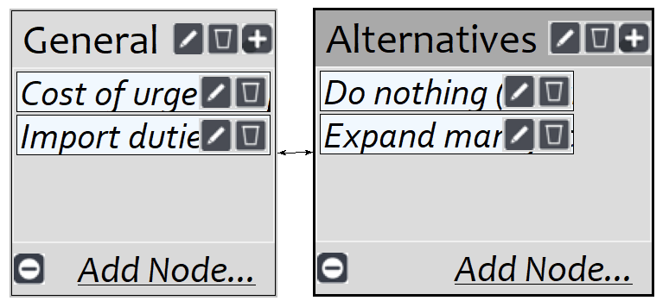

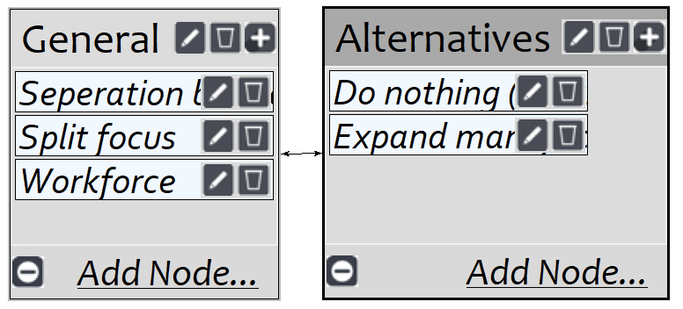
Risks

Slide 13
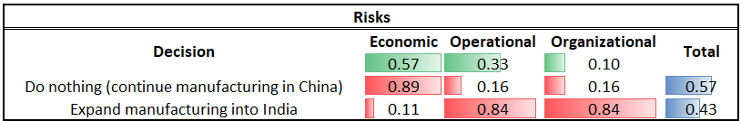
Risks - Results

Slide 14
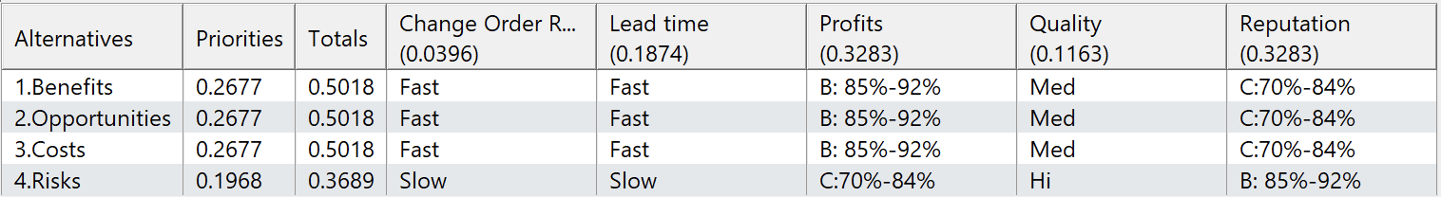
Top Level Evaluation of Ratings

Slide 15
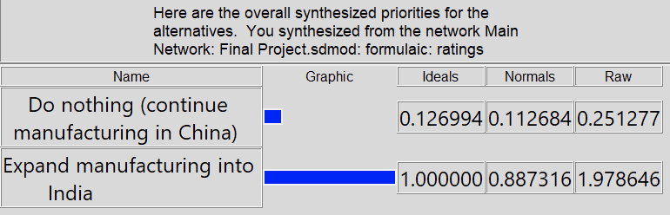
Results - Multiplicative (short term)

Slide 16
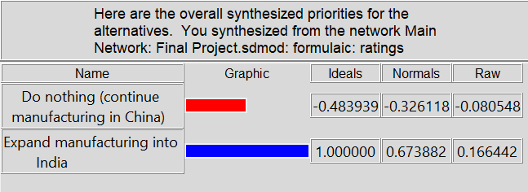
Results - Additive (long term)

Slide 17
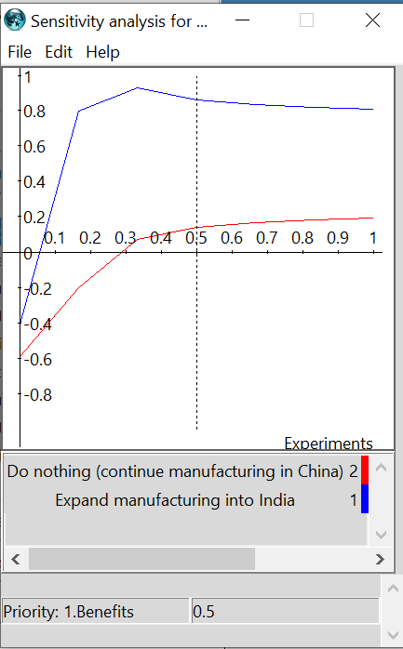
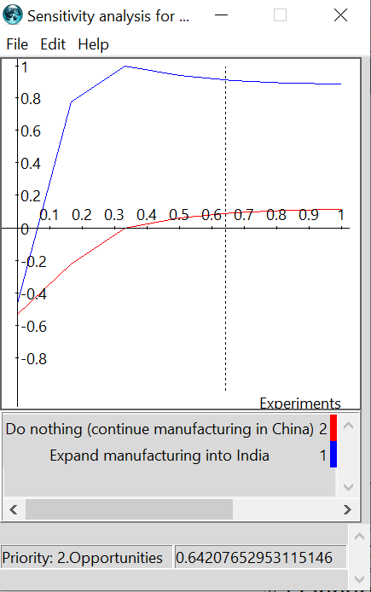
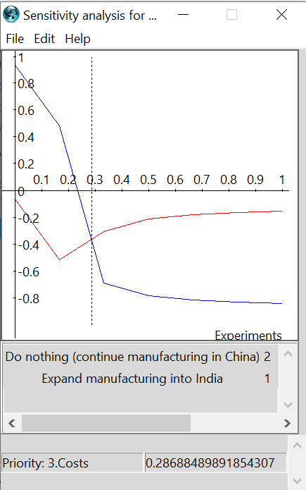
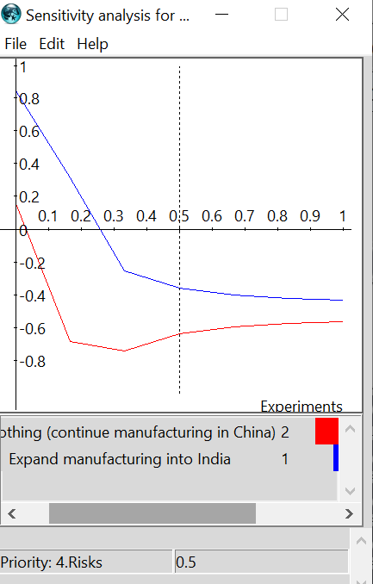
Sensitivity Analysis

Slide 18
Questions?

