Slide 1

New Corporate Office Location
Tavon Johnson & Jahari Mercer
04/26/2022
BQOM 2521 Final Project Presentation

Slide 2
Agenda
Background Info & Process Description
Strategic Criteria
Alternatives & Assumptions
Control Criteria & Bottom Level Factors
Results & Sensitivity Analysis
Conclusion

Slide 3

Background Info & Decision Description
Software and Controls company within Pittsburgh is moving Headquarters
Three key areas have been presented as places of interest: Canonsburg, City of Pittsburgh, or Cranberry Township
Current facility has been in operation since 1998
Current facility is nearly 400,000 sq ft and operates regularly under 50% on weekdays.
Senior leadership are decision makers with advice from outside consultant and employee focus groups
Current office business park restricts abilities of green technology due to Industrial governance policies
Reduction of carbon footprint to align with corporate objectives of being Net 0 by 2050 in alliance with European Commission plan
Growing calls for renovation, and newer amenities/ network infrastructure

Slide 4
Strategic Criteria
Core Values
Support Our People
Customer Focus
Collaboration
Integrity
Safety & Quality
Continuous Improvement
Innovation
Notes:
Add all 7 core values : Highlight the 4 we pulled from… Integrity, Safety & Quality, Support Our People, Customer Focus, Continuous Improvement, Collaboration and Innovation.

Slide 5
Alternatives & Assumptions
Cranberry Township, PA
Assumption: Functioning facility needing upgrades
Assumption: Facility is fully functional and ready for use
Near other major businesses, multi-star hotels, and restaurants
Canonsburg, PA
Near Interstate, Highway Route, and Airport Access
Near other major businesses, hotel chains, and restaurants
Inner City Pittsburgh, PA
Assumption: Existing building that needs construction work
Notes:
Cranberry: Located 17.86 miles from Pittsburgh
Inner City: Locations could include downtown and surrounding areas
Canonsburg: Located 18 miles away from Pittsburgh

Slide 6
Control Criteria & Bottom Level Factors
Benefits | Opportunities | Costs | Risks
Economic (Corporate Finance) | Economic (Corporate Finance) | Economic (Corporate Finance) | Economic (Corporate Finance)
Tax Benefits | Long-term growth | Taxes | Over-budget Moving Expenses
Corporate Partnerships | Philanthropy | Utilities | Employee Wages
Lease Payments |  | Moving Expenses
Environmental (Sustainability) | Environmental (Sustainability) | Environmental (Sustainability) | Environmental (Sustainability)
Reduced Carbon Footprint | Reduced Carbon Footprint | Recycling & Waste Management | Increased Carbon Footprint
Energy Efficiency | Recycling & Waste Management | Efficiency Upgrades | Recycling & Waste Management
Organizational (Business Processes) | Organizational (Business Processes) | Organizational (Business Processes) | Organizational (Business Processes)
Employee Satisfaction | Recruitment | Disruption to production | Lose employees
Office Workflow | Business Longevity |  | Recruitment efforts
Organizational (Amentities) |  |  | Matching Existing Capabilities
Lodging
Airport Access
Restaurants
Notes:
Remember to mention we inverted the property tax percentage because the largest did not mean the best in this case

Slide 7
Results
Notes:
Ranking the control criteria: Opportunities, Benefits, Costs, & Risks

Slide 8
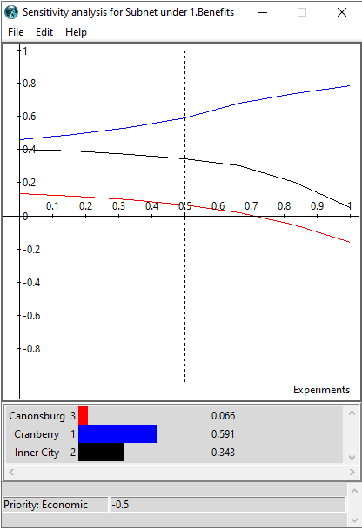
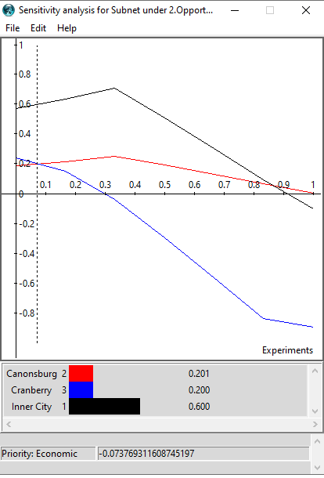
Sensitivity Analysis
Benefits
Opportunities

Slide 9
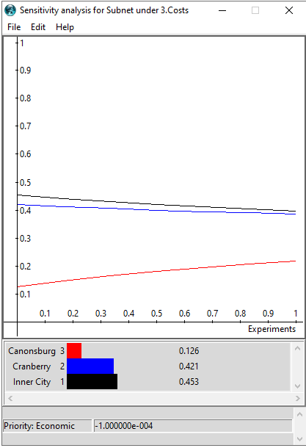
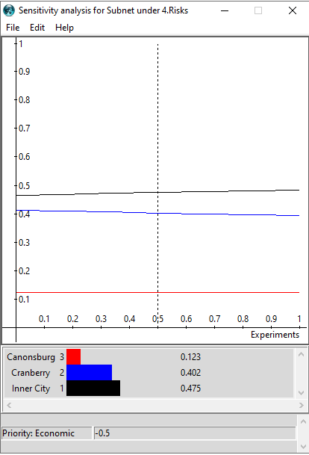
Sensitivity Analysis
Costs
Risks

Slide 10
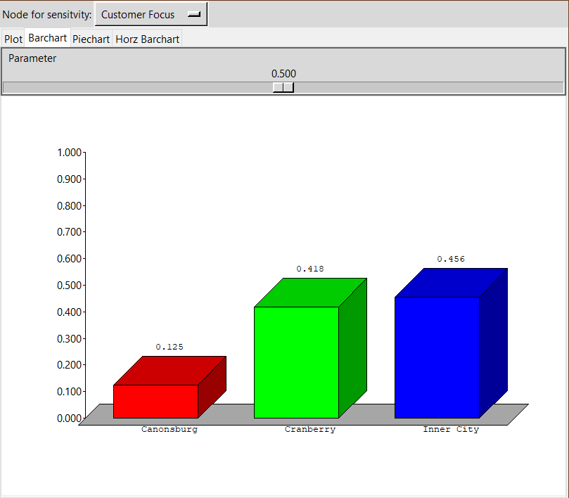
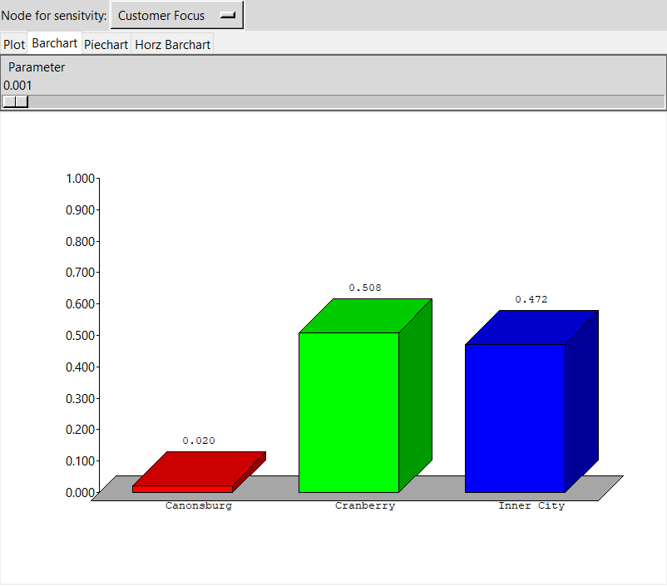
ANP Row Sensitivity Analysis – p < 0.5
P = 0.5
P < 0.5
Notes:
Innovation was not very sensitive above or below 0.5 based on the model. Customer focus is very sensitive below 0.5. This tells us that this factor has a great influence on the alternatives. At 0.5, Cranberry is at 0.418. Once p = 0.0, Cranberry is now at 0.508 which is a 0.090 increase in the value of Cranberry and puts it as the top alternative. Compared to when p = 1.0, where Cranberry is 0.370 which is a 0.048 decrease in the value of the alternative and maintaining the order for the long term best alternative.

Slide 11


ANP Row Sensitivity Analysis – p > 0.5
P = 0.5
P > 0.5
Notes:
For supporting our people, at P = 0.5 cranberry starts out with a value of 0.418. As P approaches 0.651, it increases to its highest value at 0.519. This constitutes an increase of 0.101. After 0.651, all the values for the alternatives rapidly decrease. As P approaches 0.651, Inner City also increases but is eventually surpassed by Cranberry whereas Canonsburg rapidly declines to zero and continues to decline after 0.651.
For collaboration, at P = 0.5, Cranberry starts out with a value of 0.418. As P approaches 0.701, it increases to its highest value at 0.503. This constitutes an increase of 0.085. After 0.701 all of the values for the alternatives rapidly decrease. As P approaches 0.701, Inner City increases up until p equals 0.651 and after that it begins to decrease. Canonsburg continues to decrease as P increases greater than 0.5.

Slide 12

Conclusion
Final Recommendation depends on whether the company sees themselves moving to a new facility after a few years.
Best short-term solution: Cranberry, PA
Cranberry offers advantages in future partnerships
Access to nearby restaurants, hotels, and residential housing
Why Cranberry scores high in the short term?
Even with low benefits, it has the lowest short-term costs
Best long-term solution: Inner City Pittsburgh, PA
Inner City Pittsburgh offers partnerships with schools, restaurants, and businesses
Accessible by public transit and offers a more modern facility
Why Inner-City scores high in long term?
Risk control criteria has a lower priority
Large amount of benefits and opportunities with a lower cost

Slide 13
Sources
Slide 2
1. https://www.kindpng.com/imgv/hTooowh_software-development-clipart-identity-png-download-computer-programmer/
Slide 5
https://www.google.com/maps/vt/data=M4m3i04y_6wR5J7ImyJU3i9d__pSjl5BF7J7R3q13t3xWiE78ZaH7J0-zS-_Ss9mR1xGZyqiEFbzSCq-2X7-AREzjZvnKKti1AStXibeUiRKjVMBo7VPwplm0oqkqj8jY3HCLbm2BCTv&w=182&h=160
https://www.distance-cities.com/distance-pittsburgh-pa-to-cranberry-township-pa
https://www.google.com/maps/vt/data=u1-cgko6qz9VMt9WL4X0mmGSRX-LJhbp6YZS9Z2yfXj-RfpAGayWAJMOhcriMY7sJ96EjJ7kvk6WRqbcuJHufzPIyCAUVrz2G9OEEh2k5oIzur2kbEavXvU7QFJGTSg-lTp7BIW_JFWjMYIte7AWBy4JadQXSnjF5jVHvEkPaz8KKnhtE1lTXX_FvrQy0C9CHmfvYmpeL5oURyksT04knVcaLYwekfk03aPOXSbDrnXkxm5A5Lvc1qS8
https://www.google.com/maps/vt/data=S32iD0k9-LbRjVqyjw2xKzHoHCMKcql4nndT3EFLcXtmTSM6f5Q7AEK6iwnx73fJj-TSZG9R6dzB9st2ZiY-97A08FKiltWMo4itHPvYFW4lDsr9NyLw3QIyFcaey4UXuqEVtKdugxhR0D73vc77160GjgexUT4GWIzag5VFgDNKtwYzVbHg2sE08Jl4Lss2UgBrcFne7YdnwYNLEt_ckCaMHVjfCYeE-g_iY55a-ZY6_yM&w=182&h=160
https://www.mapquest.com/us/pennsylvania/canonsburg-pa-282022500
https://smartasset.com/taxes/pennsylvania-property-tax-calculator#MbRhYtD5mC
Slide 11
1. https://www.kindpng.com/imgv/hoRwib_incandescent-light-bulb-clip-art-transparent-background-lightbulb/

