Slide 1
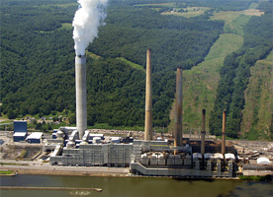
Power Plant Conversion Decision Model
Scott Cottier and Andrew Scott

Slide 2
Alternatives
DO NOTHING
CONVERT THE PLANT TO NATURAL GAS FIRED
CONVERT THE PLANT TO CO-FIRED
PERMANENTLY CLOSE THE PLANT.

Slide 3
CRITERIA
POLITICAL
  NEW GOVERNMENT REGULATIONS
SOCIAL
  EFFECTS OF PLANT CLOSURE
  ENVIRONMENTAL IMPACTS
ECONOMICAL
  COSTS
  OPERATIONAL RESULTS

Slide 4
BENEFITS Social People Electric Costs Air Quality Job Creation Community Tax Dollars Social Responsibilities Brand Image Economic Costs Labor Costs Training Costs Raw Material Costs Operational Results Conversion Costs Efficiency Marketing Flexibility Political Operating Results Tax Benefits Grants/Research Lobbying Governmental Policy Cap and Trade CO2 Emissions Particulate Discharge | OPPORTUNITIES Social People Cost of Electricity Air quality Job Creation Community Tax Dollars Community Outreach Brand Image Economic Costs Labor Costs Training Costs Raw Material Costs Operational Results Conversion Costs Efficiency Marketing Flexibility Political Operating Results Tax Benefits Grants/Research Lobbying Governmental Policy Cap and Trade CO2 Emissions Particulate Discharge

Slide 5
COSTS Social People Job Loss Air Pollution Toxic Disposal By Products Raw Material Job Creation Community Tax Dollars Image Marketing Economic Costs Labor Costs Training Costs Raw Material Costs Operational Results Conversion Costs Efficiency Marketing Flexibility | RISKS Social People Layoffs Community Tax Revenue Brand Image Economic Costs Labor Costs Training Costs Raw Material Costs Operational Results Availability of Technology Capacity Demand Political Operating Results Lobbying Governmental Policy Cap and Trade CO2 Emissions Particulate Discharge

Slide 6
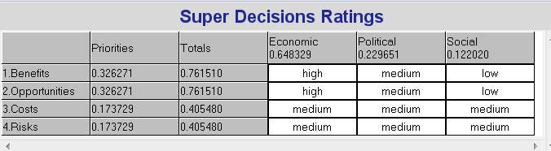
RATINGS OF B.O.C.R.

Slide 7
NORMALIZED PRIORITIES
 | Sub-Networks | Close Plant | Do Nothing | Full Conversion | Partial Conversion
Benefits .326 | Social .136 Economic .625 Political .238 | .216 | .269 | .225 | .289
 |  | .118 | .098 | .304 | .479
 |  | .199 | .114 | .336 | .349
Opportunities .326 | Social .297 Economic .539 Political .163 | .187 | .133 | .319 | .361
 |  | .118 | .098 | .271 | .512
 |  | .104 | .106 | .438 | .356
Costs .174 | Social .333 Economics .667 | .233 | .318 | .206 | .242
 |  | .007 | .373 | .382 | .238
Risks .174 | Social .105 Economic .258 Political .637 | .677 | .168 | .096 | .098
 |  | .428 | .125 | .219 | .228
 |  | .200 | .512 | .119 | .169

Slide 8
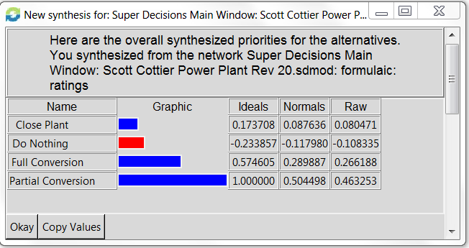
RESULTS
Additive negative formula

Slide 9
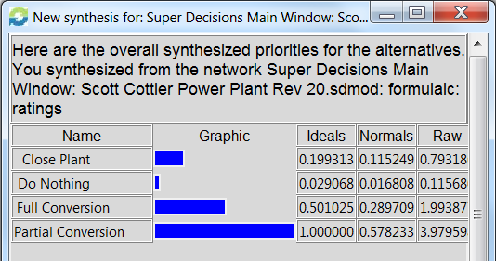
RESULTS multiplicative formula

Slide 10
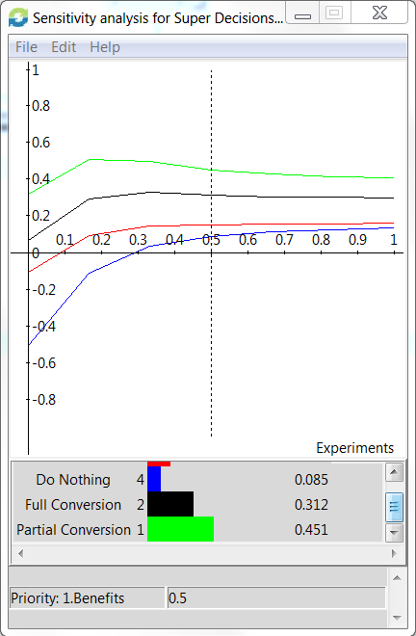
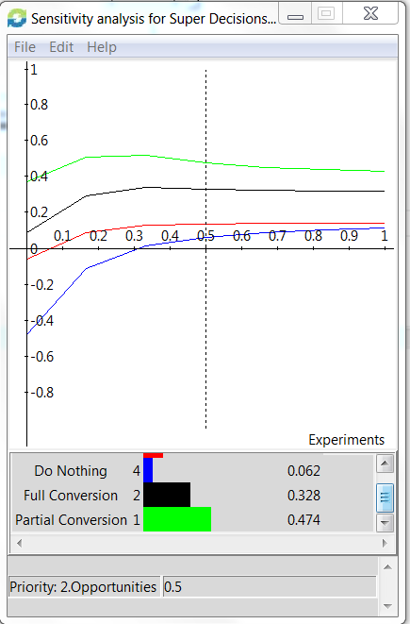
SENSITIVITY ANALYSIS

Slide 11
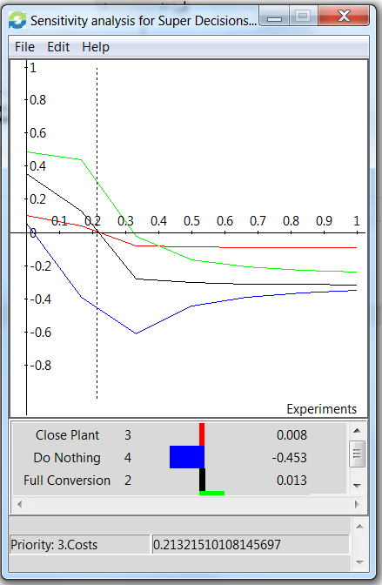
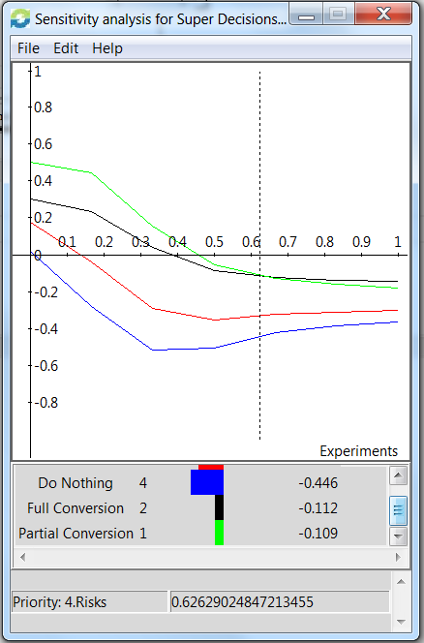
SENSITIVITY ANALYSIS

Slide 12
FUTURE RESEARCH AND APPLICATIONS
Political Decisions with respect to CO2, Particulate Discharge and Cap and Trade
Future price of natural gas
Technology Development
MW Capacity of Power Plant

