Slide 1


Coming to Pittsburgh
Garrett Breisinger
Zach Strickler

Slide 2
Intro
Apple first came to the Pittsburgh Market when it partnered with Carnegie Mellon University, by opening a small R&D facility on CMU’s campus.
In 2014 Apple started looking for 20,000 sq. ft. of new office space to expand its presence in Pittsburgh. Our decision model examines what geographic location would be the best fit for Apple to open a new office.
Alternatives (Location)
Strip District
Lower Hill
Almono
SouthPointe

Slide 3
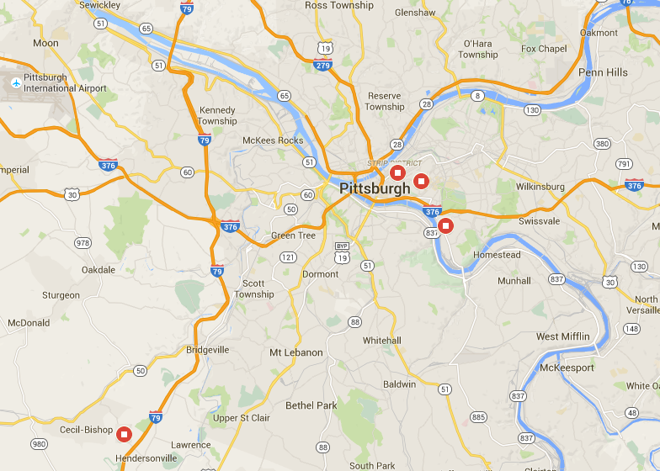
Site Map
Strip District
Lower Hill
SouthPointe
Almono

Slide 4
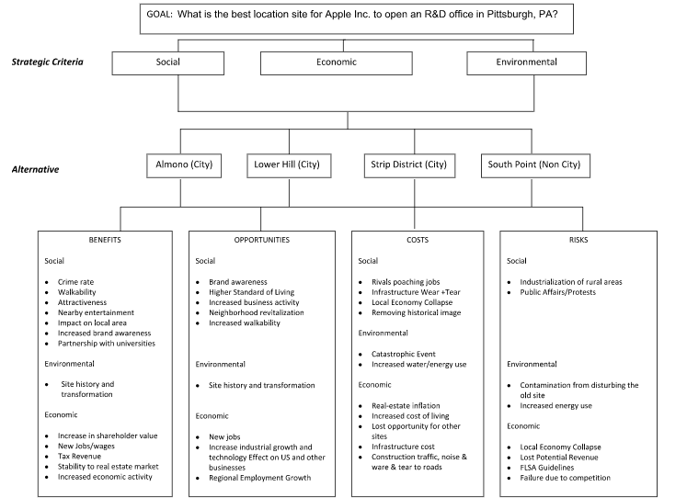
BOCR

Slide 5
Other Criteria to Consider
Proximity
  Airport, competitors, universities
Nearby or available housing
Nearby dining & entertainment
  Employees, customers, vendors, suppliers
General attractiveness of the area
  Crime rate
Cost
  Living, office space, taxes
Parking & public transportation
Congestion

Slide 6
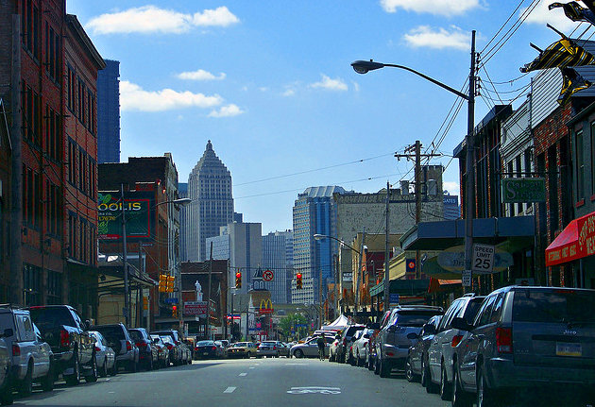
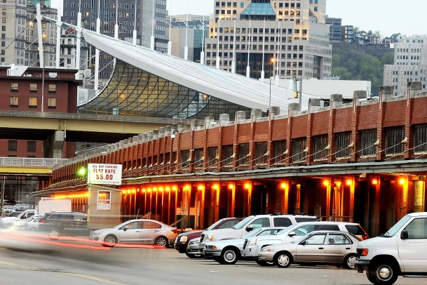
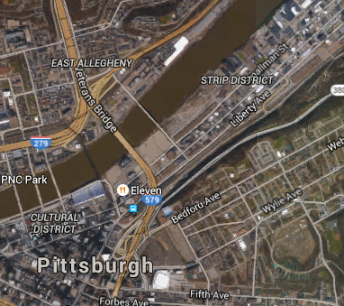
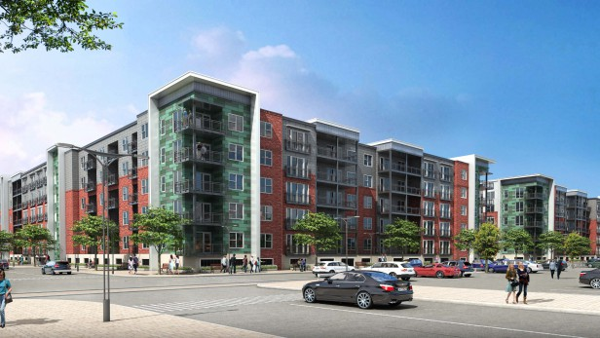
Site#1 – Strip District
Development Site
Shops & Dining
Downtown Living

Slide 7
Site#1 – Strip District
Benefits:
  Downtown urban area
  Large selection of hotels, dining & entertainment
  Close to universities
  Abundant option of living space
  River front
Setbacks:
  Congestion
  Limited and expensive parking
  Limited space and room for expansion
  Expensive real estate & taxes, high cost of living
  19 miles from Airport

Slide 8
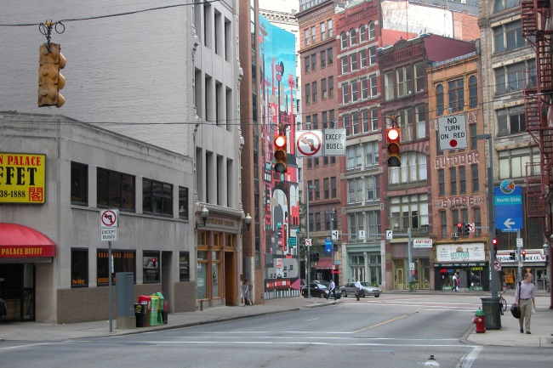
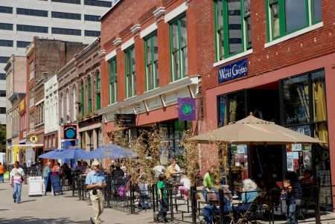
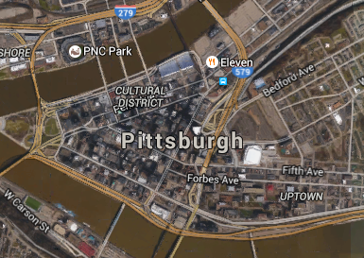
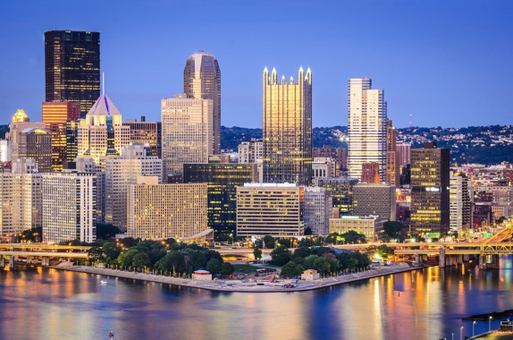
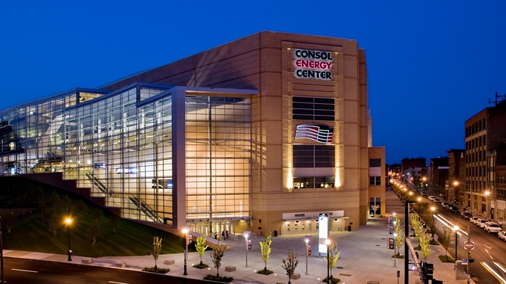
Site#2 – Lower Hill
Development Site
Local Dining & Shops
Entertainment
Downtown Living

Slide 9
Site#2 – Lower Hill
Benefits:
  Downtown urban area
  Large selection of hotels, dining & entertainment
  Close to universities
  Abundant option of living space
Setbacks:
  Congestion
  Limited and expensive parking
  Limited space and room for expansion
  Expensive real estate & taxes, high cost of living
  17.5 miles from Airport

Slide 10
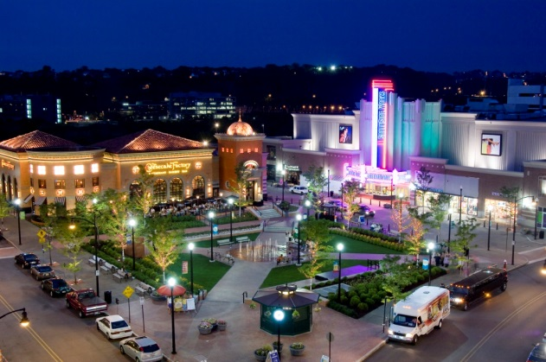
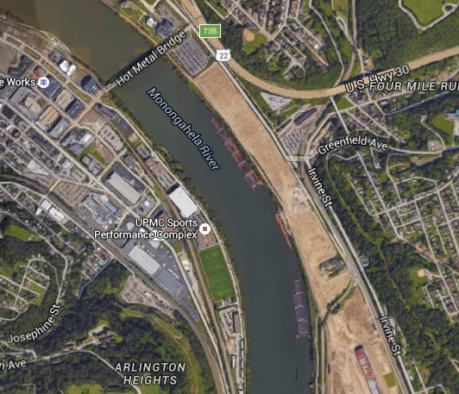
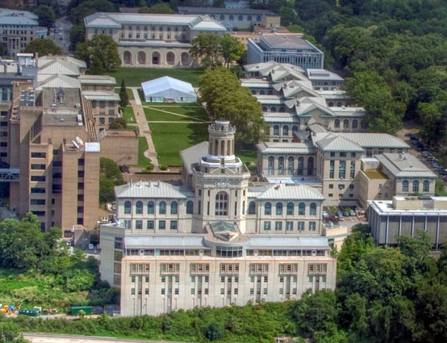
Site#3 - Almono
Development Site
Southside Works
Nearby Universities

Slide 11
Site#3 - Almono
Benefits:
  Urban area
  Large selection of hotels, dining & entertainment
  Close to universities and Southside Works
  Abundant option of living space
  River front
Setbacks:
  High Congestion
  Expensive real estate & taxes, high cost of living
  21 miles from Airport

Slide 12
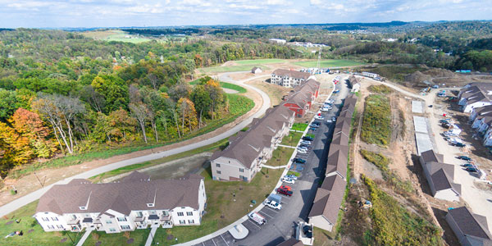
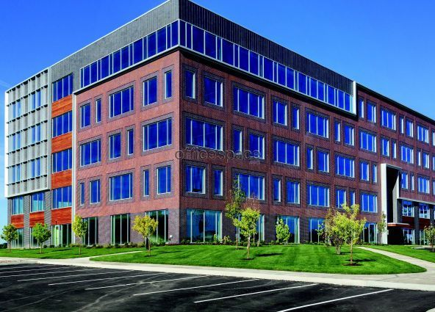
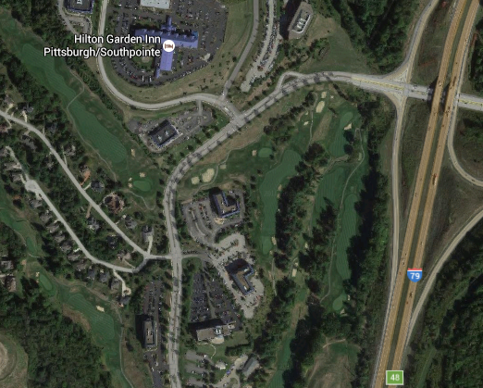
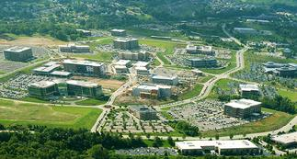
Site#4 – SouthPointe
Rural Living
Open Office Space
Open Land
Site
Major Highway

Slide 13
Site#4 – SouthPointe
Benefits:
  Residential and more rural area
  Limited congestion and quick access to major highways
  Widely available parking
  More options for residential single family home living
  Tax breaks
Setbacks:
  Limited selection of hotels, dining & entertainment
  Not close to universities
  24 miles from Airport

Slide 14
Site Map
Strip District
Lower Hill
SouthPointe
Almono

Slide 15
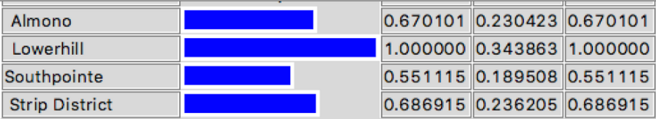
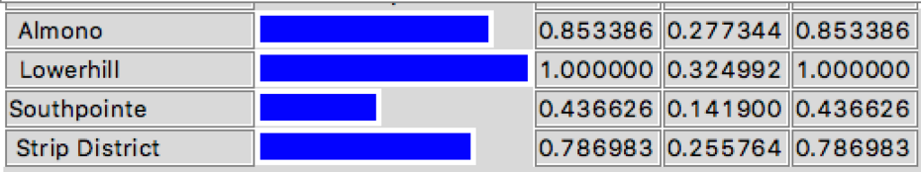
BOCR Synthesis
Benefits
Opportunities

Slide 16
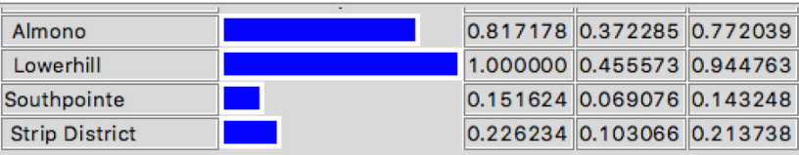
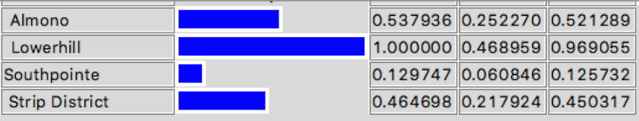
BOCR Synthesis
Risks
Costs

Slide 17
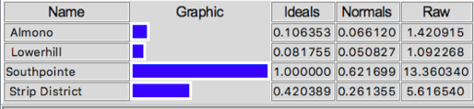

Overall Synthesis Results
Short Term
Long Term

Slide 18
Questions..

