Slide 1
Decision Making in Complex Environments Final Presentation
New optimal location to place American textile company’s Midwest operations
Mike Pontzloff

Slide 2

Background on American Textile Company (ATC)
Pillow and bedding products manufacturer based in Pittsburgh, PA
Currently have four locations for manufacturing and distribution:
Pittsburgh, PA
Tifton, GA
Salt Lake City, UT
Dallas, TX
Problem: Recent growth has Dallas, TX facility at full capacity (need 200k sq. ft.)

Slide 3
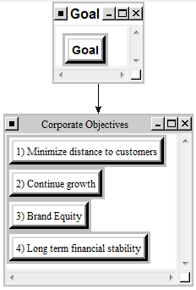
Using Analytical Hierarchy Process (AHP) to determine optimal location
Structure
Goal: Find new optimal location to place ATC Midwest operations
Corporate Objectives:
Minimize distance to customers
Continue growth
Brand equity
Long term financial stability

Slide 4
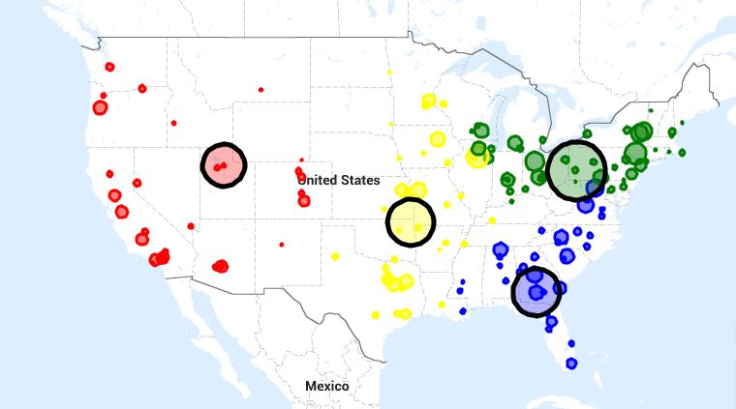
Using Analytical Hierarchy Process (AHP) to determine optimal location
Structure
BOCR Model
Control Criteria
Internal Impacts
External Impacts
Alternatives (found using COG model)
Joplin, MO
Fairland, OK
Fayetteville, AR
Dallas, TX

Slide 5
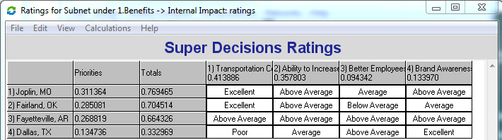
Benefits
Internal Impact
Transportation Cost Savings
Every 1 degree (69 miles) from optimal coordinates = $30,000 in transportation costs
Ability to Increase Operation Site Size
Currently at 105k, Need 200k sq ft.
Better Employees
Brand Awareness

Slide 6
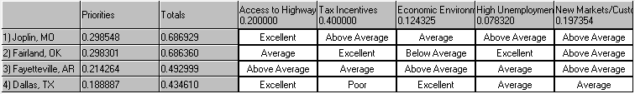
Benefits
External Impact
Access to Highways/Interstates
New site must have access to highways, particularly N-S highways
Tax Incentives
OK projects $1.1M over 10 yrs
Economic Environment
High Unemployment Rate
Higher rate = easier to find new workers
New Markets/Customers
Operations in new area of country

Slide 7
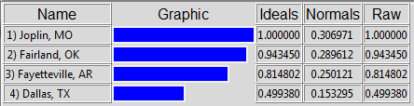
Benefits Summary
Joplin, MO highest score
Very low transportation costs to Midwest customers
Economic environment
Dallas, TX (current location) lowest score
Very far from center of gravity for customers

Slide 8
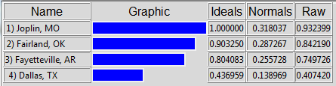
Opportunities Summary
Internal Impact
Increase speed to market
Opportunity for LT growth
R&D
External Impact
Future tax incentives
Regional impact
New markets/customers

Slide 9
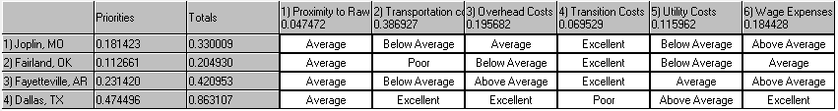
Costs
Internal Impact
Proximity to raw goods
Transportation costs to customers
Overhead costs
Dallas most expense; Fairland, OK cheapest
Transition costs
Moving from current Dallas facility to new facility
Utility costs
Wage exp.

Slide 10
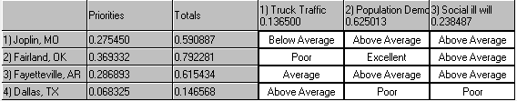
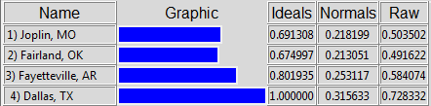
Costs Summary
External Impact
Truck traffic
Population demographic
Workforce size
Dallas 3.3M vs. others not more than 250k
Education level
Social ill will
Negative P.R. move if leave Dallas

Slide 11
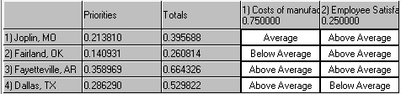
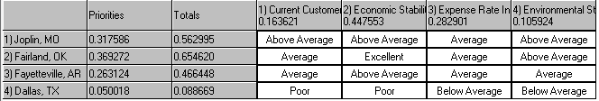
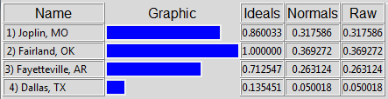
Risks Summary
Internal Impact
Costs of manufacturing increasing
Employee satisfaction
External Impact
Current customer stability
Economic stability
Expense rate stability
Environmental stability

Slide 12
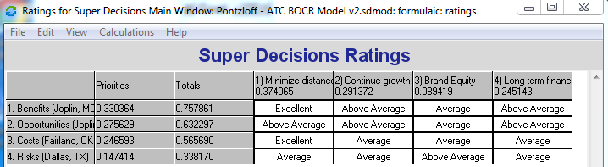
Risks Summary
Evaluating BOCR locations vs. the Corporate Objectives

Slide 13
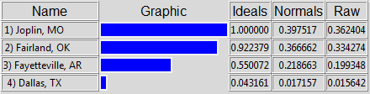
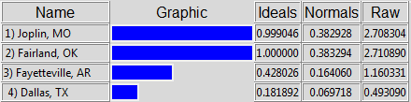
Final Decision
Short Term (Additive) Long Term (Multiplicative)

Slide 14
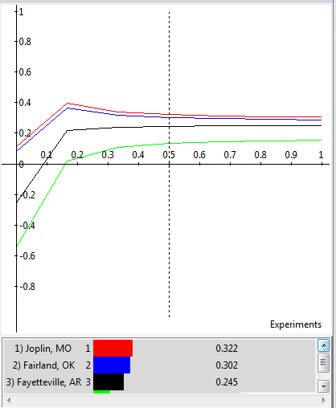
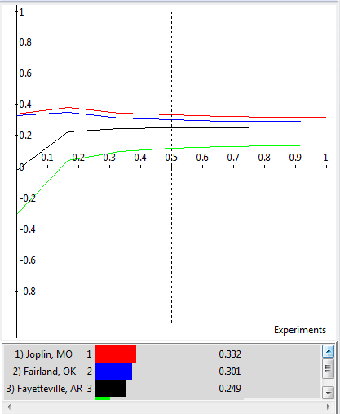
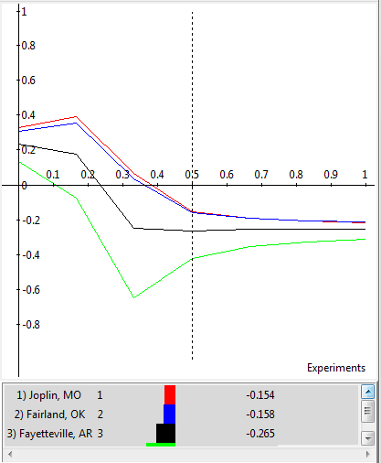
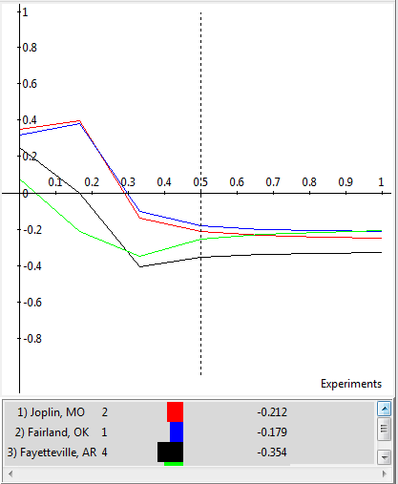
Sensitivity Analysis
Benefits Opportunities Costs Risks

