Slide 1
Kraft Heinz HQ
Julia Schaller
BQOM 2521 final Project

Slide 2


Introduction
Kraft Heinz company founded in 2015
Merger between Kraft Foods and Heinz
Dual headquartered in Pittsburgh and Chicago
Covid-19 WFH Environment
Decision: Should KHC close one HQ location or maintain dual HQ locations?

Slide 3
Economic Background
Current Locations
AON- Chicago
Average lease price: $49.75/sqft/year
PPG- Pittsburgh
Average lease price: $27.75/sqft/year
Cost of Living
Cost of living in Chicago is 21.6% higher than Pittsburgh

Slide 4
Alternatives
Close Pittsburgh HQ
Close Chicago HQ
Maintain Dual HQ Locations

Slide 5
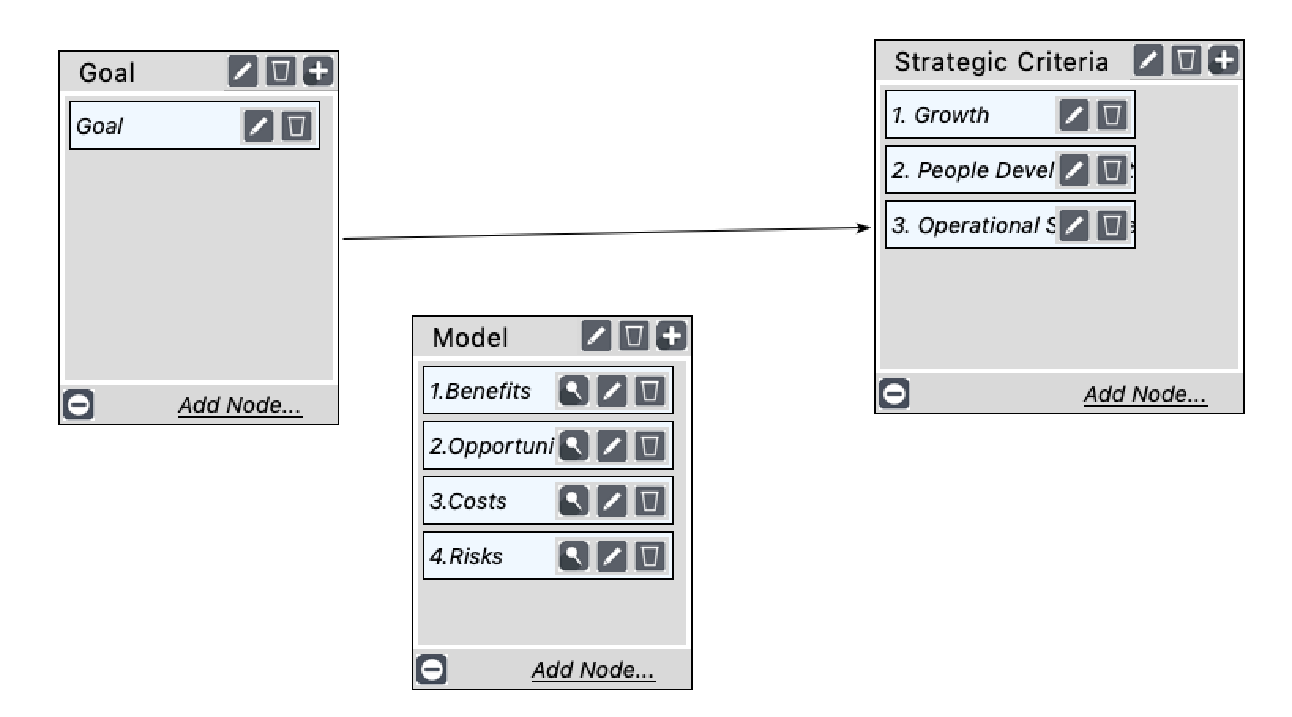
Strategic Criteria- BOCR

Slide 6
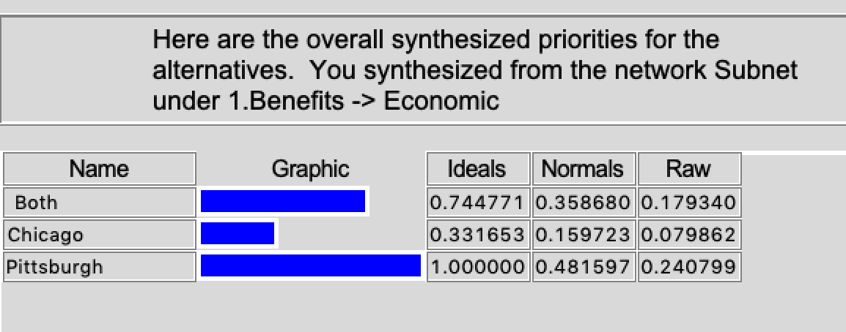
Benefits
Economic
Rent cost
Employee salary
# Buildings Needed
Operational
Agile Management
Hiring Availability
Travelling requirements
Organizational
Business continuity
Collaboration
Travel requirements

Slide 7
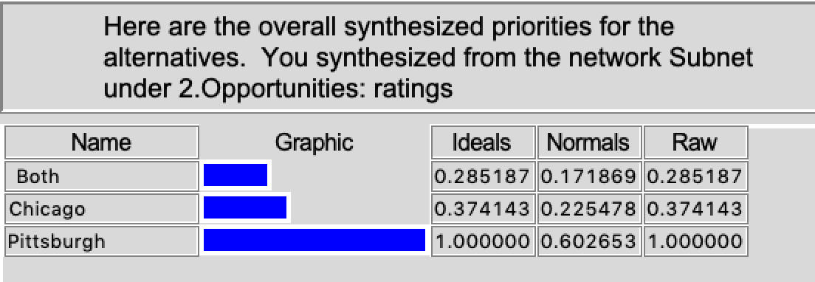
Opportunities
Economic
Travel expenses
Salary expenses
Rent expenses
Operational
Collaborative workforce
University presence
Centralized locations
Organizational
Employee growth
Locational continuation
Location growth/ presence

Slide 8
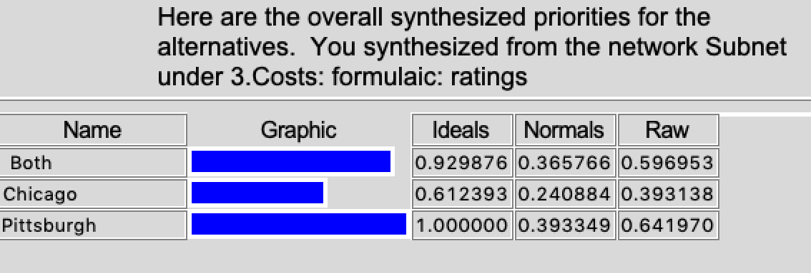
Costs
Economic
Rent
Salary
Relocation bonus payout
Operational
Hiring expense
Travel
Standard salary
Organizational
Office restructuring
Relocation
Employee satisfaction

Slide 9
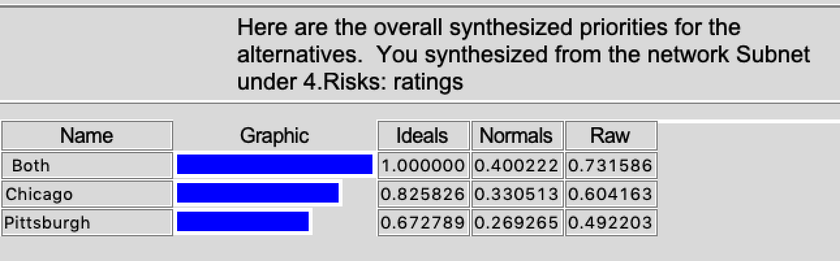
Risks
Economic
Hiring Expenses
Increased salary expectations
Rent expense
Operational
Agile management
Synergy disruption
Travel requirements
Organizational
Employee retention
Growth opportunities
Process continuation

Slide 10
Results
Benefits
Both | 57%
Chicago | 15%
Pittsburgh | 27%
Opportunities
Both | 17%
Chicago | 23%
Pittsburgh | 60%
Costs
Both | 39%
Chicago | 19%
Pittsburgh | 42%
Risks
Both | 40%
Chicago | 33%
Pittsburgh | 27%

Slide 11
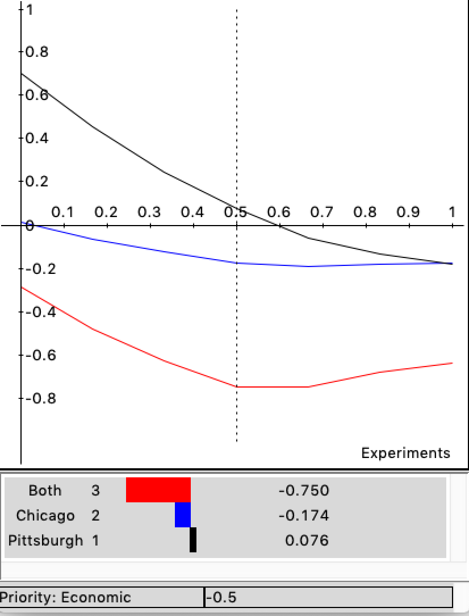
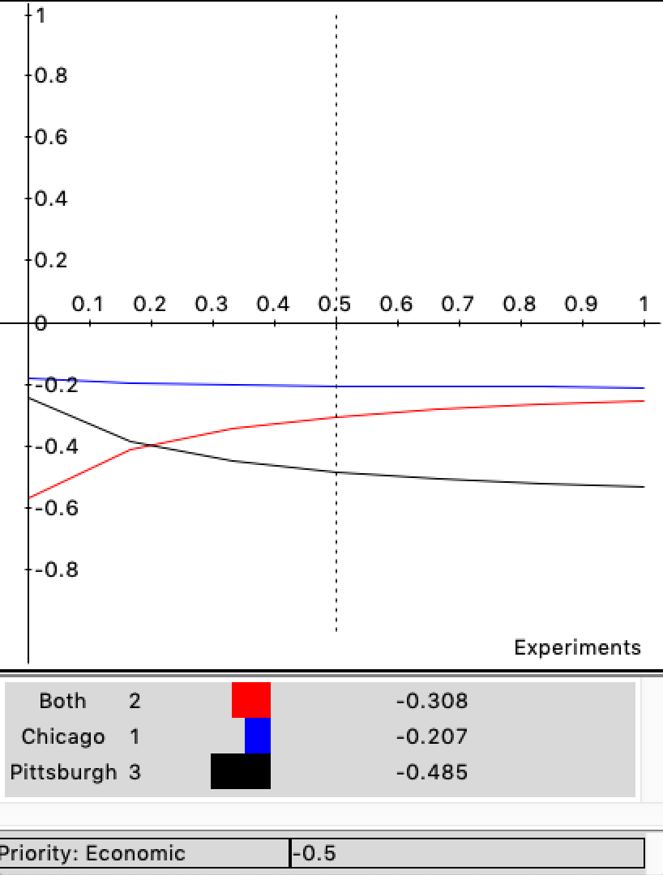
Sensitivity analysis- Benefits and Opportunities
Benefits
Opportunities

Slide 12
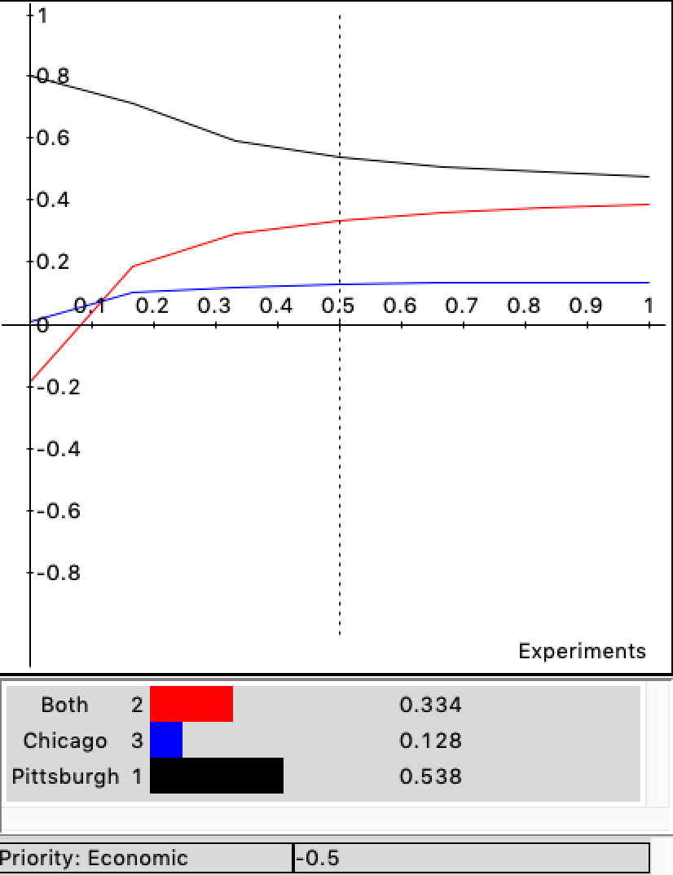
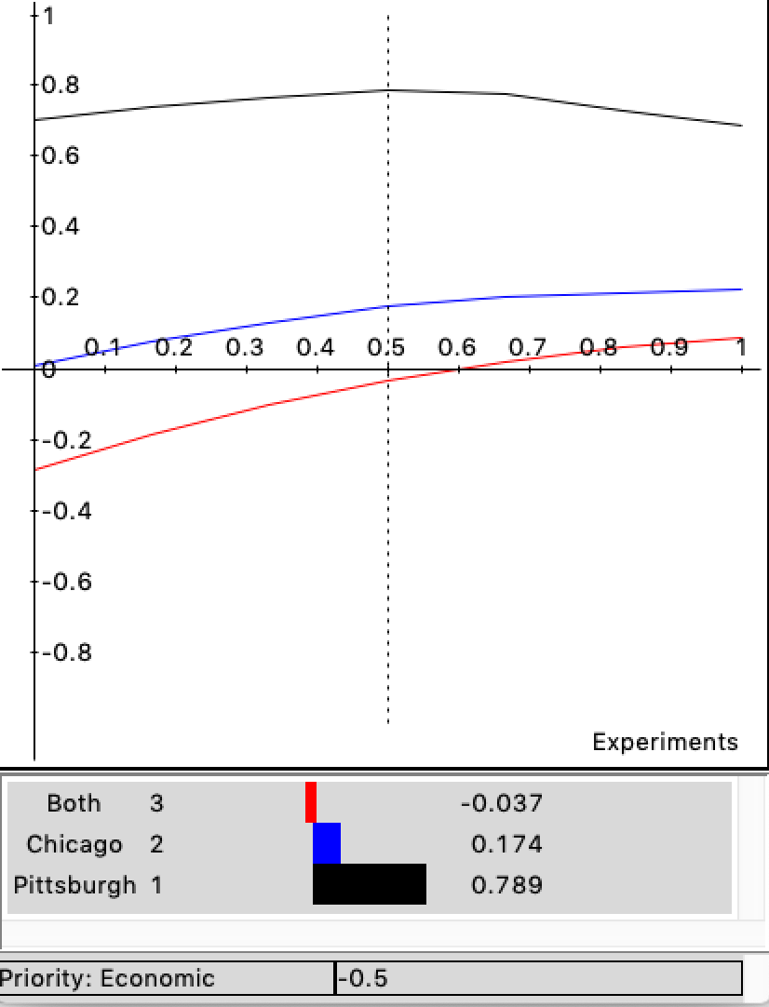
Sensitivity analysis- Cost and Risk
Cost
Risk

Slide 13
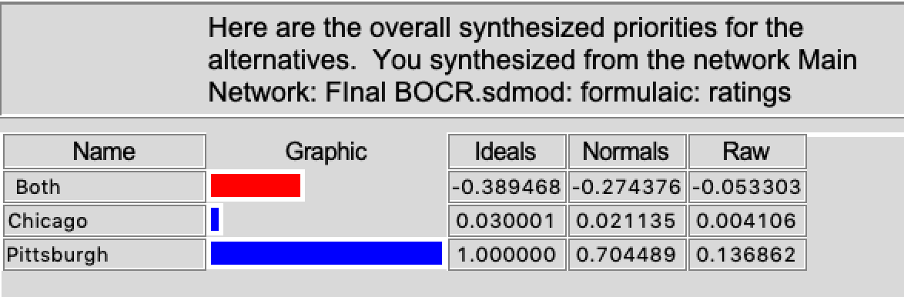
BOCR Ratings and Outcome

Slide 14
Thank you!

