Slide 1
ANP BOCR - THE LOCATION OF THE NEW STADIUM
ALTERNATIVES:
Ballpark in central city Philadelphia
Ballpark in Southside

Slide 2
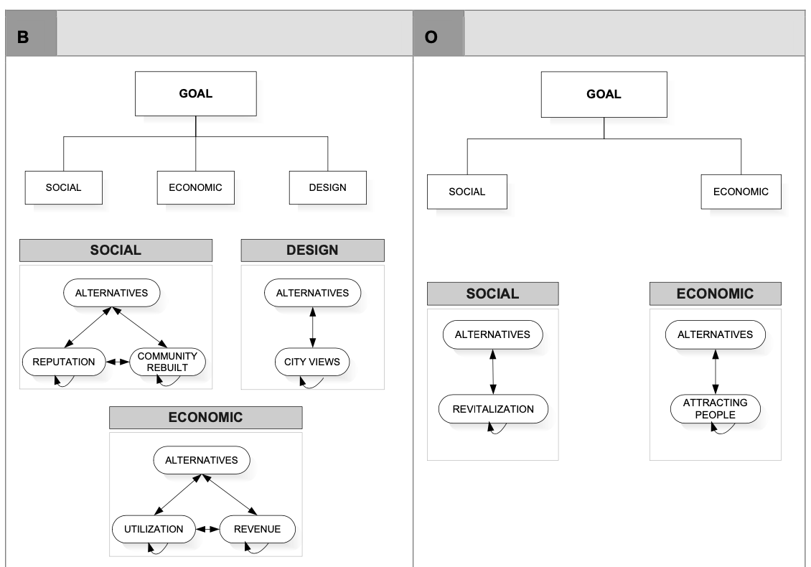
Model – BOCR subnets

Slide 3
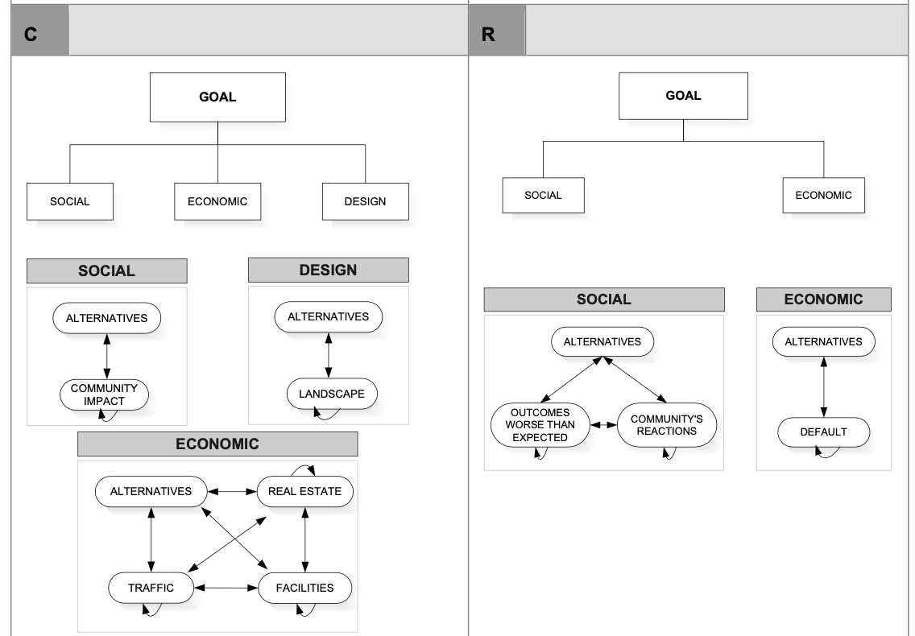
Model – BOCR subnets

Slide 4
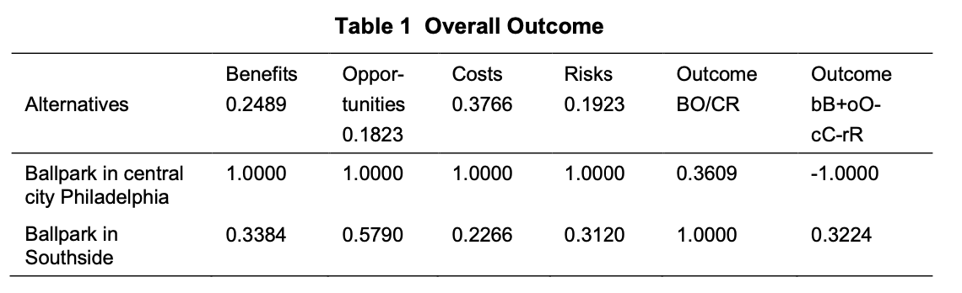
Results

