Slide 1

HR Machine Learning / AI Platform
Larry Garchar
BQOM 2521

Slide 2

BACKGROUND
HR Technology
AI / Machine Learning Role
Talent Acquisition
Employee Development
Compliance
Wellbeing and Engagement
Employee Self-Service
Chatbots
Range of algorithms and tools to ingest data
Pattern recognition
Optimize and predict trends
Not “intuitive” like human beings
Fast, analyze millions of pieces of information and quickly correlate patterns.

Slide 3

PROBLEM
Heavy reliance on subjective information
Anecdotal data with little insight
Administratively burdening to manage
Hard to demonstrate engagement

Slide 4

POTENTIAL SOLUTIONS
Emergence of wellbeing “tech” companies
Complete system integration
Data and reporting are core features
Automation
Personalization

Slide 5

ALTERNATIVES
LIMEADE | VIRGIN PULSE | GLINT | CULTURE AMP
Wellbeing, engagement, and communications | Behavior change and superior outcomes | Improve business results by developing people | Engagement through automated feedback surveys
INDUSTRY LEADERS

Slide 6



STRATEGIC CRITERIA
Technology
Investment
UX
Integration

Slide 7
BOCR MODEL
Benefits | Opportunities
Economic Admin Resource Allocation Consolidation Organizational System Upgrade Efficiency Employee Satisfaction | Economic International New processes Reputation Organizational Analytics Reporting Strategy
Costs | Risks
Economic Implementation Maintenance Annual Fees Organizational Training Cross-integration Internal Marketing | Economic Productivity Loss Exceed Budget Stakeholders support Organizational Employee Buy-in Product Failure Vendor Issues

Slide 8
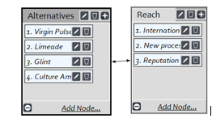
EXAMPLE SUBNETWORK
Main Network → Opportunities → Economic

Slide 9

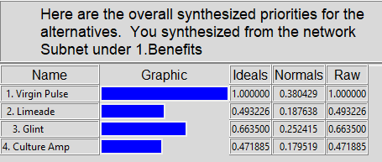
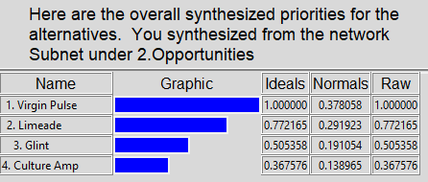
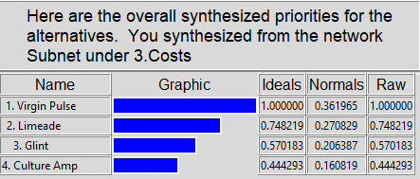
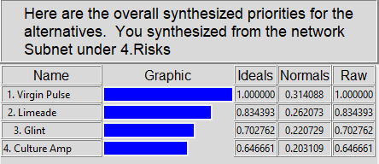
RESULTS
Benefits
Virgin Pulse
Opportunities
Virgin Pulse
Cost
Virgin Pulse
Risk
Virgin Pulse

Slide 10

FINAL THOUGHTS
Virgin Pulse
Leads the group on technology, innovation, personalization, and international landscape.
Tight Competition
Contenders 2-4 were all close in functionality with Limeade having a slight advantage.
Possible Bias
Having tested several of these vendors and fully integrating Virgin Pulse, I may have some bias.

