Slide 1
Iraqi War
When should the majority of US troops withdraw from Iraq?

Slide 2
Timeline
Aug. 2, 1990 – Iraq invades Kuwait
Feb. 24, 1991 – Operation Desert Storm begins
Feb. 28, 1991 – Iraq agrees to a ceasefire
Sept. 11, 2001 – Twin Towers terrorist attack
Oct. 7, 2001 – Operation Enduring Freedom begins against Afghanistan
March 20, 2003 – Operation Iraq Freedom begins
April 9, 2003 – Baghdad falls
May 1, 2003 – President Bush declares end of major combat operations in Iraq
Background Model Setup Data Collection Final Results Problems

Slide 3
Timeline (continued)
May 2, 2003 – Rumsfeld announces end of Afghanistan combat
Dec. 13, 2003 – Saddam Hussein was captured
June 28, 2004 – U.S. transfers sovereignty to Iraq
Oct. 15, 2005 – Iraqis votes to ratify constitution
Dec. 15, 2005 – Iraqis vote to elect members of Iraqi assembly
Mar. 21, 2006 – Bush announces U.S. troops will remain in Iraq until at least 2009.
Background Model Setup Data Collection Final Results Problems

Slide 4
Background Highlights
United States military troops have been in Iraq for 3 years
The main policy questions center around how long the US should remain in Iraq
Key question – “When should a majority of the United States military forces withdraw from Iraq?”
Determining the alternatives
Background Model Setup Data Collection Final Results Problems

Slide 5
When should the majority of US troops withdraw from Iraq?
Alternative 1: Upon the request of the Iraqi
government
Alternative 2: After 5 years
Alternative 3: Within 2-5 years
Alternative 4: Within 1 year
Alternative 5:Withdraw within 3 months and redeploy troops
Background Model Setup Data Collection Final Results Problems

Slide 6
Strategic Criteria
Strategic Evaluation of Withdrawing US Troops From Iraq
Democracy in Iraq .337 |  |  |  | Economic Development .092
Stable Government .717 |  |  |  | US Energy Security .455
Iraqi National Defense .195 |  |  |  | Market Creation .091
Minority Representation .088 |  |  |  | Rebuilding Infrastructure .455
 | World Peace .185 |  | US Domestic Politics .386
 | Terrorism Abroad .073 |  | US National Security .750
 | Terrorism at Home .671 |  | US Public Support .125
 | Future US Foreign Policy .256 |  | US Military Relations .125

Slide 7
BOCR Model
Merits | Criteria | Sub-criteria | Merits | Criteria | Sub-criteria
Benefits | Economic | Iraq Economy | Costs | Economic | US Budget Deficit
 |  | US Economy |  |  | International Coalition Costs
 |  | World Economy |  | Political | Creating New Enemies
 | Political | Creating New Allies |  |  | Potential Government Corruption
 |  | US Bargaining Power |  |  | Iraq Initiative
 |  | US Presence in the Region |  | Security | Civil War in Iraq
 |  | Iraq Initiative |  |  | Destabilization of the Region
 | Security | Deterrence |  | Social | Human Life (Allies)
 |  | Anti-Terrorism |  |  | Human Life (US)
 |  | Insurgency Warfare Training |  |  | Human Life (Iraq)
Opportunities | Economic | US Economy |  | Political | US Reputation
 |  | Iraq Economy | Risks |  | Iraq Initiative
 | Political | Protection of US Allies |  | Security | Increased Terrorism
 |  | Spread of Democracy
 |  | Democracy in Iraq
 |  | Iraq Initiative
Background Model Setup Data Collection Final Results Problems

Slide 8
Data Collection
Survey ➔

Slide 9
Data Collection
Professors and PHD faculty
GSPIA
Katz
Periodicals
Ex: Time, The Economist
Government Studies
Ex: National Security Council : Iraq War Strategy
Websites
Informal conversations
Background Model Setup Data Collection Final Results Problems

Slide 10
Spheres of Influence
Al-Qaeda | Iraqi Citizens | Pentagon | China
World Bank | Shi'ites | President | France
World Humanitarian Organization | Iraqi Women | US Citizens | Great Britain
Religious Militant Groups | Kurds | US Corporations | Iran
Enemies | Iraq Government | US Defense Industry | Italy
Allies | Iraq Insurgency | US Congress | Poland
World community | Sunnis | Press | Russia
Foreign Corporations | Iraq Congress |  | Syria
Background Model Setup Data Collection Final Results Problems

Slide 11
Spheres of Influences
Model Representation

Slide 12
Benefits Control Criteria
Breakdown of highlighted subnets to follow

Slide 13
US Economy Subnet

Slide 14
US Presence in Region Subnet

Slide 15
Opportunities Control Criteria
Breakdown of highlighted subnets to follow

Slide 16
US Economy Subnet

Slide 17
Iraq Economy Subnet

Slide 18
Costs Control Criteria
Breakdown of highlighted subnets to follow

Slide 19
US Budget Deficit Subnet

Slide 20
Civil War in Iraq Subnet

Slide 21
Risks Control Criteria
Breakdown of highlighted subnets to follow

Slide 22
US Reputation Subnet

Slide 23
Increased Terrorism Subnet

Slide 24
Criteria and Their Priorities
Merits | Criteria | Sub-criteria | Global Priorities (Normalized)
Benefits | Economic (.6144) | Iraq Economy (.2184) | 0.134
 |  | US Economy (.6301) | 0.387
 |  | World Economy (.1514) | 0.093
 | Political (.2684) | Creating New Allies (.1992) | 0.053
 |  | US Bargaining Power (.3115) | 0.084
 |  | US Presence in the Region (.3363) | 0.090
 |  | Iraq Initiative (.1529) | 0.041
 | Security (.1172) | Deterrence (.3535) | 0.041
 |  | Anti-Terrorism (.3737) | 0.044
 |  | Insurgency Warfare Training (.2727) | 0.032
Opportunities | Economic (.8333) | US Economy (.7500) | 0.625
 |  | Iraq Economy (.2500) | 0.208
 | Political (.1667) | Protection of US Allies (.2118) | 0.035
 |  | Spread of Democracy (.5551) | 0.093
 |  | Democracy in Iraq (.0808) | 0.013
 |  | Iraq Initiative (.1524) | 0.025
Background Model Setup Data Collection Final Results Problems

Slide 25
Criteria and Their Priorities
Merits | Criteria | Sub-criteria | Global Priorities (Normalized)
Costs | Economic (.0792) | US Budget Deficit (.7031) | 0.056
 |  | International Coalition Costs (.2969) | 0.024
 | Political (.0462) | Creating New Enemies (.6782) | 0.031
 |  | Potential Government Corruption (.1424) | 0.007
 |  | Iraq Initiative (.1794) | 0.008
 | Security (.1731) | Civil War in Iraq (.5099) | 0.088
 |  | Destabilization of the Region (.4901) | 0.085
 | Social (.7015) | Human Life (Allies) (.2626) | 0.184
 |  | Human Life (US) (.4040) | 0.283
 |  | Human Life (Iraq) (.3333) | 0.234
 | Political (.1250) | US Reputation (.8002) | 0.100
Risks |  | Iraq Initiative (.1998) | 0.025
 | Security (.8750) | Increased Terrorism (1.0) | 0.875
Background Model Setup Data Collection Final Results Problems

Slide 26
Weight Benefits and Opportunities
Benefits | US Economy |  | US Presence in the Region |  | Sum of wtd Alt.
Normalized CC | 0.811 |  | 0.189
Alternatives | Idealized | (CC x Ideal) | Idealized | (CC x Ideal)
1 year | 0.470 | 0.381 | 1.000 | 0.189 | 0.570
2-5 years | 0.291 | 0.236 | 0.305 | 0.058 | 0.294
> 5 years | 1.000 | 0.811 | 0.049 | 0.009 | 0.820
Redeploy Troops | 0.678 | 0.549 | 0.891 | 0.168 | 0.718
Iraq Request | 0.375 | 0.304 | 0.353 | 0.067 | 0.371
Opportunities | US Economy |  | Iraq Economy |  | Sum of wtd Alt.
Normalized CC | 0.750 |  | 0.250
Alternatives | Idealized | (CC x Ideal) | Idealized | (CC x Ideal)
1 year | 0.000 | 0.000 | 0.000 | 0.000 | 0.000
2-5 years | 0.335 | 0.251 | 1.000 | 0.250 | 0.501
> 5 years | 0.941 | 0.706 | 0.347 | 0.087 | 0.792
Redeploy Troops | 1.000 | 0.750 | 0.877 | 0.219 | 0.969
Iraq Request | 0.035 | 0.026 | 0.962 | 0.240 | 0.267
Background Model Setup Data Collection Final Results Problems

Slide 27
Weighted Costs and Risks
Costs | Civil War in Iraq |  | US Budget Deficit |  | Sum of wtd Alt.
Normalized CC | 0.613 |  | 0.387
Alternatives | Idealized | (CC x Ideal) | Idealized | (CC x Ideal)
1 year | 0.519 | 0.318 | 0.104 | 0.040 | 0.359
2-5 years | 0.308 | 0.189 | 0.481 | 0.186 | 0.375
> 5 years | 1.000 | 0.613 | 1.000 | 0.387 | 1.000
Redeploy Troops | 0.321 | 0.197 | 0.136 | 0.052 | 0.249
Iraq Request | 0.366 | 0.224 | 0.269 | 0.104 | 0.328
Risks | US Reputation |  | Increased Terrorism |  | Sum of wtd Alt.
Normalized CC | 0.103 |  | 0.897
Alternatives | Idealized | (CC x Ideal) | Idealized | (CC x Ideal)
1 year | 0.547 | 0.056 | 1.000 | 0.897 | 0.954
2-5 years | 0.258 | 0.026 | 0.045 | 0.040 | 0.066
> 5 years | 1.000 | 0.103 | 0.000 | 0.000 | 0.103
Redeploy Troops | 0.390 | 0.040 | 0.289 | 0.259 | 0.299
Iraq Request | 0.263 | 0.027 | 0.522 | 0.468 | 0.495
Background Model Setup Data Collection Final Results Problems

Slide 28
Final Results
 |  | Sum of the BOCR merit Priorities times the "Totals" for their control criteria
 | Benefits | 0.2862 | Opportunities | 0.2397 | Costs | 0.2991 | Risks | 0.175
Alternatives | Sum (from previous) | (Sum x .2782) | Sum (from previous) | (Sum x .2275) | Sum (from previous) | (Sum x .3094) | Sum (from previous) | (Sum x .1848)
1 year | 0.570 | 0.163 | 0.000 | 0.000 | 0.359 | 0.107 | 0.954 | 0.167
2-5 years | 0.294 | 0.084 | 0.501 | 0.120 | 0.375 | 0.112 | 0.066 | 0.012
> 5 years | 0.820 | 0.235 | 0.792 | 0.190 | 1.000 | 0.299 | 0.103 | 0.018
Redeploy Troops | 0.718 | 0.205 | 0.969 | 0.232 | 0.249 | 0.074 | 0.299 | 0.052
Iraq Request | 0.371 | 0.106 | 0.267 | 0.064 | 0.328 | 0.098 | 0.495 | 0.087
Background Model Setup Data Collection Final Results Problems

Slide 29
Short-term/Long-term Results
 | BO/CR |  | bB+oO-cC-rR
Alternatives | Unwtd | Normalized | Wtd | Unitized
1 year | 0.063 | 0.003 | -0.111 | -7.525
2-5 years | 6.920 | 0.378 | 0.081 | 5.467
> 5 years | 5.975 | 0.326 | 0.108 | 7.304
Redeploy Troops | 4.875 | 0.266 | 0.311 | 21.105
Iraq Request | 0.469 | 0.026 | -0.015 | -1.000
Background Model Setup Data Collection Final Results Problems

Slide 30
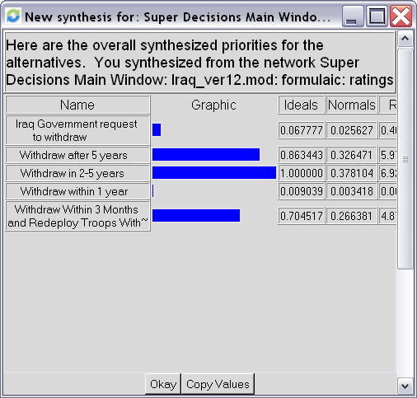
Results - Multiplicative
Background Model Setup Data Collection Final Results Problems

Slide 31
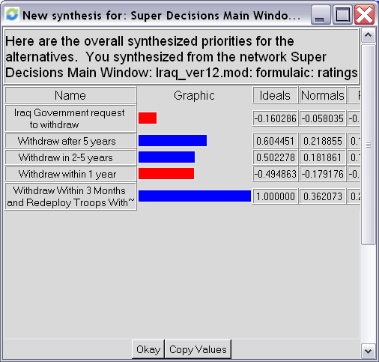
Results – Additive (Negative)
Background Model Setup Data Collection Final Results Problems

Slide 32
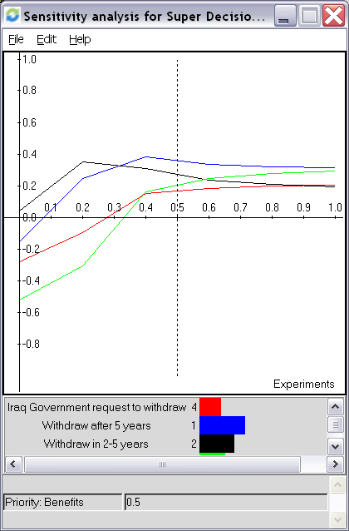
Sensitivity Analysis - Benefits

Slide 33
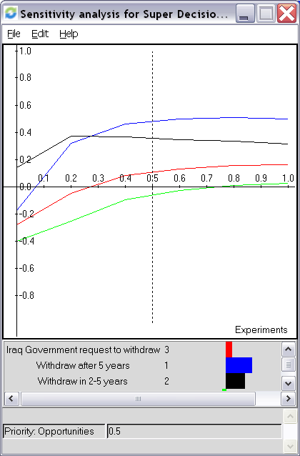
Sensitivity Analysis - Opportunities

Slide 34
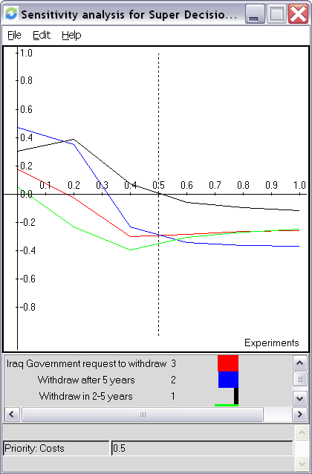
Sensitivity Analysis - Costs

Slide 35
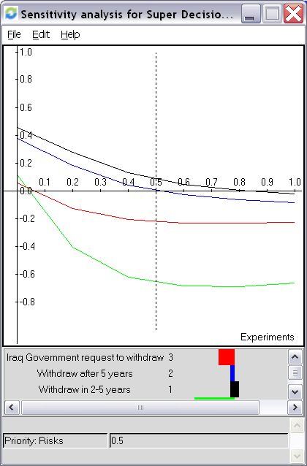
Sensitivity Analysis - Risks

